Slide 1
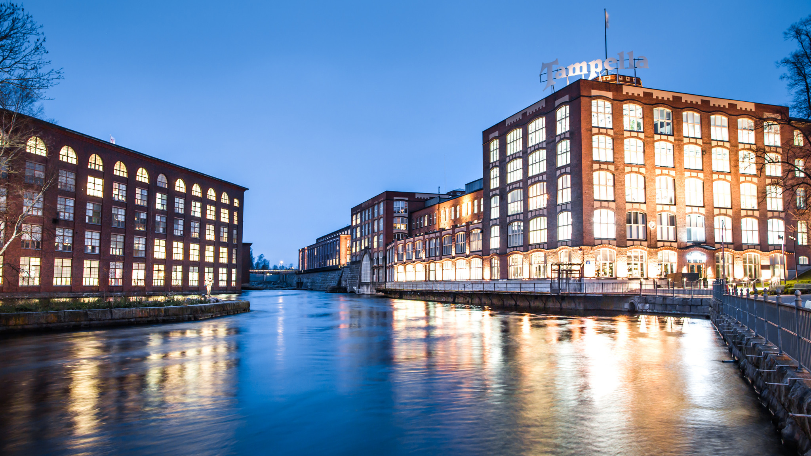


Image: Visit Tampere / Laura Vanzo

Slide 2
TAMPERE.
Tampere is a state of mind. It is something that resides within all of us and is deeply rooted in the ridges of the landscape. Here, by the banks of the Tammerkoski rapids, ideas have always been born. They have turned into lines of work – and even entire communities. ​
Whenever a set of machines has fallen silent, new thoughts have soon filled that space. Rolls of cloth have changed into lines of code and unforgettable experiences. ​
A promise of things to come has been planted into the rough brick walls, and the rows of windows rise ever higher. The city skyline may change, but you can always find that familiar feeling in Tampere.
This is home.
Image: Visit Tampere / Laura Vanzo

Slide 3
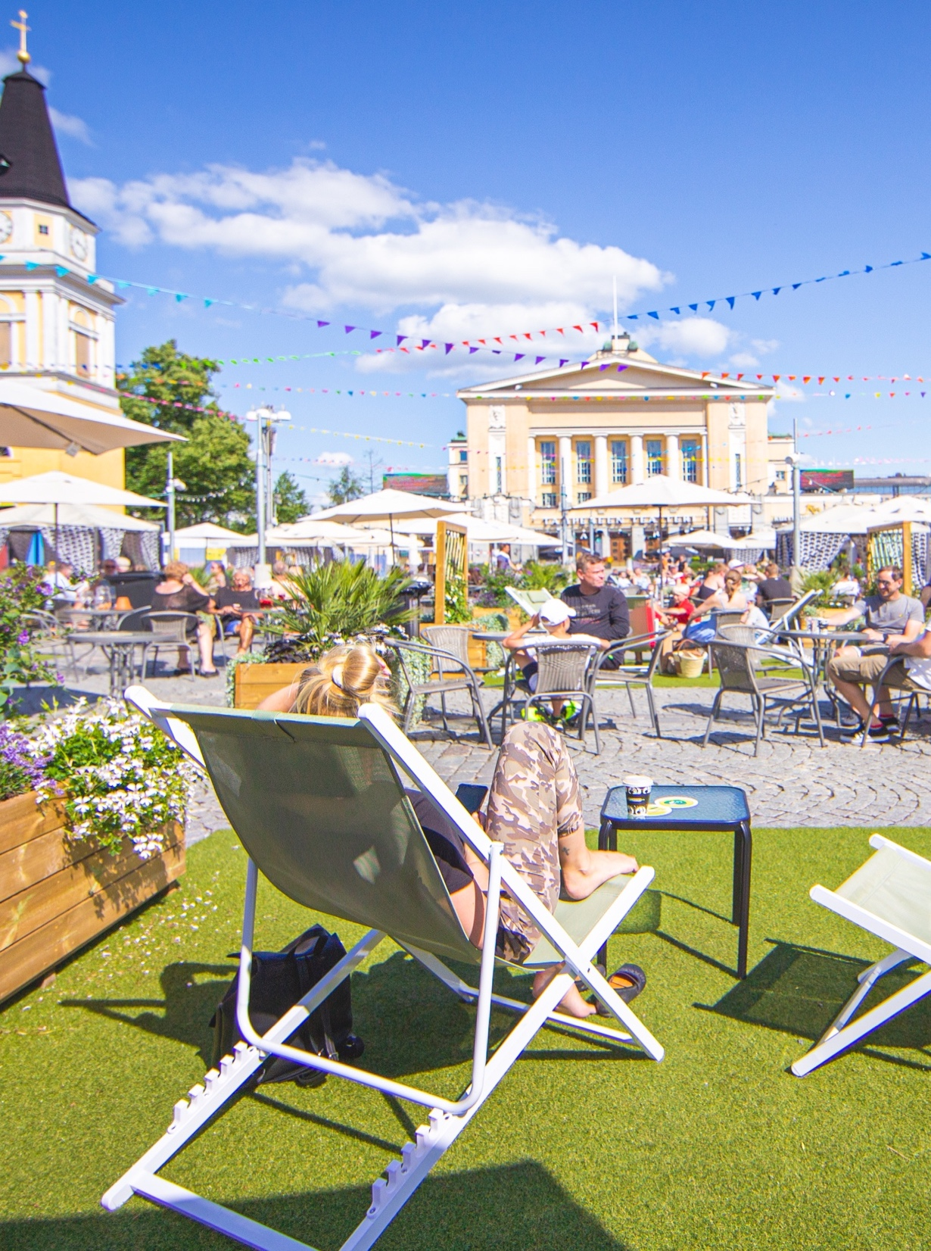
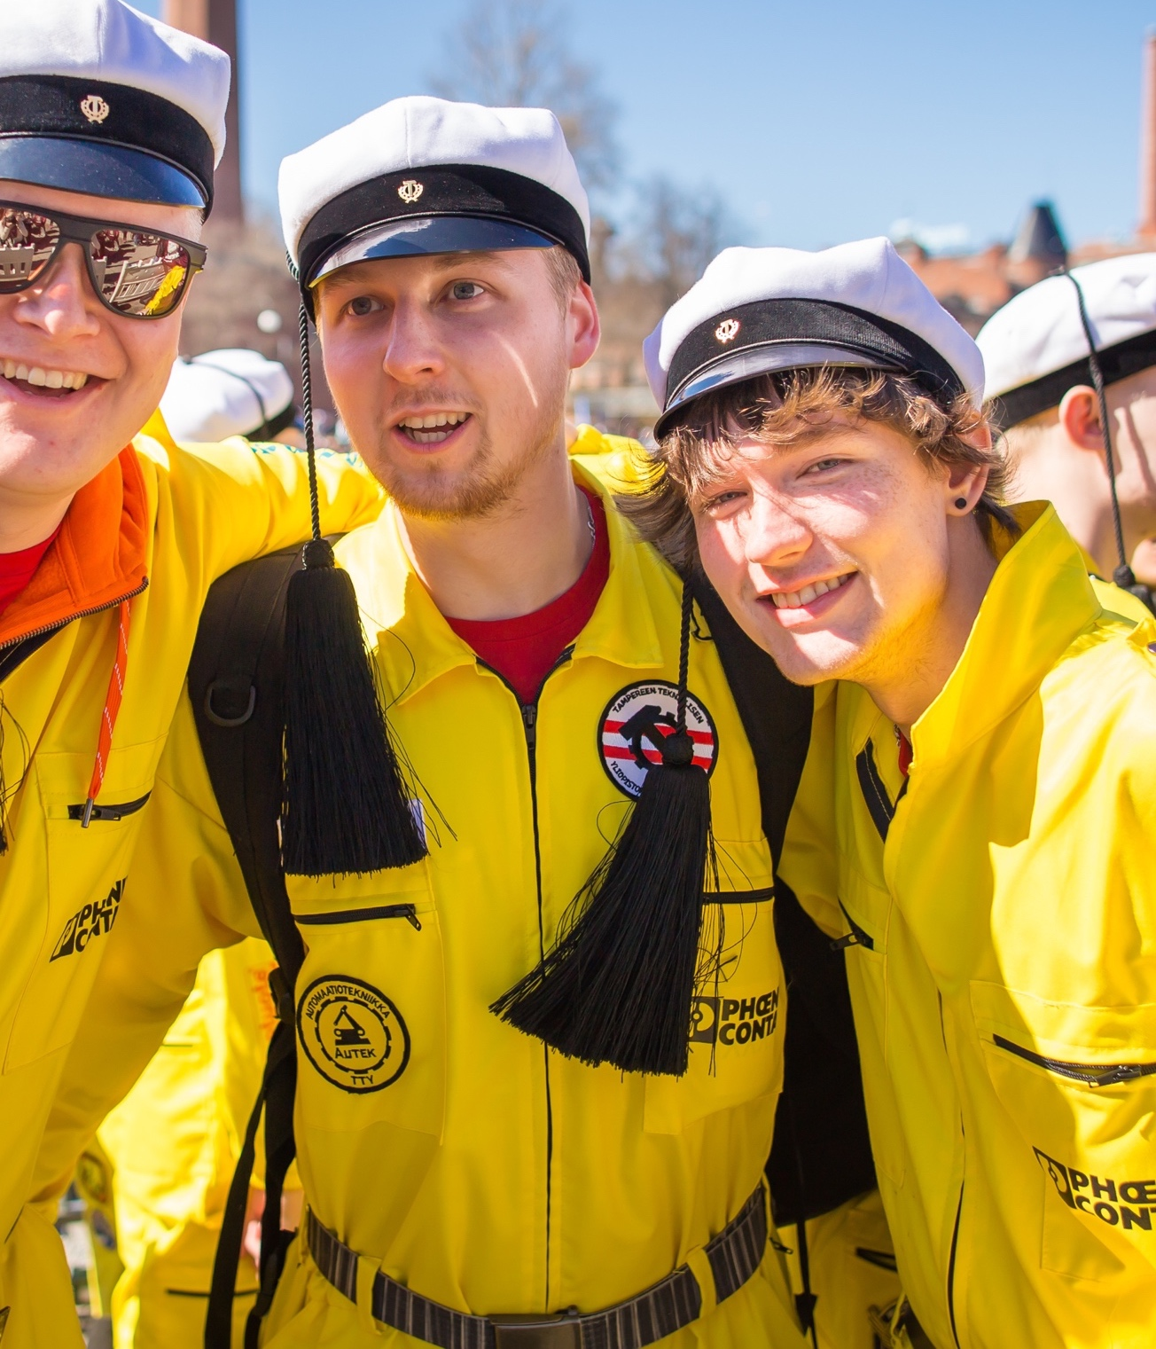
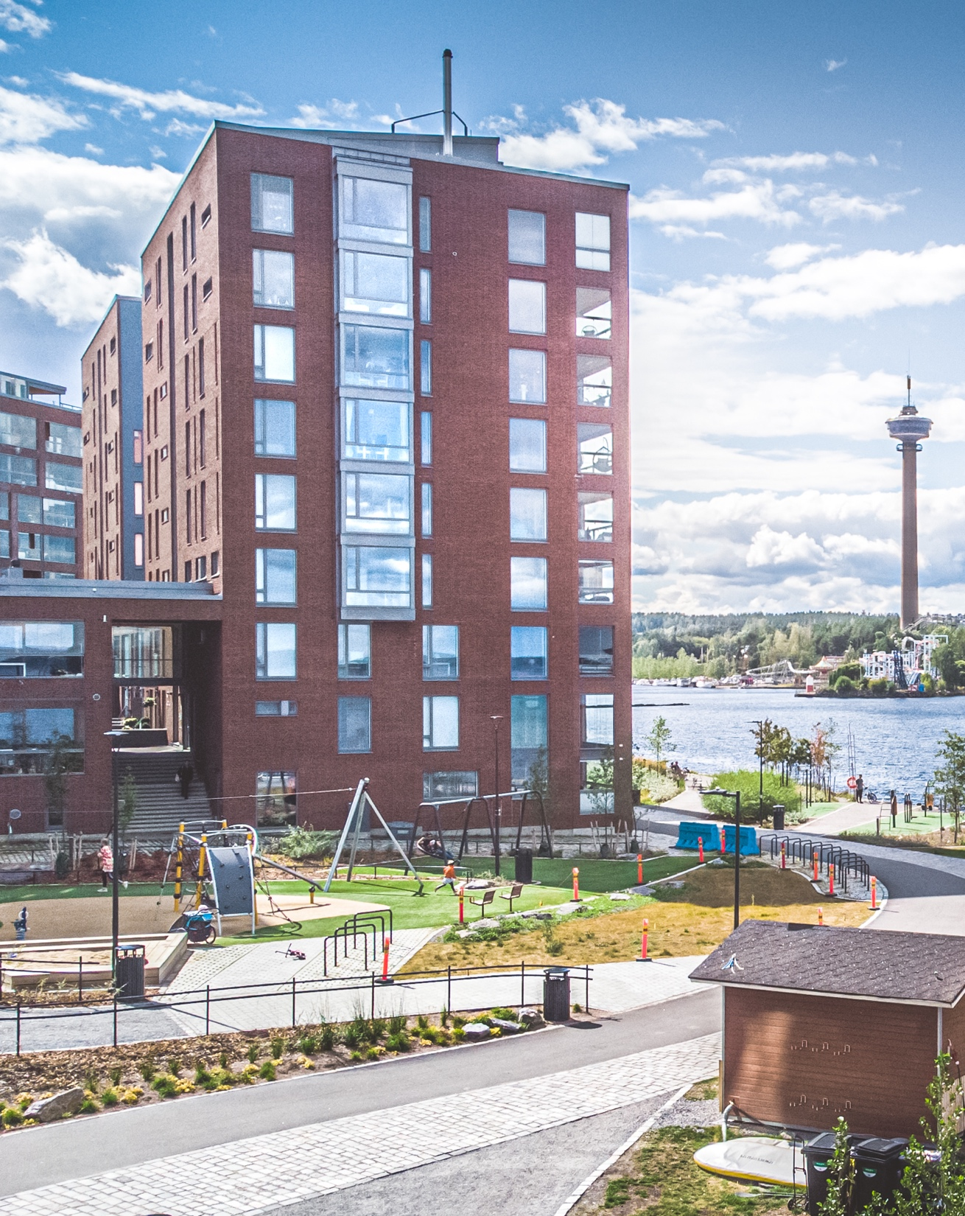

Finland’s most attractive city
Most recommended student city 2022
Most attractive residential destination 2022
The second popular travel destination 2023
Kuvat: Visit Tampere / Laura Vanzo
Notes:
Sources:​​
Opiskelukaupunkien suositteluhalukkuus 2022, Taloustutkimus​
Muuttohalukkuus ja kaupunkien/kuntien imago 2022, Taloustutkimus
Kaupungit ja kunnat matkailukohteina 2023, Taloustutkimus

Slide 4
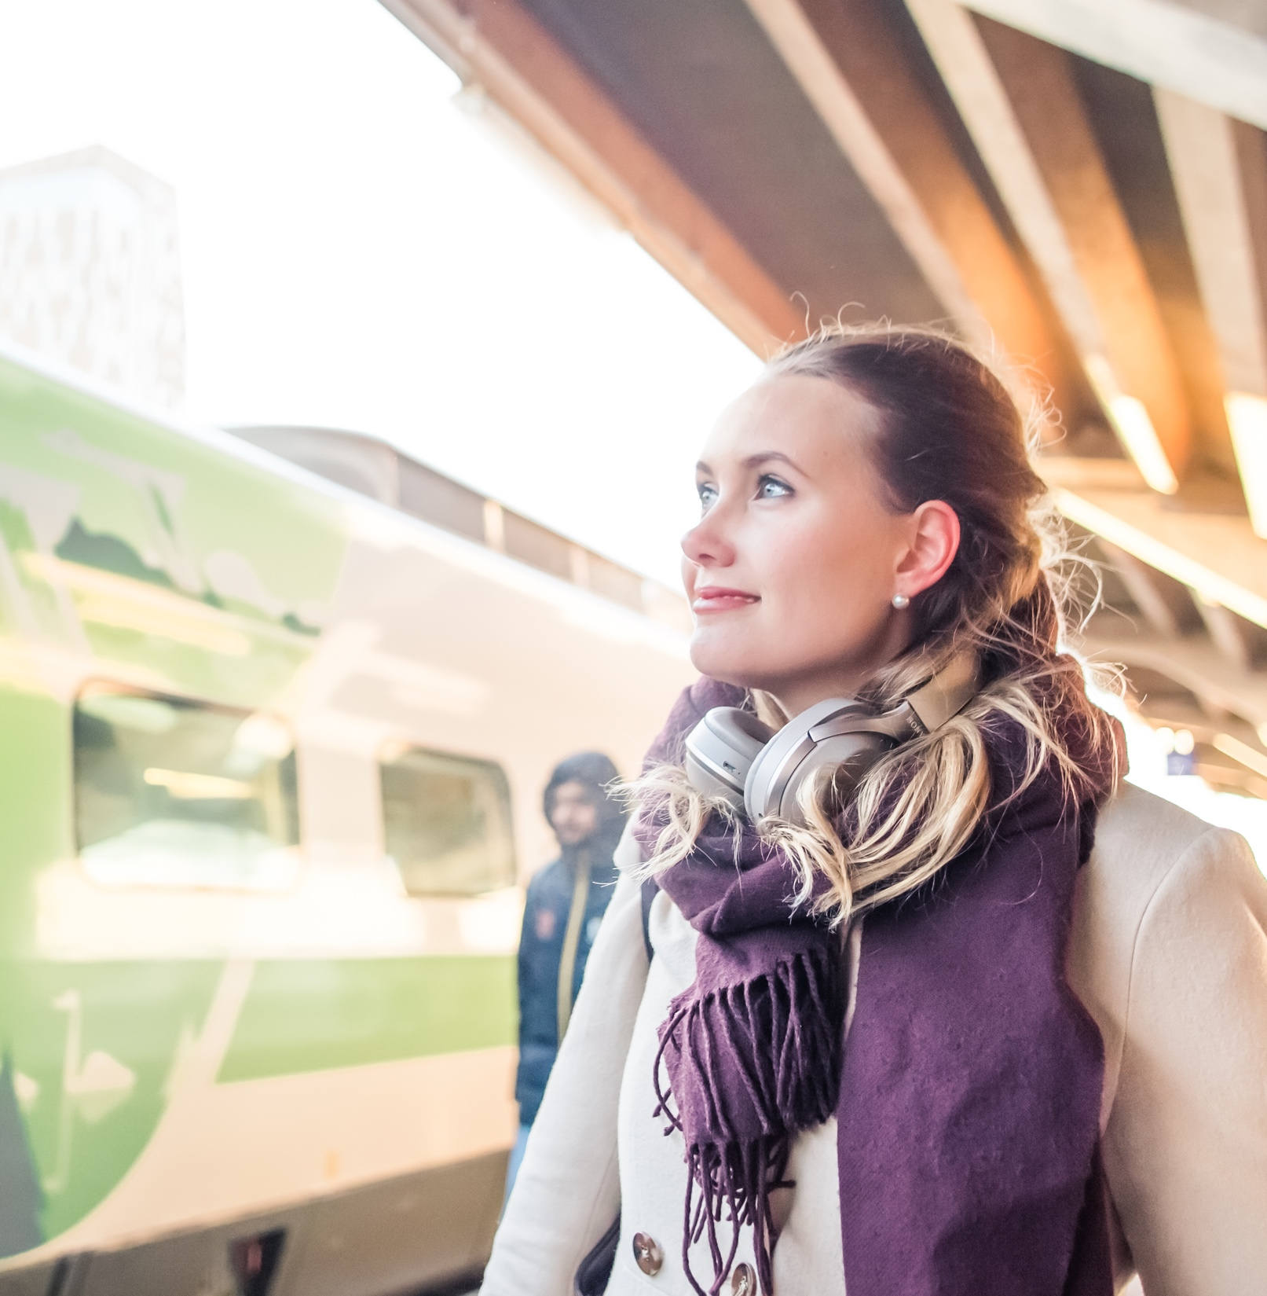



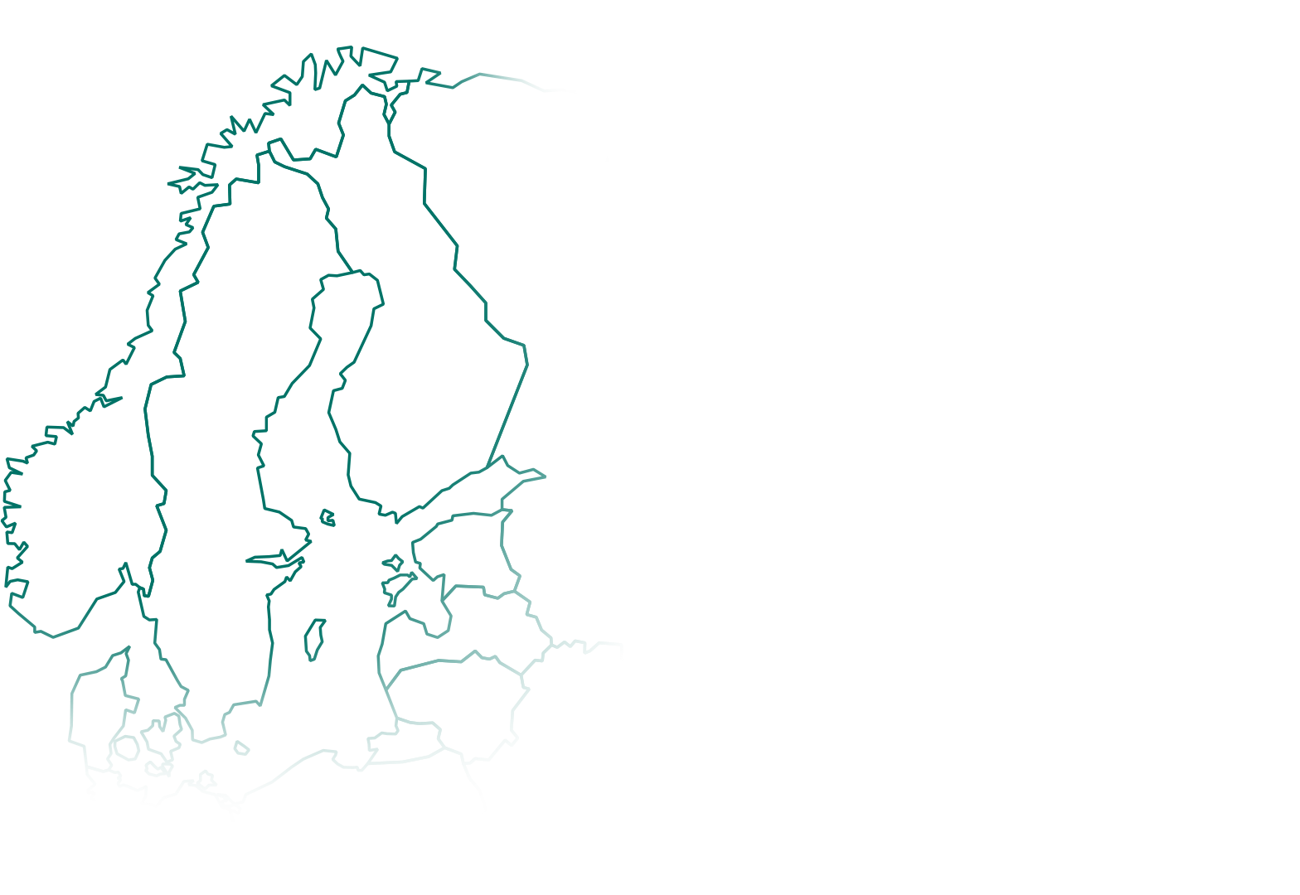



We are easy to reach
Direct flights:
Copenhagen
Amsterdam
Malaga
Milan
München
Nice
Riga
Rhodes
¾ of Finns live within 2 hours of Tampere.
Image: Visit Tampere / Laura Vanzo
Notes:
Rynair: London Stansted​
airBaltic: Copenhagen, Malaga, München, Riga, Rhodes​, Nice, Amsterdam, Milan
SAS: Stockholm (from August 2022)
By the end of 2023: Las Palmas de Gran Canaria 5.12.2023, Tallinn 29.10.2023, Tenerife 1.11.2023

Slide 5


The city of action – Tampere city strategy 2030

Slide 6






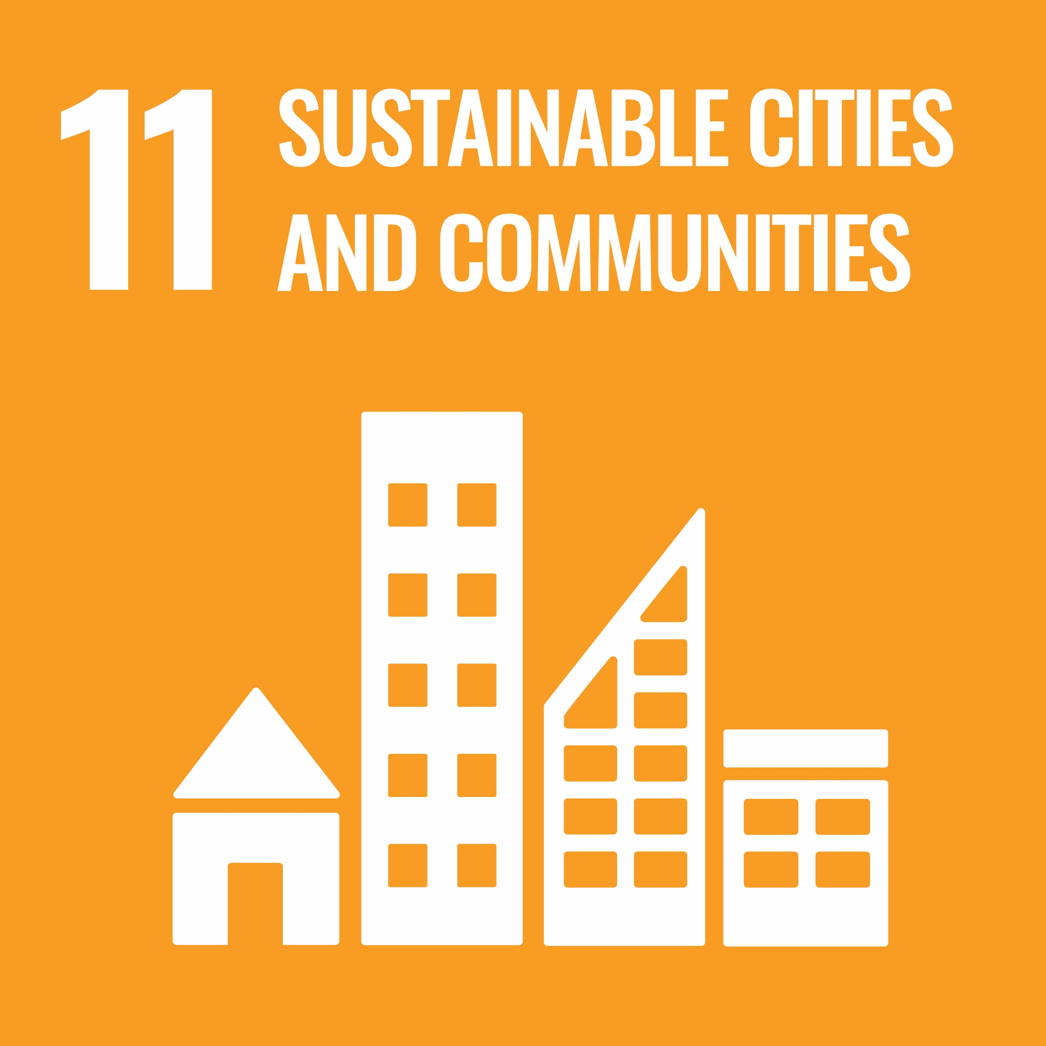





THE CITY OF ACTION FOCUS AREAS
EQUAL INDIVIDUALS
ACTIVE COMMUNITIES
CARBON-NEUTRAL ACTION
A PIONEER OF THE FUTURE
Tampere is the best place to grow, develop and age.
In Tampere, everyone can be themselves and make their dreams come true.
Tampere points the way for the community of the future. Tampere's diverse communities and companies feed well-being, creativity and innovation. ​ Together we will make a better tomorrow.
Tampere is internationally known for its impressive work on climate and biodiversity. Making sustainable choices is easy here – our appeal comes from the smoothness of everyday life.
Tampere is continuing its success story; we provide the best conditions to make the solutions of the future. Tampere has a strong position as an international city of science and know-how.

Slide 7
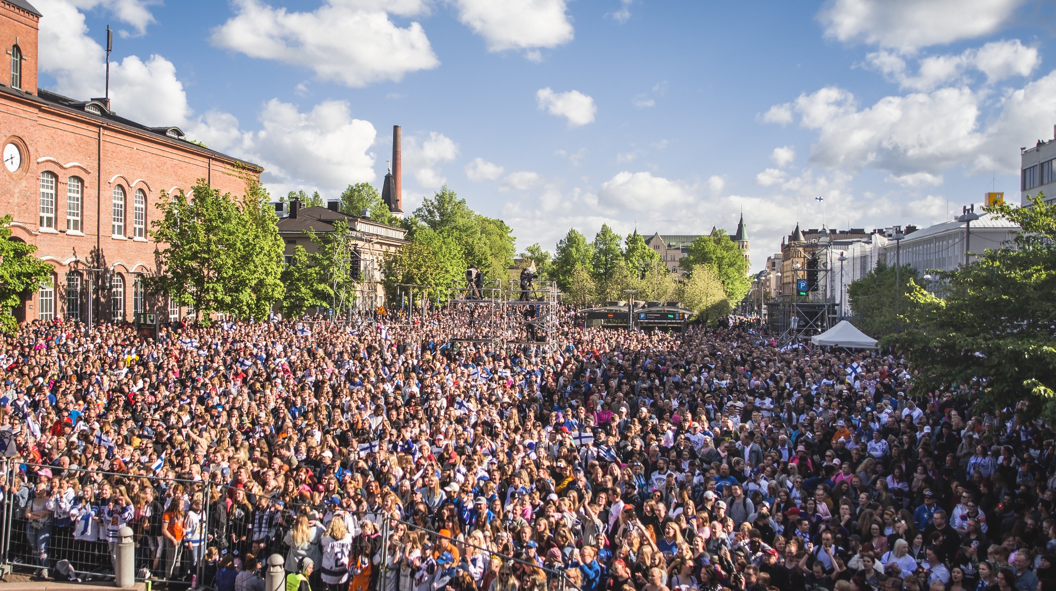


The people of Tampere
91,000
69,000
Largest age group 25-29 v.
48,000
45,000
252, 872 residents
0-19
20-39
40-64
65+
291,300 by 2033
Population by age group
Average age 41,5 years
Image: Visit Tampere / Laura Vanzo
Notes:
Source: Tampereen väkiluku: väestökatsaus (ennakkoväkiluku 4/2023) Microsoft Power BI
Unemployment rate 11,6% (January 2022) https://www.ely-keskus.fi/ely-pirkanmaa-tyollisyyskatsaukset​
​
2021: 18 422 foreign-language speakers (7.6% of total population), 11,434 foreign citizens. Most common foreign nationalities: Estonia, Russia, Iraq, Afghanistan​
​​

Slide 8
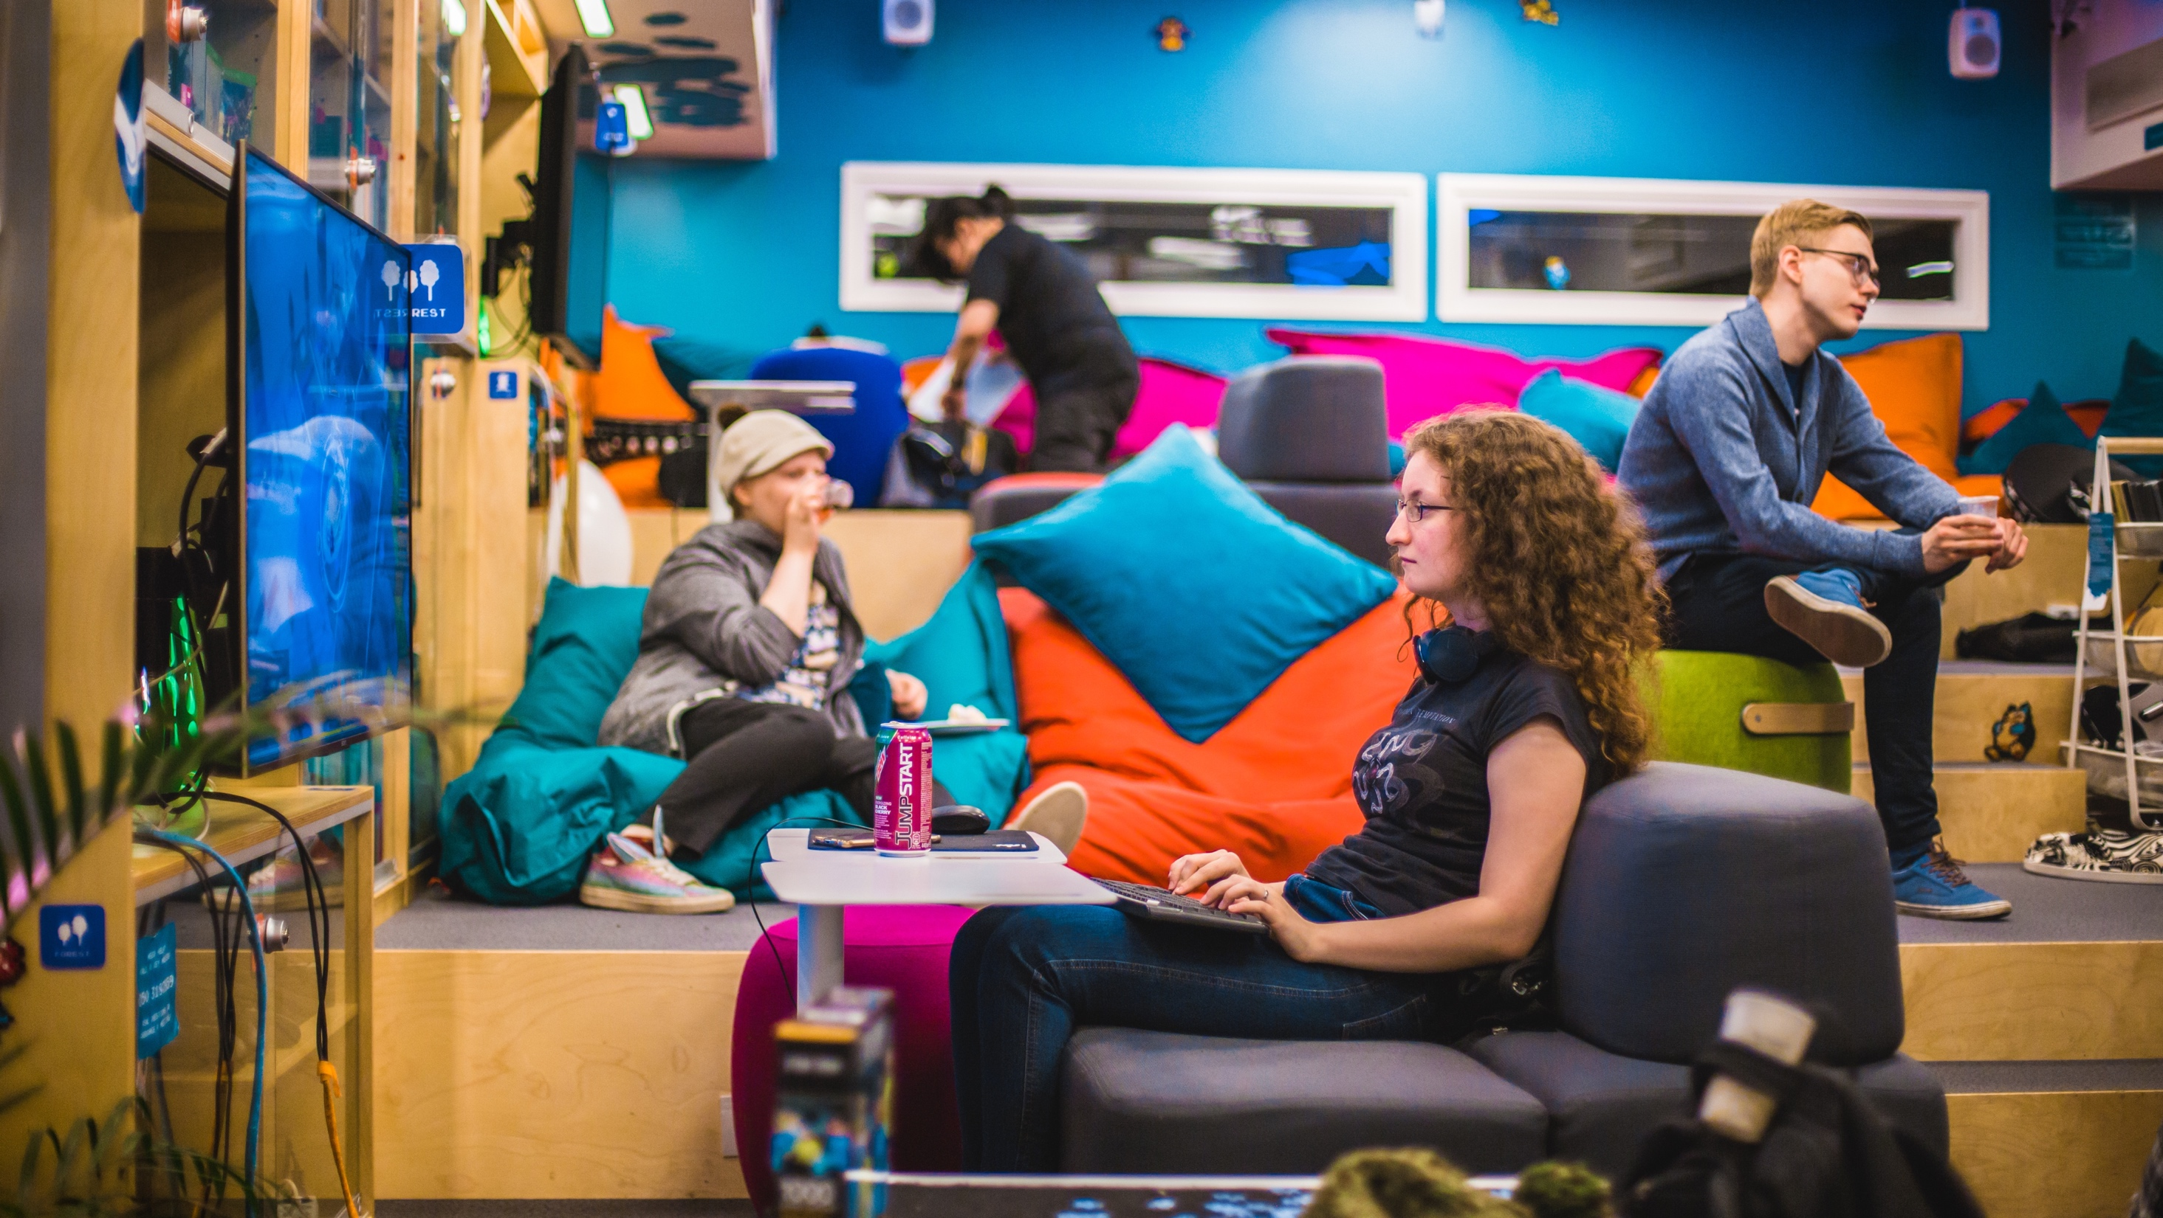

IDEA
Idea. Tampere
Education and top research generate fresh ideas in Tampere. Skilled people turn ideasinto successful business.
Image: Visit Tampere / Laura Vanzo

Slide 9
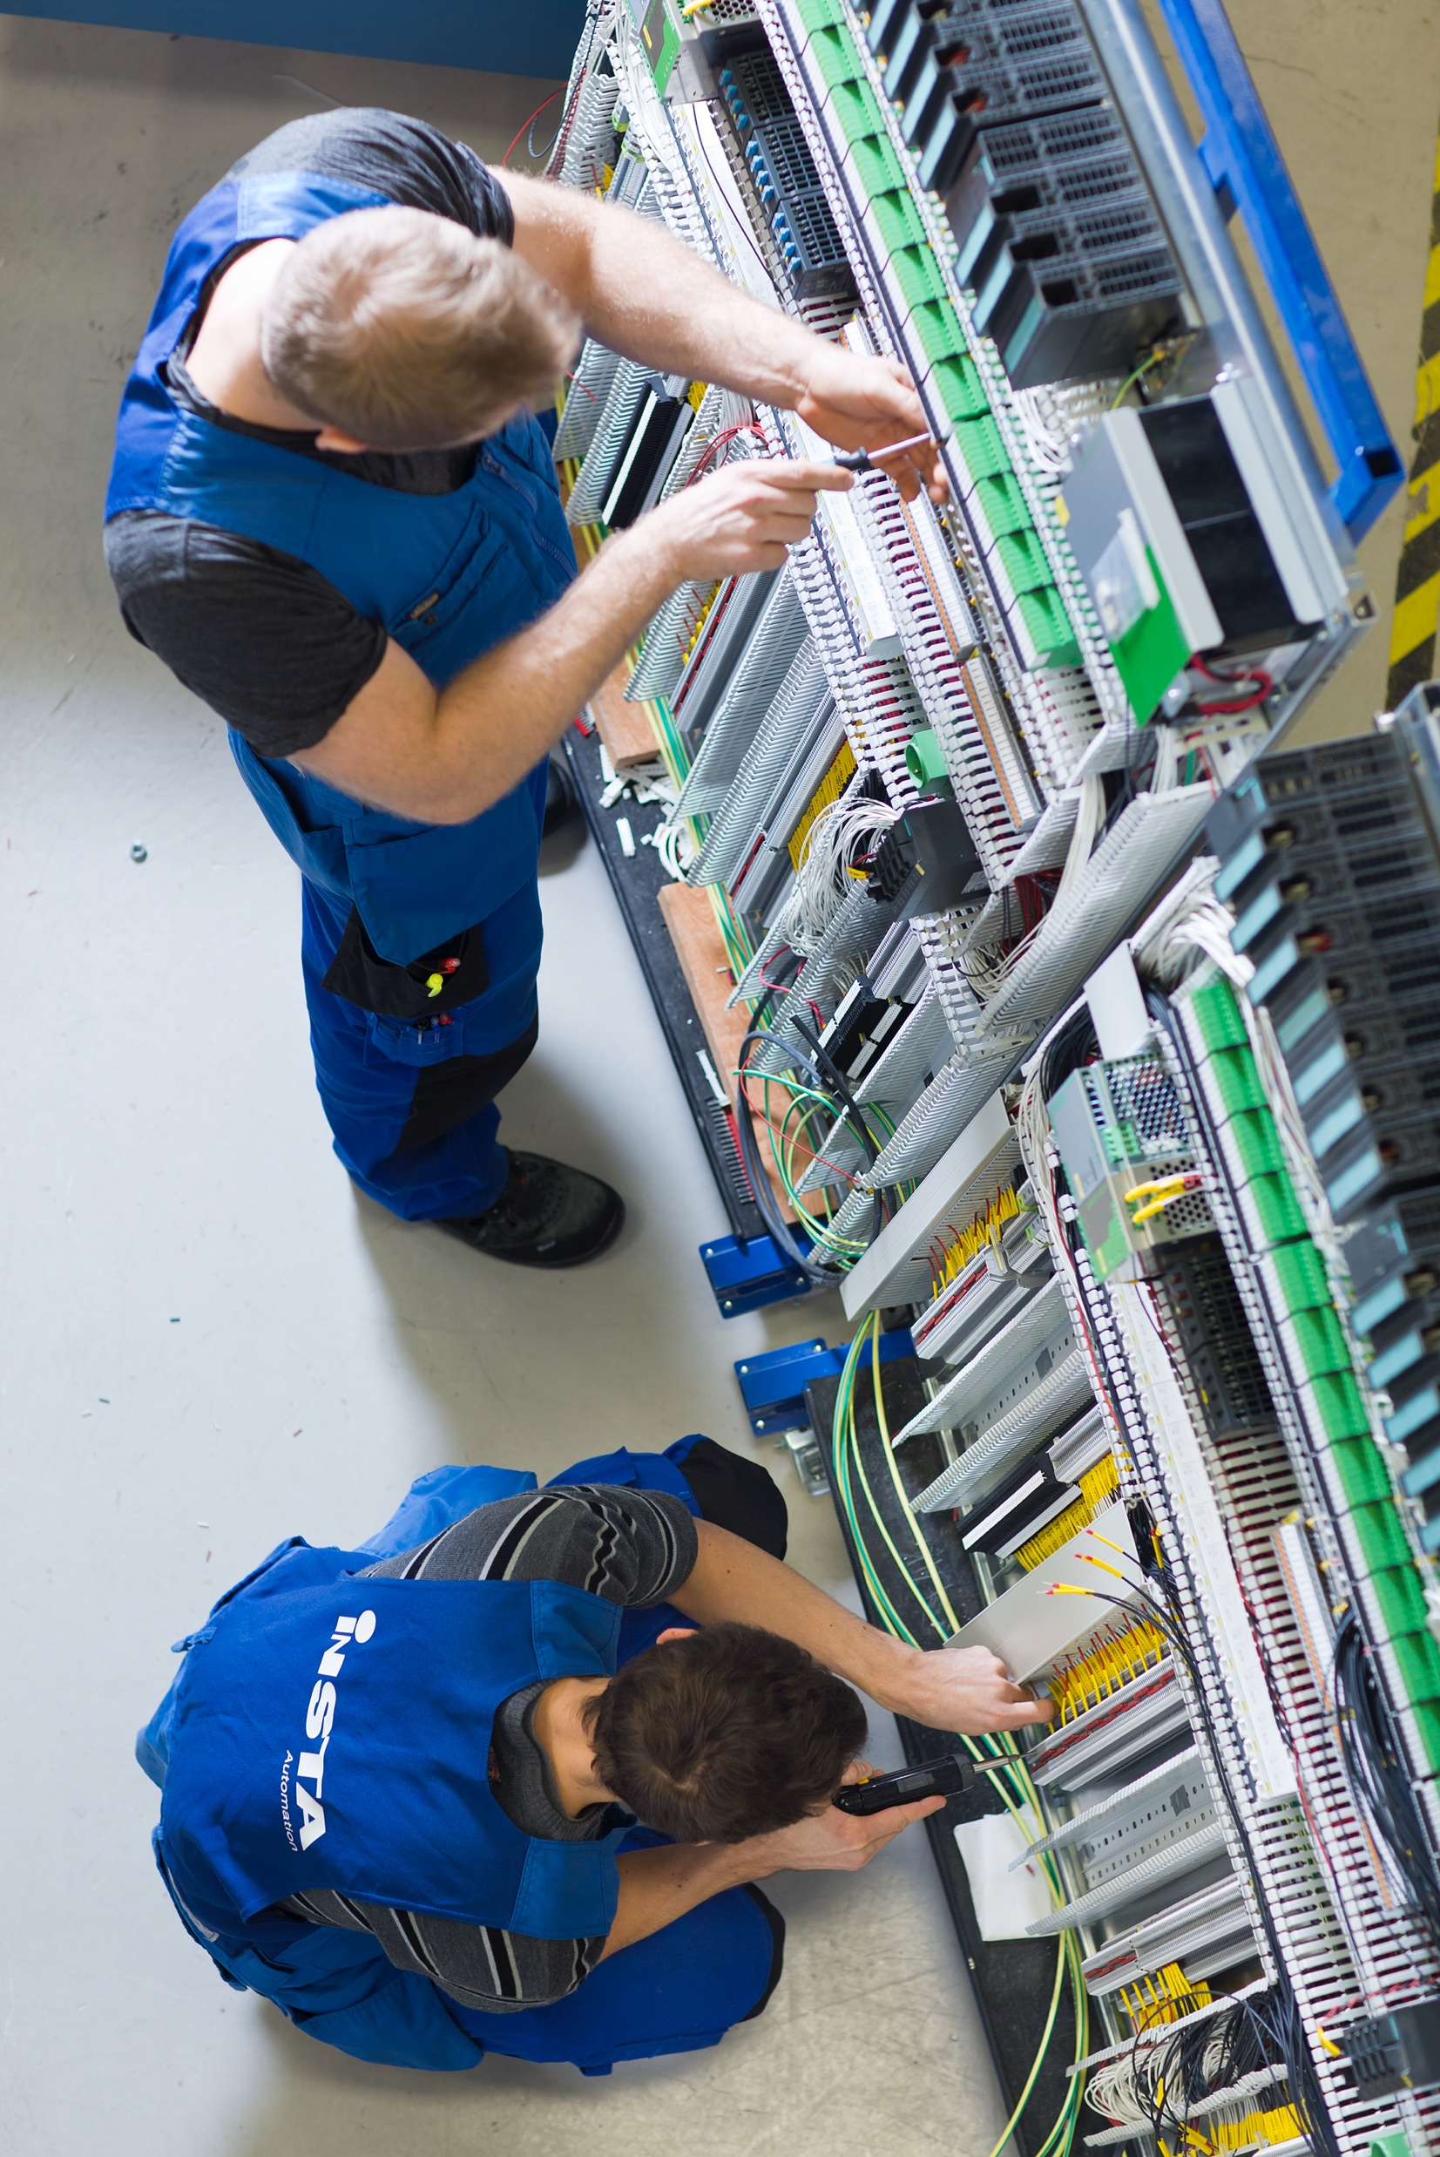





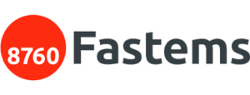
Home of entrepreneurship – strong business culture
THE REGION’S LEADING INDUSTRIES are manufacturing, intelligent machines, automation, Al and analytics, health technology, circular economy and cleantech.
EMERGING INDUSTRIES include gaming, automotive, nanotechnology, and the creative industries, among others.
Image: Visit Tampere / Opa Latvala
Notes:
Higher education institution investing in research, product development and collaboration with businesses has created success stories in the gaming industry, the industrial sector and health technology.​
​
A world-leading competence centre in the fields of imaging and camera technologies, Tampere is already number one in Europe.​
https://businesstampere.com/investments/investment-opportunities/focus-industries-and-business-ecosystems-in-the-tampere-region/​
​
The companies in circular economy and cleantech in the Tampere region offer a wide range of innovative solutions, life cycle services and automation to various industries.​
https://businesstampere.com/business-environment/business-ecosystems/tampere-circular-economy-and-cleantech-ecosystem/​

Slide 10
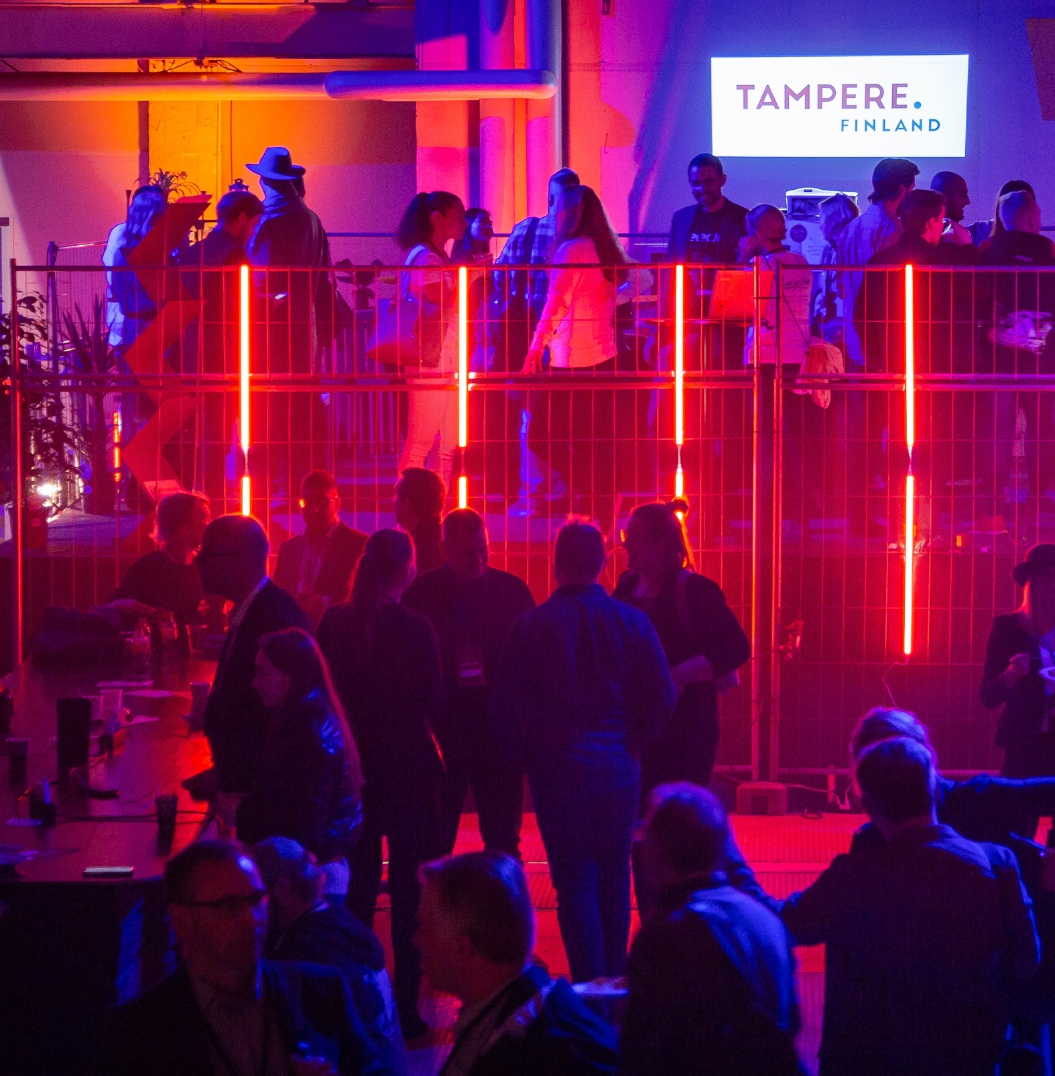

Fertile ground for NEW IDEAS
We are one of the most active start-up cities in Finland.
ATTRACTIVE OPERATING ENVIRONMENT
Good availability of a trained workforce
More cost-effective than the capital region
Cooperation with universities creates talent and ideas
Central location
Image: Visit Tampere / Mirella Mellonmaa
Notes:
Formerly known as a traditional industrial town, Tampere is now Finland’s most active start-up city. The bolts of fabric have been replaced by strings of code, and heavy industries are increasingly joined by smart technology.​
​
Tampere is an attractive city for start-ups:​
Good availability of a trained workforce​
More cost-effective than the capital region area​
Cooperation with universities creates talent and ideas​
Central location​
​

Slide 11
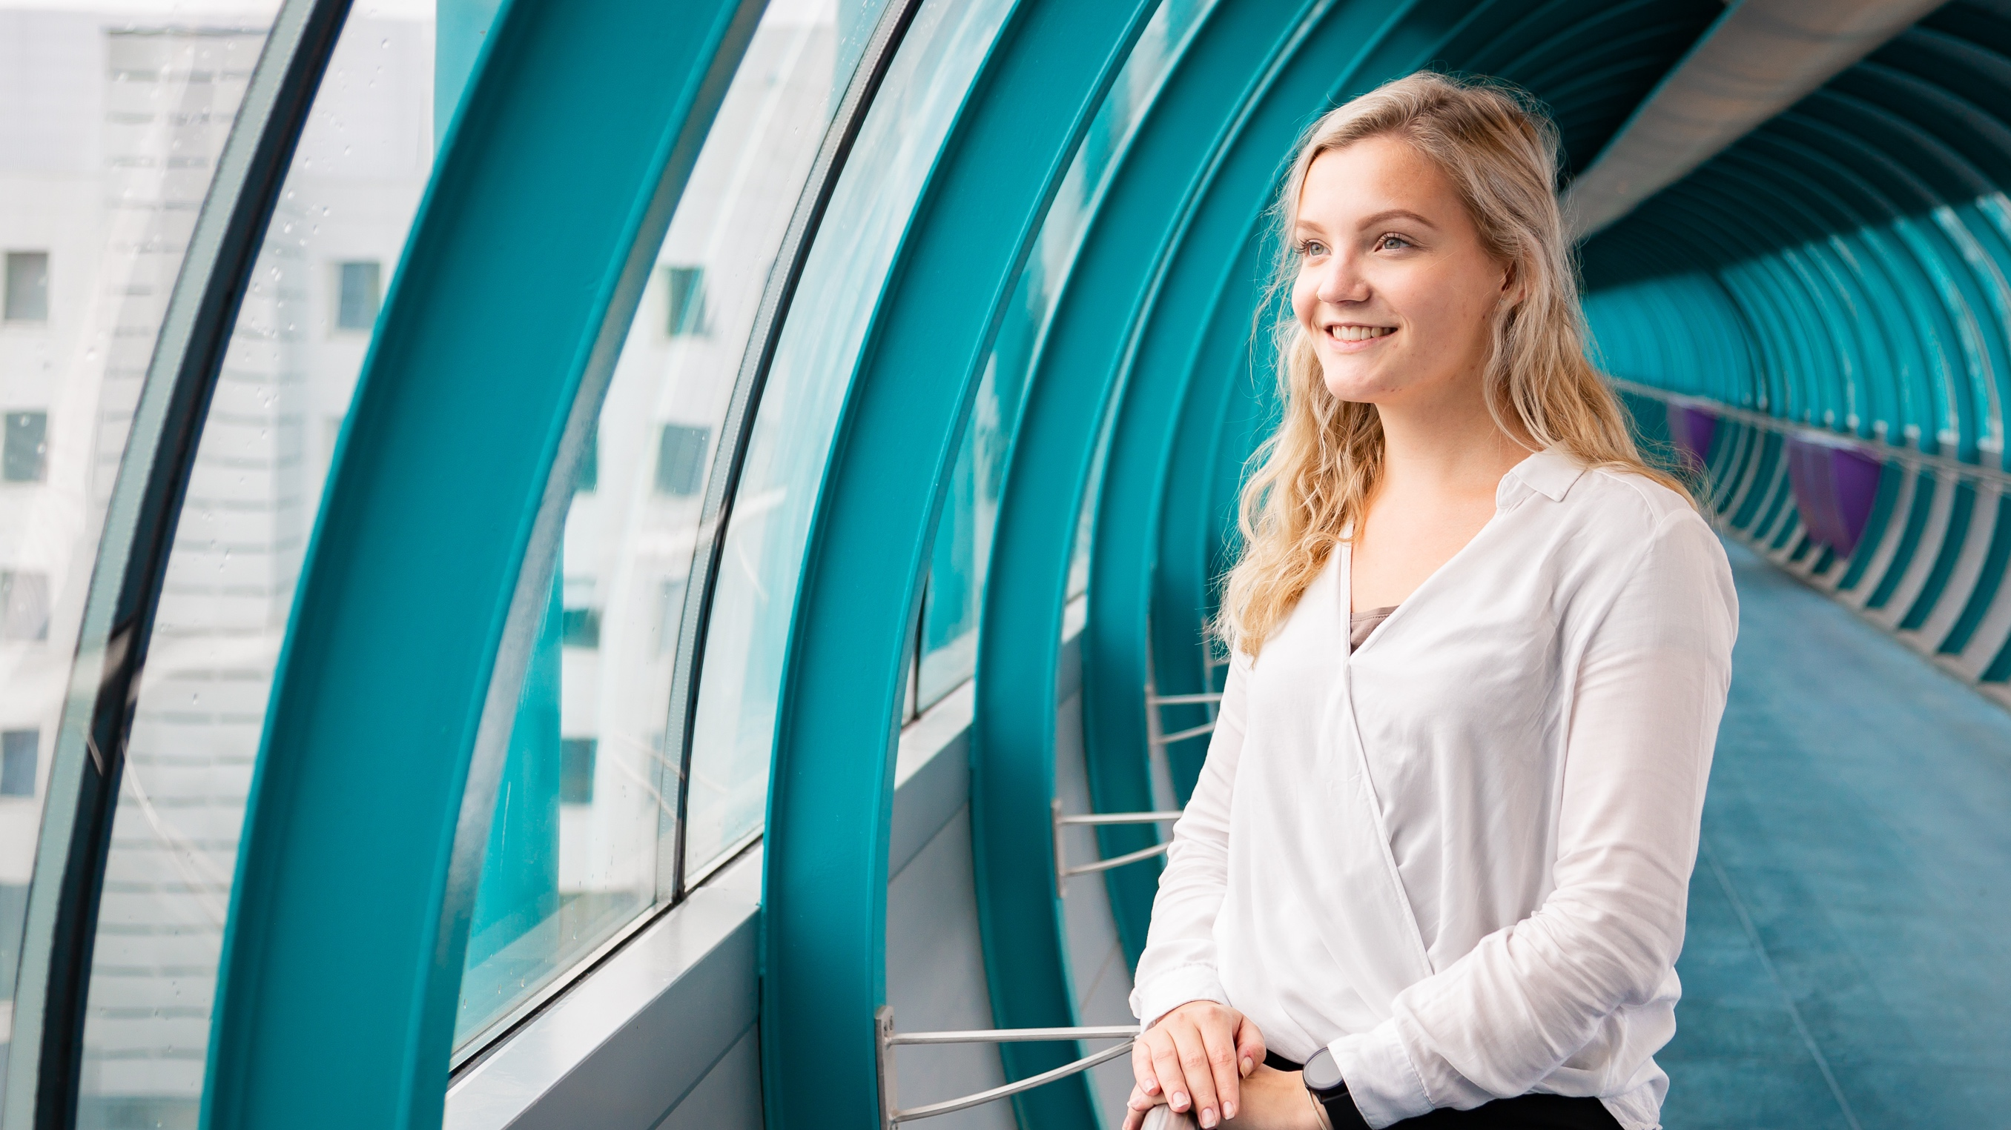
We invest in education
40 % of the population have a higher education degree
79 % of people over the age of 15 have an upper secondary degree
Image: Visit Tampere / Mirella Mellonmaa
Notes:
- 79% of people over the age of 15 have an upper secondary degree which is more than on average in Finland (74%). (31.12.2019)​
​
- 38% of the population in Tampere have a higher education degree (31.12.2019). ​
​
- 40% of people over 20 have higher education degree (31.12.2019)​
Source: https://pxnet2.stat.fi/PXWeb/pxweb/fi/StatFin/StatFin__kou__vkour/statfin_vkour_pxt_12bq.px/​
​

Slide 12
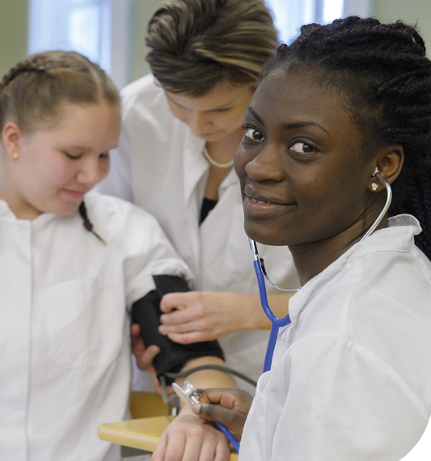
Lifelong learning – UPPER SECONDARY LEVEL AND ADULT EDUCATION AND TRAINING
6 upper secondary schools and 1 upper secondary school for adults
4,000 students – young people and adults
Tampere Vocational College Tredu
17,000 students, young people and adults
28 vocational upper secondary qualifications, 23 further vocational qualifications
Image: Tampereen kaupunki / Tredu
Notes:
6 upper secondary schools and 1 upper secondary school for adults​
Around 3,200 students in general upper secondary education and 500 students in upper secondary school for adults​
​
Tredu (Tampere Vocational College)​
17,000 students, young people and adults​
29 vocational upper secondary qualifications​
21 further vocational qualifications​

Slide 13
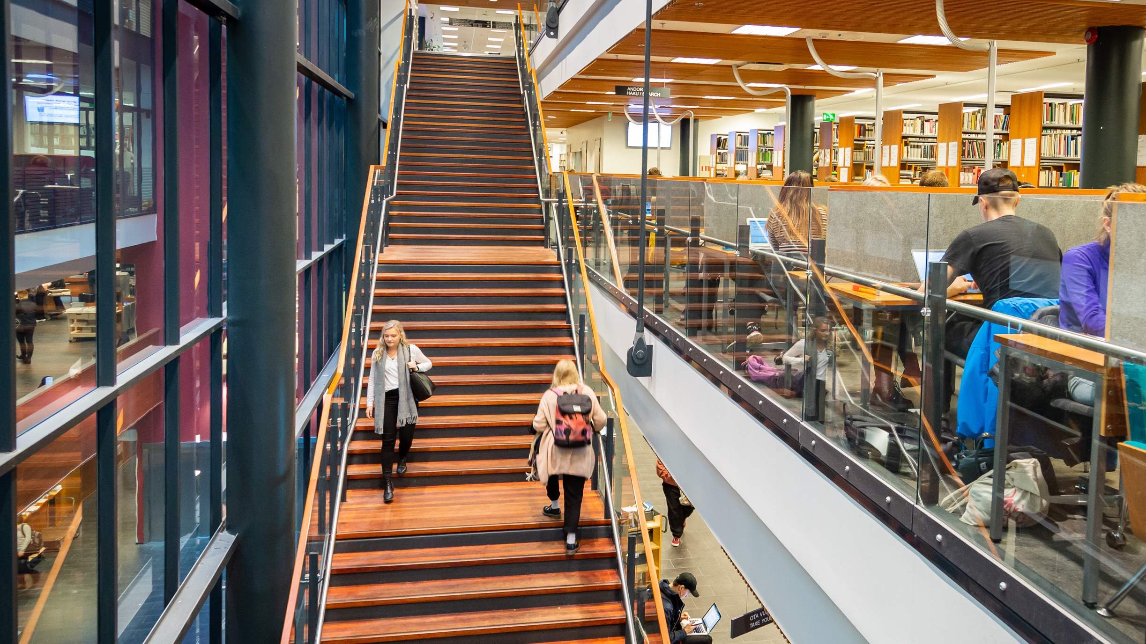

City for students – TAMPERE HIGHER EDUCATION COMMUNITY
University of Tampere (UTA) and Tampere University of Applied Sciences(TAMK)
30,000 students, annual student
intake 5,000
4,400 employees
Academic focus:
technology, health and society
6 campuses in Tampere
5 in other locations
Ikaalinen, Mänttä-Vilppula, Pori, Seinäjoki and Virrat
Image: Visit Tampere / Mirella Mellonmaa
Notes:
The University of Tampere, Tampere University of Technology and Tampere University of Applied Sciences formed a multidisciplined higher education community on 1 January 2019. ​
​
The community comprises a total of 30,000 students. One-third of the students are enrolled in the Tampere University of Applied Sciences, and two-thirds in the Tampere University.​
​
Around 2,000 students begin their studies in TAMK each year, and 3,000 students in the university. In addition to this, thousands of students participate in open higher education studies and different types of continuing education. ​
​
The community employs nearly 4,100 people.​
​
Six campuses in Tampere (Hervanta, Kauppi, Keskusta, TAMK main campus, Mediapolis, Proakatemia), five in other locations​
(Ikaalinen, Mänttä-Vilppula, Pori, Seinäjoki, Virrat)​
​
Academic focus is on technology, health and society.​
​
The Tampere University has seven faculties:​
Information Technology and Communication Sciences​
Management and Business​
Education and Culture​
Medicine and Health Technology​
Built Environment​
Engineering and Natural Sciences​
Social Sciences​
​
TAMK provides education in nine fields of study:​
agriculture and forestry; arts; business administration; education; engineering, manufacturing and construction; health and welfare; information and communication technologies; services; social sciences.​

Slide 14
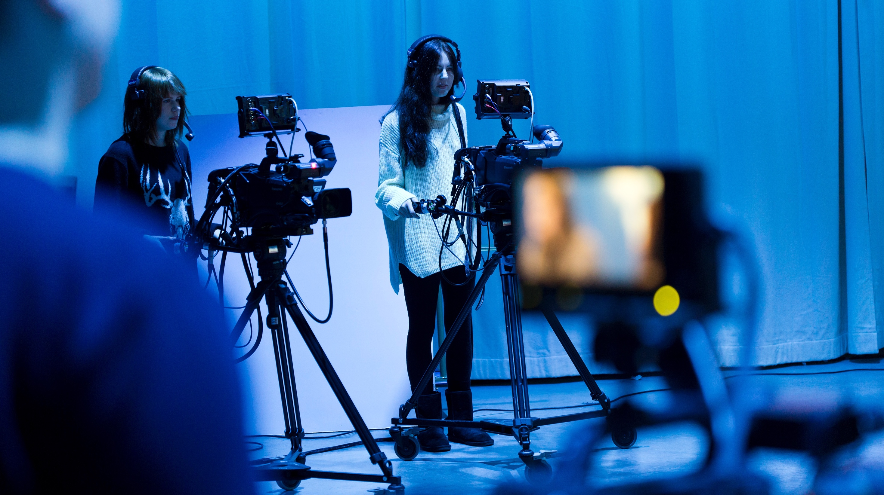
WORK
Tampere has always offered work, even though the nature and methods of work have varied over the years. Tampere is still known for work, and you can find diverse know-how here.
Image: Visit Tampere / Opa Latvala

Slide 15
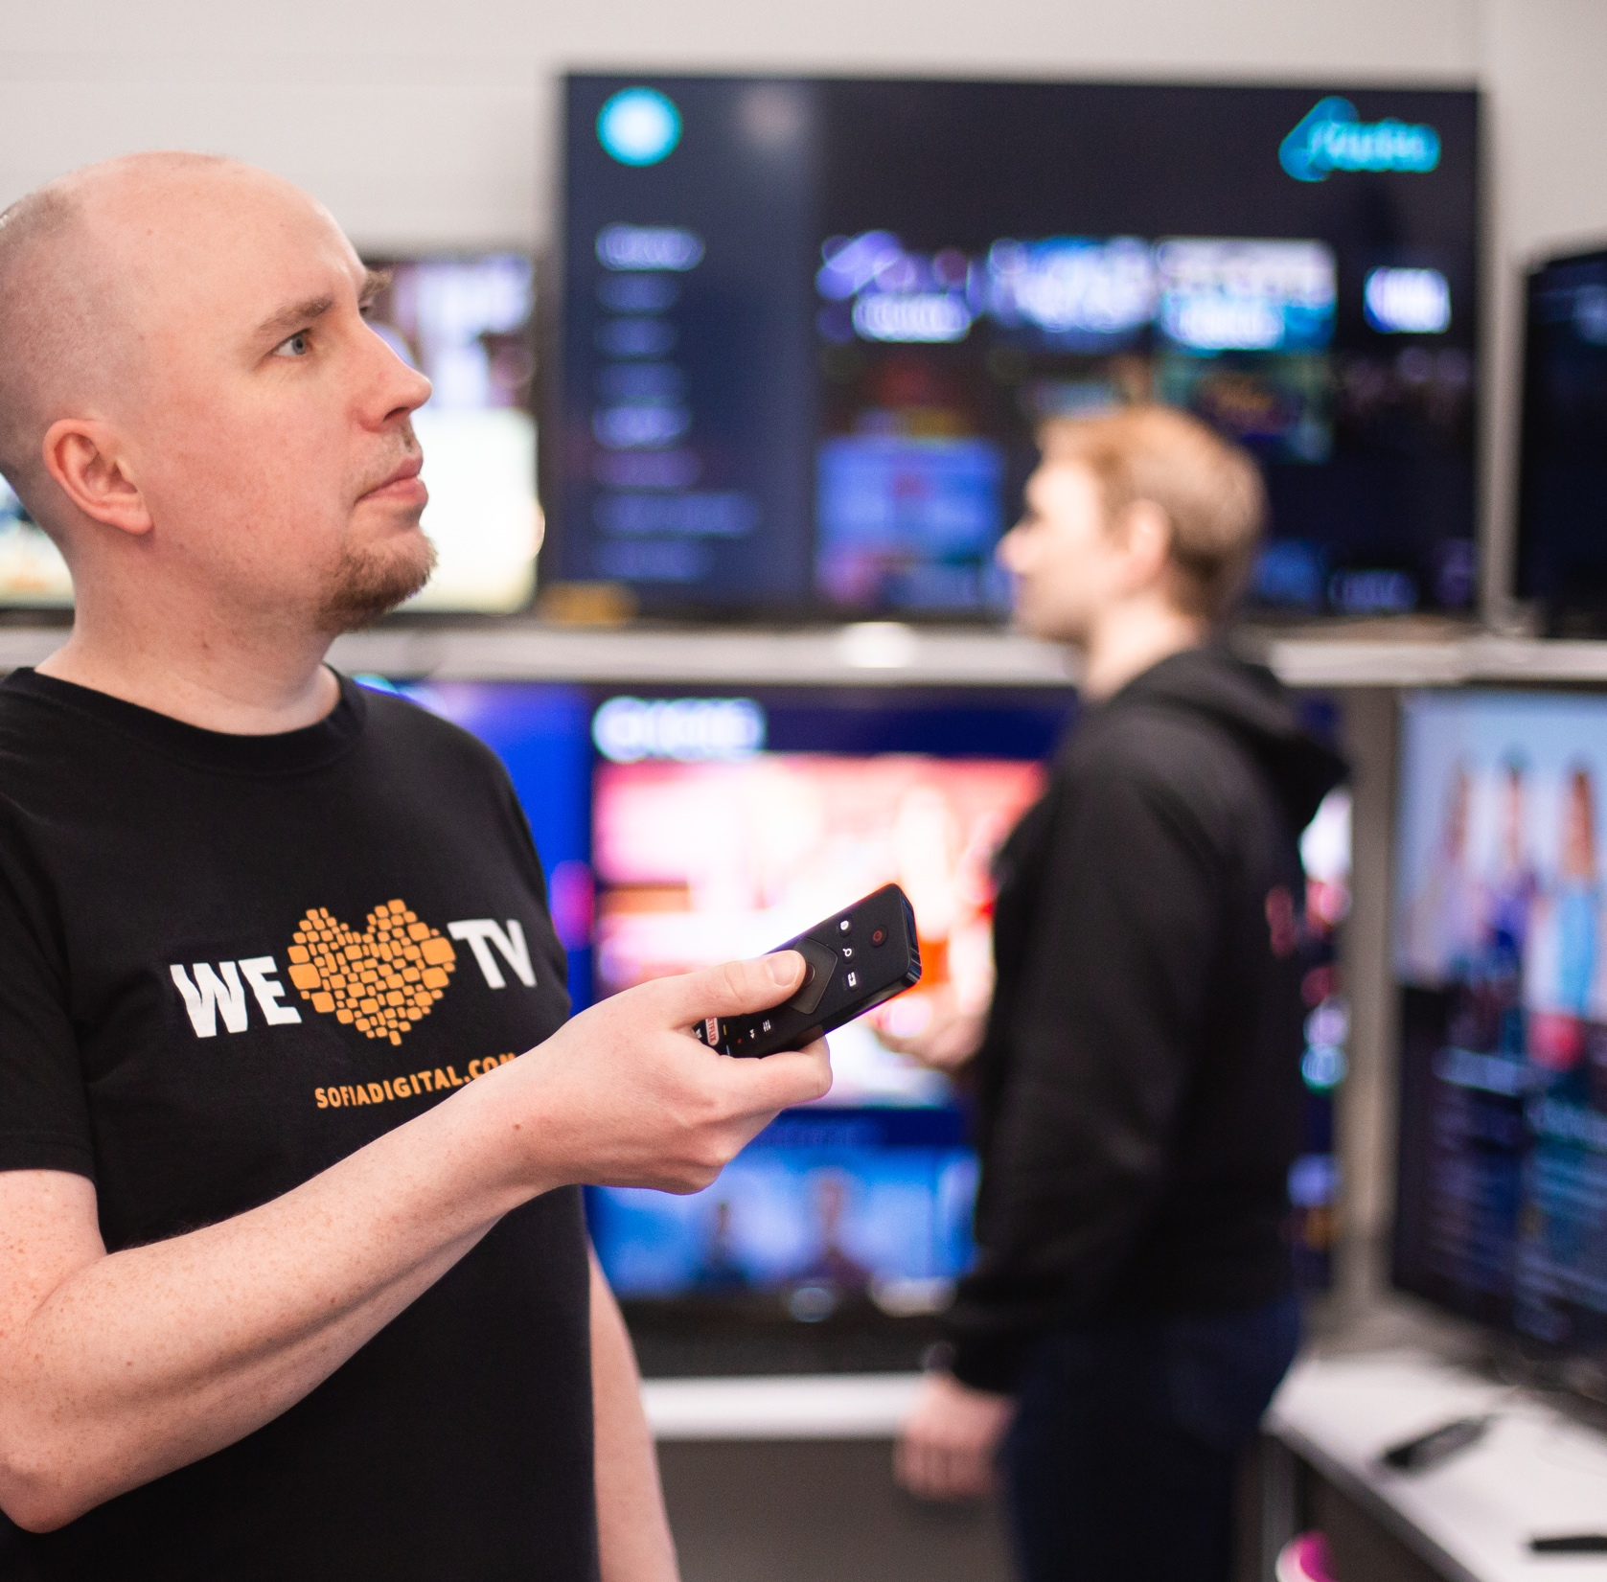
We work
Largest industries :
Health care and social services 19 %
Manufacturing 13 %
Trade sector 11 %
Unemployment rate 11,9 %
173 000 jobs in the region
Employment review 8/2023
Source: Business Tampere 31.8.2022.
Image: Visit Tampere / Laura Vanzo
Notes:
​Unemployment rate Source: https://public.tableau.com/profile/tampereen.kaupunki#!/vizhome/Tyllisyyskatsaus/Etusivu​
​

Slide 16
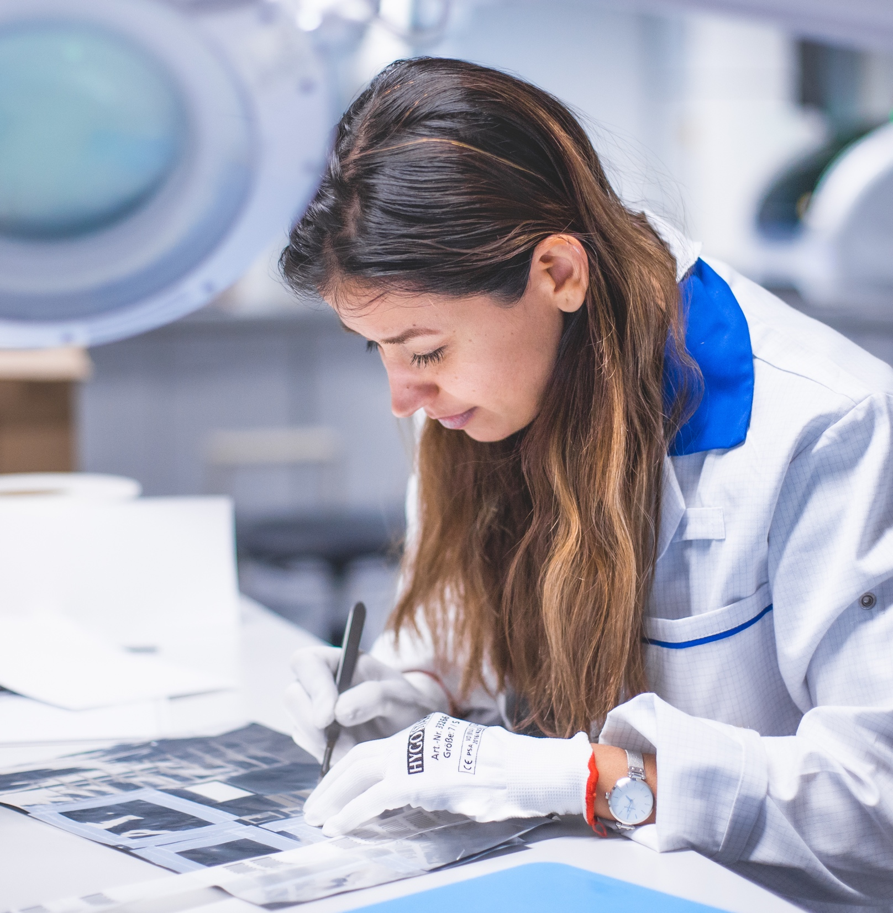
We attract expertise and new talent
Tampere has plenty of jobs for highly educated people and those with vocational expertise. The Tampere region is a home to 38 100 businesses.
Top industries:
Manufacturing
ICT
Social and health care services
Cost-efficient living expenses, smooth mobility and diverse opportunities for experiences make everyday life easy and attractive. It’s easy to feel at home here.
Image: Visit Tampere / Laura Vanzo
Notes:
Tampere adds quality to life. ​
​
Proof:​
​
Tampere has plenty of jobs, for example in manufacturing, ICT and social and health care services for highly educated people and those with vocational expertise.​
​
Housing costs are lower than in the capital region. Plenty of different types of homes available.​
​
Services and experiences are easy to reach with public transportation or on foot. ​
​
Diverse cultural offering and excellent sports offering. Among other things, 23 museums, ten theatres, a world-class philharmonic orchestra, the most Finnish Composers’ Copyright Society (Teosto) licences per capita, over 20 public saunas.​
​
Tampere is a relaxed and easygoing city where it’s easy to feel at home. Only one in every three residents were born here – but we are all proud to live here. In fact, Tampere has been ranked the most attractive city in Finland in several studies.​
​
The most important location criterion for students is jobs. The story of positive employment as one target of Tampere’s business strategy (Business Tampere) and attraction/retention.​
https://www.aamulehti.fi/a/9bd3552b-dfa0-463f-8d3a-00cb9f3ed1f7​
​
Target established in the attraction-retention seminar: promoting the feeling of being proud to be from Tampere​ https://www.tamperelainen.fi/artikkeli/714284-tilastot-kertovat-vain-joka-kolmas-tamperelainen-on-syntyperainen-tamperelainen ​

Slide 17
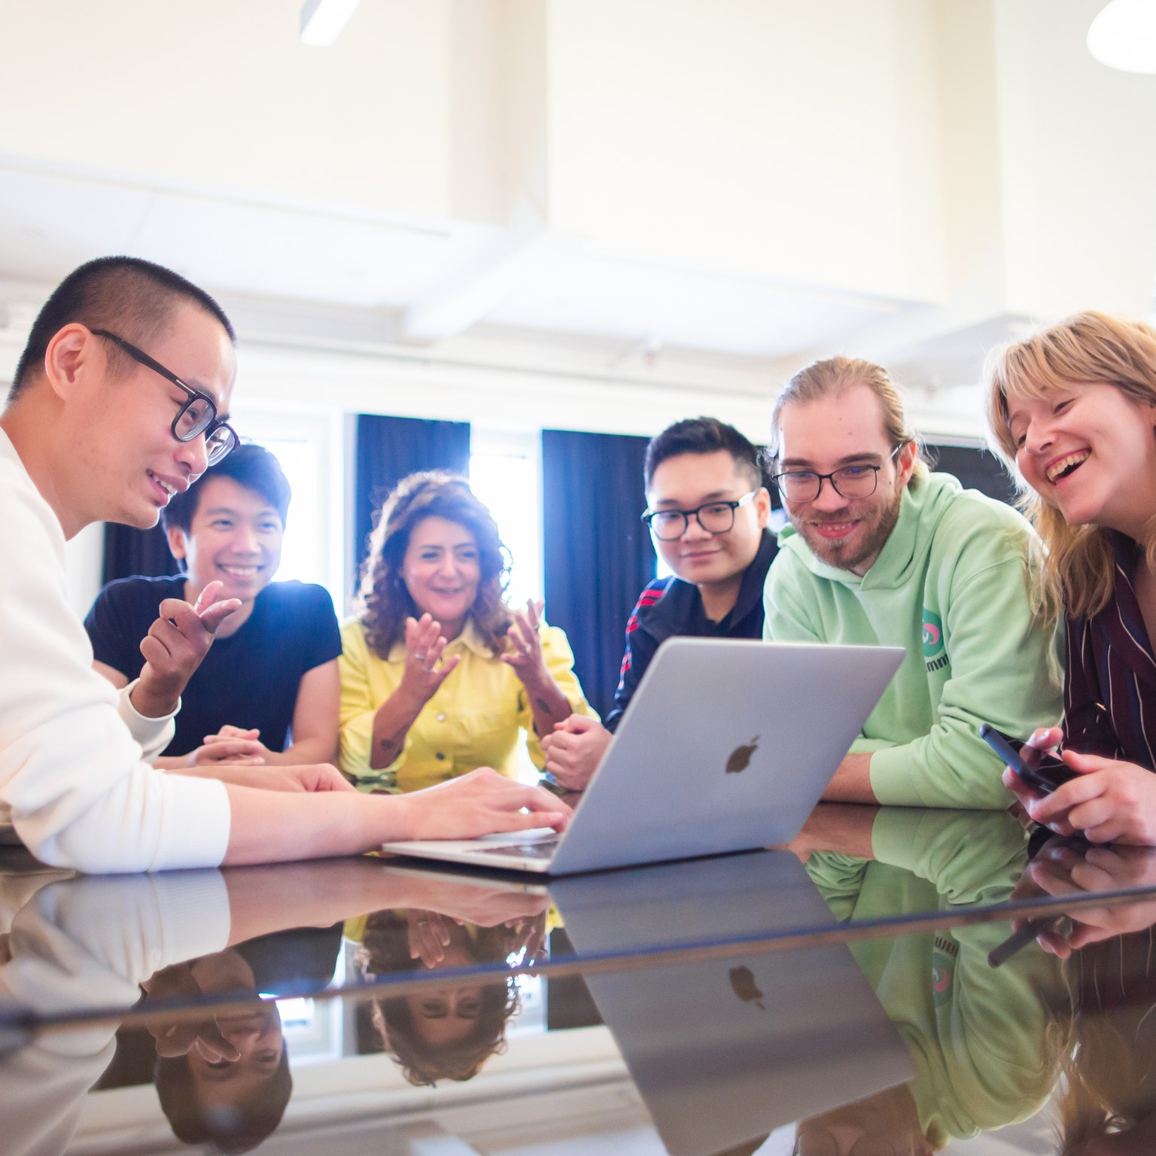
INTERNATIONAL TALENT– Functioning communities support good living
100 languages
84 nationalities
23 391 non-Finnish speakers (5/2023)
In Tampere, it’s easy to balance your work and private life. Our international community welcomes all new residents with open arms.
The Hidden Gems project helps the spouses of international employees to integrate and find jobs.
Image: Visit Tampere / Laura Vanzo
Lähde: Talousarvio 2020
Notes:
Non-Finnish speakers 20,793 (12/2021) https://public.tableau.com/profile/tampereen.kaupunki#!/vizhome/UlkomaalaistaustaisetTampereella/Etusivu_1​ Thea amount of foreign citizens in Tampere and non-Finnish speakers is growing each year.​
In 2012 the amount of non-Finnish speakers in Tampere was 9 % and the amount of foreign citizens 6 %. The largest foreign-language speaking age group in Tampere is 30–34-year-olds and the smallest group people over 70 years. The largest nationalities come from Russia, Afgsnistan, Estonia and Irak. The most spoken languages are Russian, Arabic, Persian and English. ​
​
Tampere provides opportunities. Functioning communities and the ease of living support leading a happy life.​
​ Proof:​
​
*Finland facts. Balancing work and private life is easy. Finland is a forerunner in equality and one of the safest countries in the world. World-class free pre-school education and comprehensive education for children. Clean water and clean air. Beautiful nature that is easily accessible in all seasons. ​
​
Over 38,000 businesses operate in the Tampere region. Tampere has multidisciplined and new technological expertise in multiple fields, such as camera technology, VR/AR, gaming industry, health care technology and automotive industry. ​
​
Several start-ups and business networks operate in Tampere. The businesses in the region regularly work with universities. For example, Mediapolis, Tribe, International HUB Tampere, DIMECC and SMACC.​
​
Several international businesses have R&D operations in Tampere. For example, BHTC, AAC Technologies, Axon, Huawei, Xiaomi, Scandit, Polight.​
​
Tampere has a central location in Finland – excellent road, train and air traffic connections.​
​
Tampere is a great place for children to grow and learn. ​
​
The Hidden Gems project helps the spouses of international employees to integrate and to find jobs.​
​

Slide 18
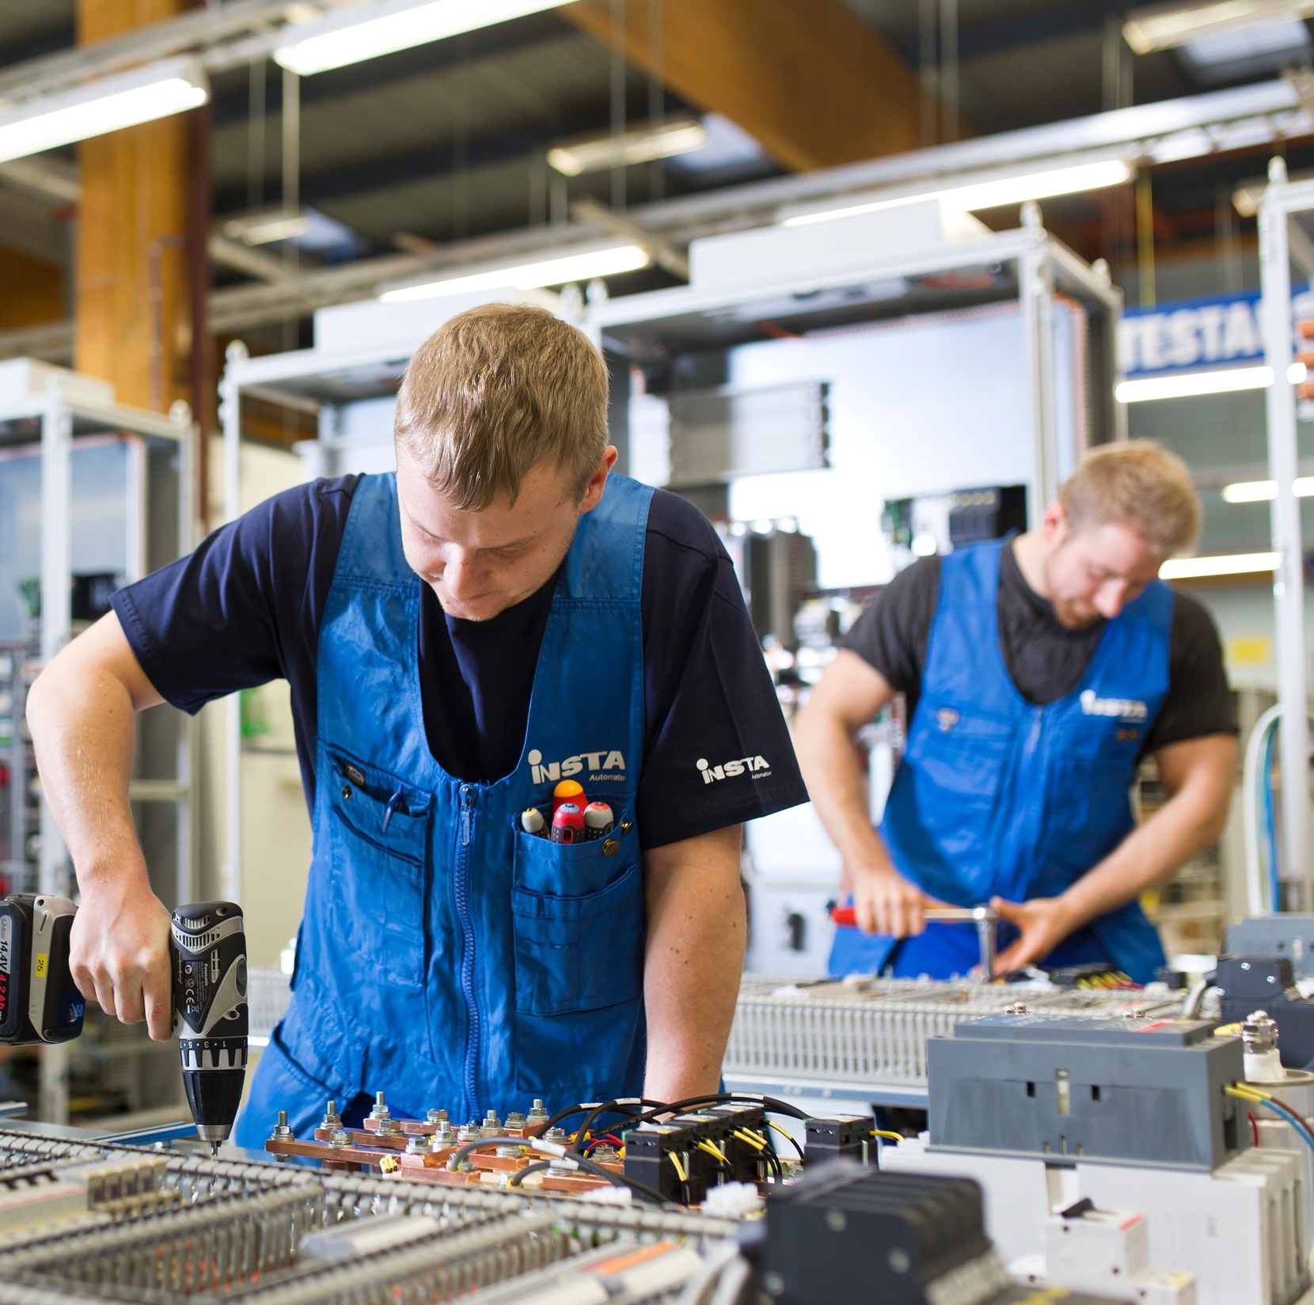
The city of employer growth
The manufacturing industry in Tampere is one of the most important components of export in Finland.
Tampere is a home to multidisciplinary and new technological expertise in multiple fields, such as:
Camera technology
VR/AR business
Gaming industry
Health care technology
Automotive industry
Competent employees, the power of networks and its central location make Tampere an appealing home for employers.
Image: Visit Tampere / Opa Latvala
Lähde: Talousarvio 2020
Notes:
Tampere is a city of growth.​ ​
Competent employees, the power of networks and its central location make Tampere an appealing home for employers. ​ ​ Proof:​
The manufacturing industry of Tampere is one of the most important sources of exports in Finland. ​ ​
Tampere has multidisciplined and new technological expertise in multiple fields, such as camera technology, VR/AR, the gaming industry, health care technology and the automotive industry. ​
​
Tampere has a central location in Finland – excellent road, train and air traffic connections. The new tramway is central to Tampere’s growth: it enables effortless movement for residents and creates opportunities for forming new clusters of businesses and services. ​
​
Tampere has the capacity for renewal and for taking brave steps: the tramway, Smart City, Deck and Arena, Travel and Service Centre, Hiedanranta. Tampere will invest over 6 billion euros in development by 2030.​
​
Several start-ups and business networks operate in Tampere. The businesses in the region regularly work with universities. For example, Mediapolis, Tribe, International HUB Tampere, DIMECC and SMACC.​
​
Over 35,900 businesses operate in the Tampere region.​
​
Availability of skilled workforce is the number one criterion for businesses, with location/accessibility in second place. Expertise in technology as a fact about our skilled workforce.​
​
Of the individual industrial clusters in the area, one of the most significant is the manufacture of mobile work machines with the connected subcontracting chains, since it generates a turnover of billions of euros for the region.​
​

Slide 19
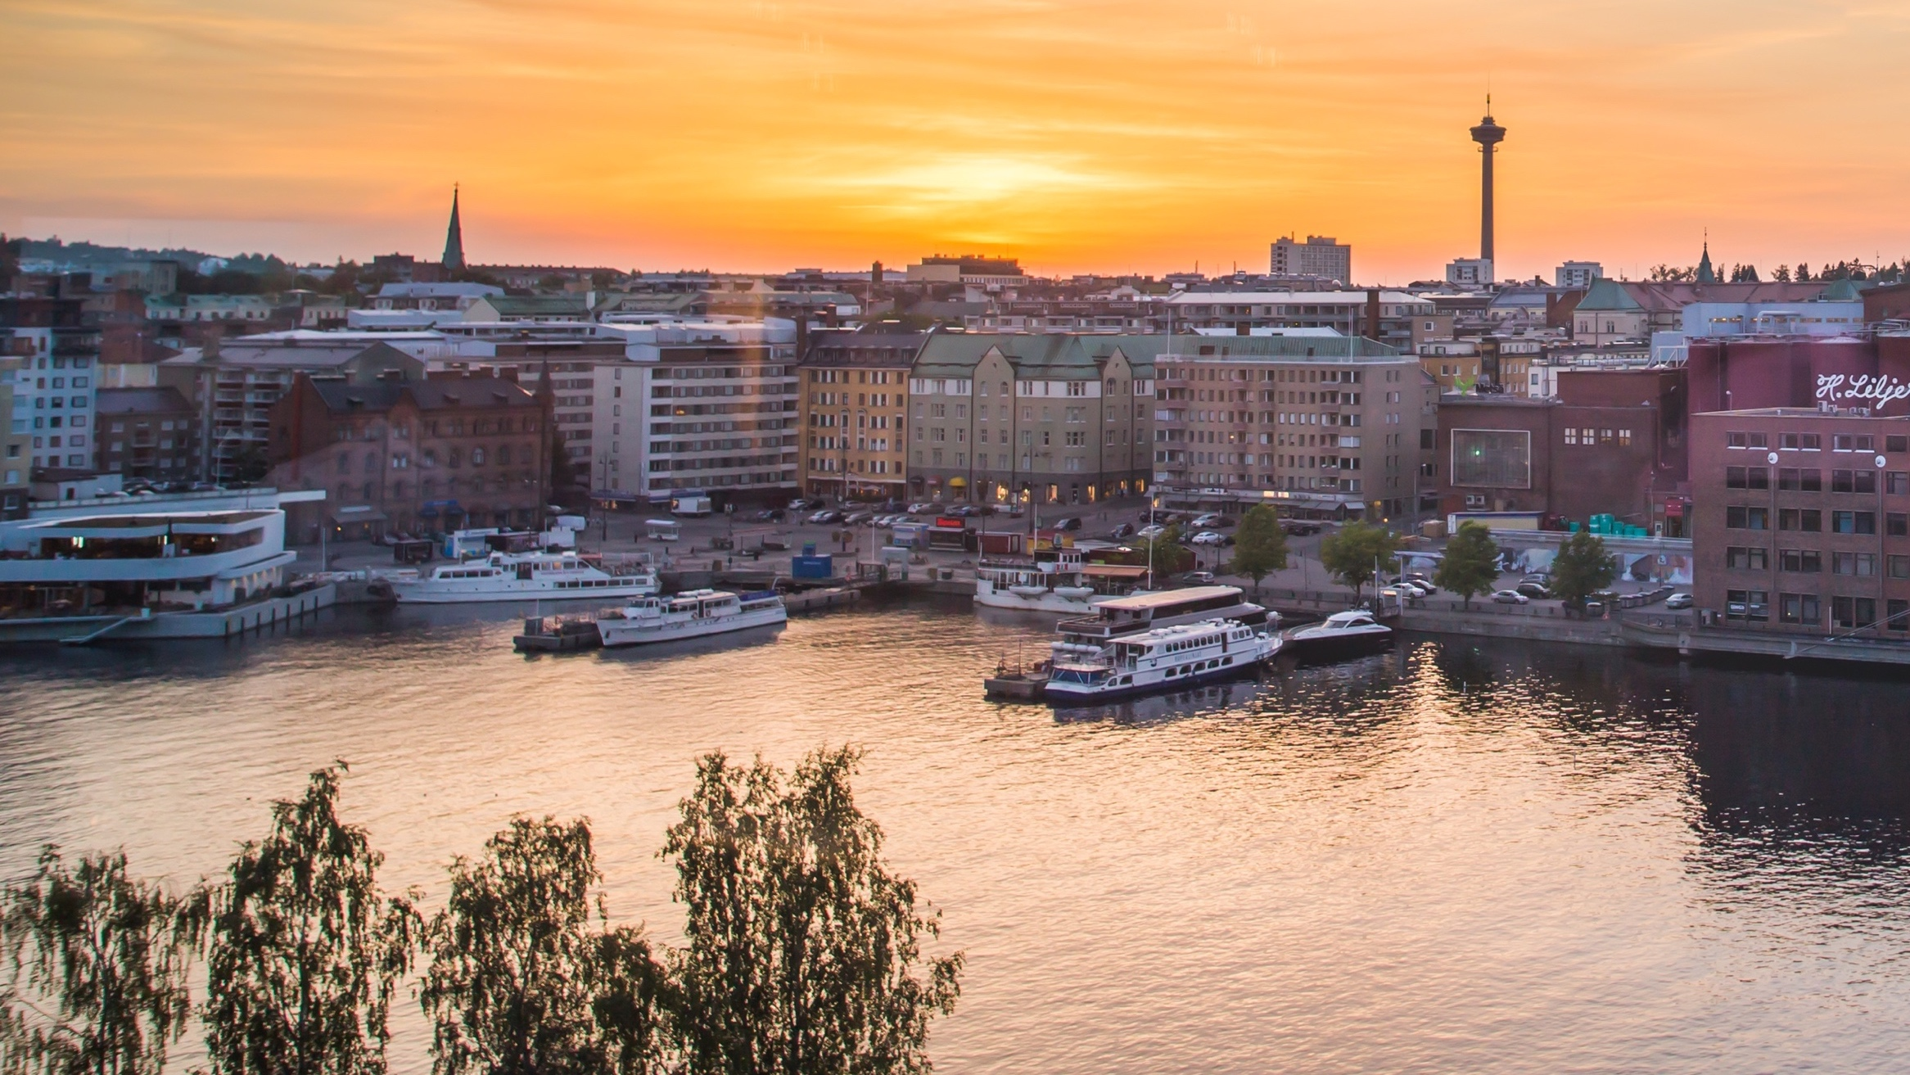



Largest private employers
25 000 Active companies
Tampere is a central and cost-effective location with plenty of talent, making it an attractive city for businesses.
Image: Visit Tampere / Laura Vanzo
Notes:
Tampere active companies 09/2023 (https://yritystieto.businesstampere.fi/)​
​
Largest private employers:​
Pirkanmaan Osuuskauppa​
Sandvik Mining and Construction Oy​
Fimlab Laboratoriot Oy
Millog Oy
Saarioinen Oy
​

Slide 20
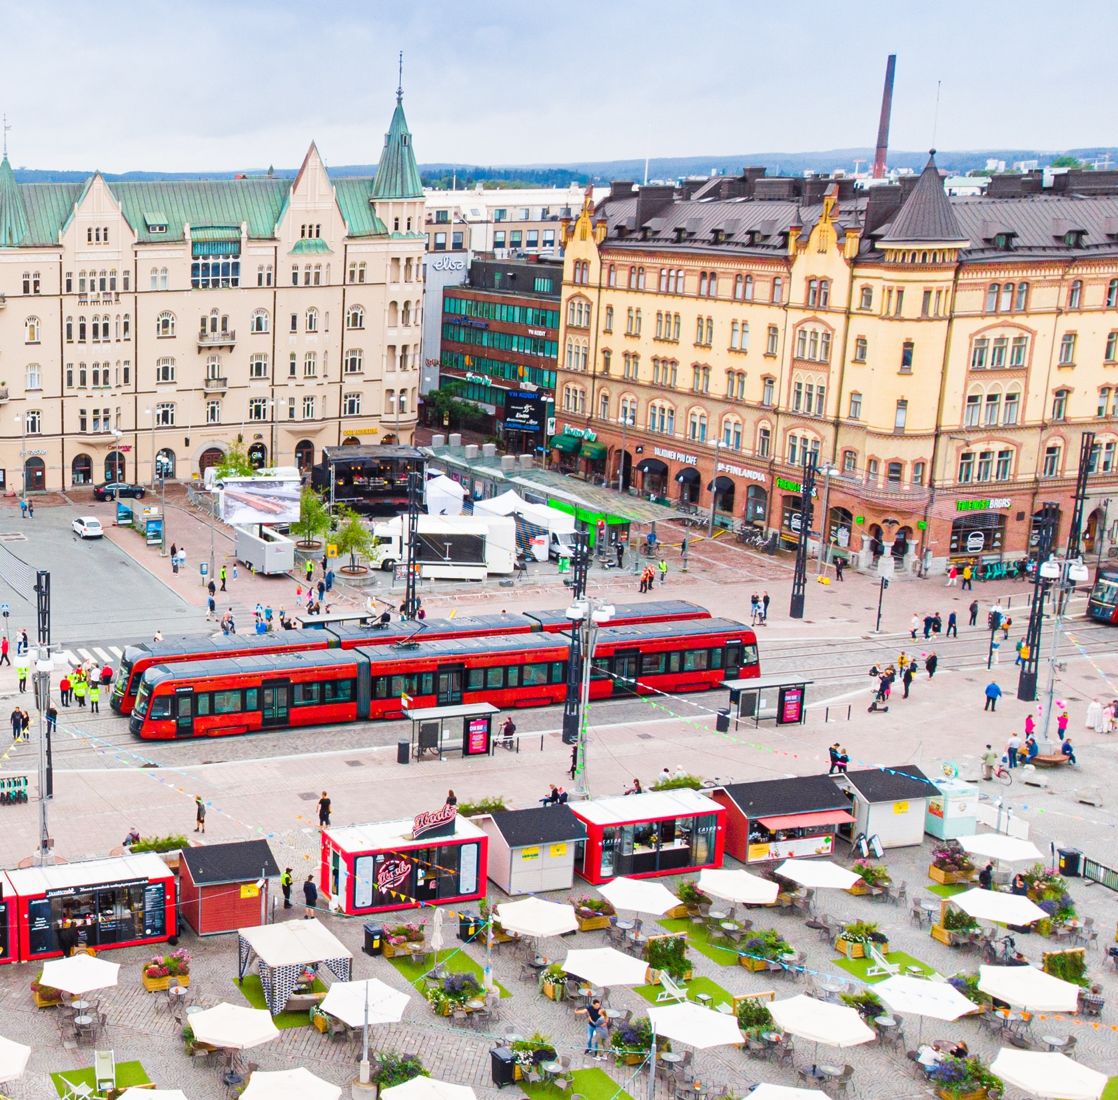
Together we are greater
We embrace change and get things done – innovatively.
In an alliance, the client and the service providers design and implement the project together, with a joint organisation and based on common decisions. Everyone wins, given that the risks and rewards are shared.
An alliance helped us build:
The Tampere Tunnel
The Tesoma Wellbeing Centre
The Tampere Tramway
Image: Visit Tampere / Laura Vanzo
Notes:
The Tampere-way of cooperating​
We embrace change and get things done. Tampere is known for its efficient decision-making and innovative ways of cooperating.​
​
The Tampere Tunnel: The road tunnel’s construction with an alliance model was successful beyond all expectations. Finland’s longest road tunnel was built in Tampere in 2013–2016. It was completed six months ahead of schedule and for less than the original budget. ​
The project was carried out with an alliance model, the parties involved being the City of Tampere, the Finnish Transport Infrastructure Agency, Lemminkäinen, YIT, Saanio & Riekkola and AINS Group.​
The alliance model for the Tesoma Health and Well-Being Centre: The services of the health and well-being centre in the Tesoma district of Tampere have been implemented with a partnership model of the public, private and third sectors, in which the alliance is formed by the City of Tampere and Mehiläinen. This is the first time that the alliance model was applied to the implementation of health and wellbeing services in Finland.​

Slide 21
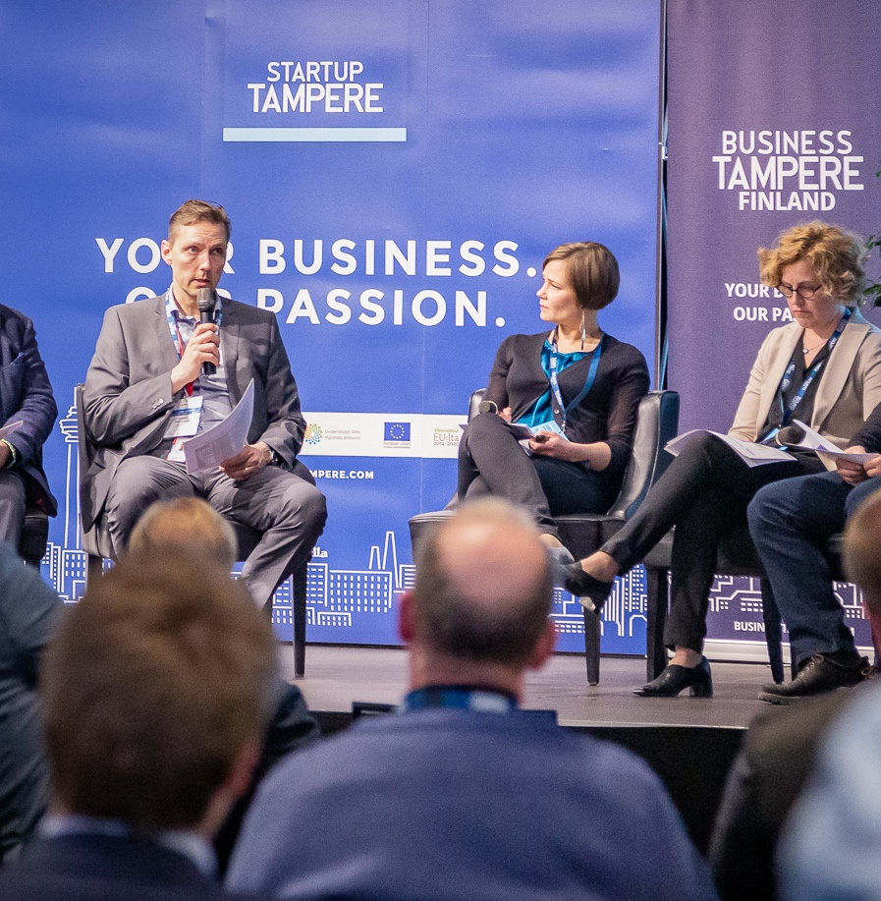
Ecosystems bringing talent together
The ecosystems unite experts from multiple fields, facilitate making use of opportunities and help with innovation.
The ecosystems already in place:
Camera technology – Tampere Imaging Ecosystem
Artificial intelligence – Tampere AI ecosystem
Mobility – ITS Factory
Startup Tampere
The Tampere Automotive Cluster
Tampere Region Safety and Security Ecosystem
Connectivity ecosystem
Tampere Region Circular Economy Ecosystem
Film Tampere
Education and learning
Intelligent Machines and Automation
Health technology and life science
12 ecosystems - for open and smart collaboration.
Image: Visit Tampere / Mirella Mellonmaa
Notes:
The ecosystems unite experts from multiple fields, facilitate making use of the opportunities that digitalisation presents and help with innovation, for example.​
​
Currently, there are nine ecosystems in place.​
Film Tampere​
Camera technology – Tampere Imaging Ecosystem​
The circular economy​
Mobility – ITS Factory​
Startup Tampere​
The Tampere Automotive Cluster​
Tampere Region Safety and Security Ecosystem​
Artificial intelligence – Tampere AI ecosystem​
Connectivity ecosystem ​
Education and learning​
Intelligent Machines and Automation​
Health technology and life science​
​
Things created in Tampere include​
A smartphone​
OZO – the world’s first VR movie camera​
Digital X-ray camera​

Slide 22
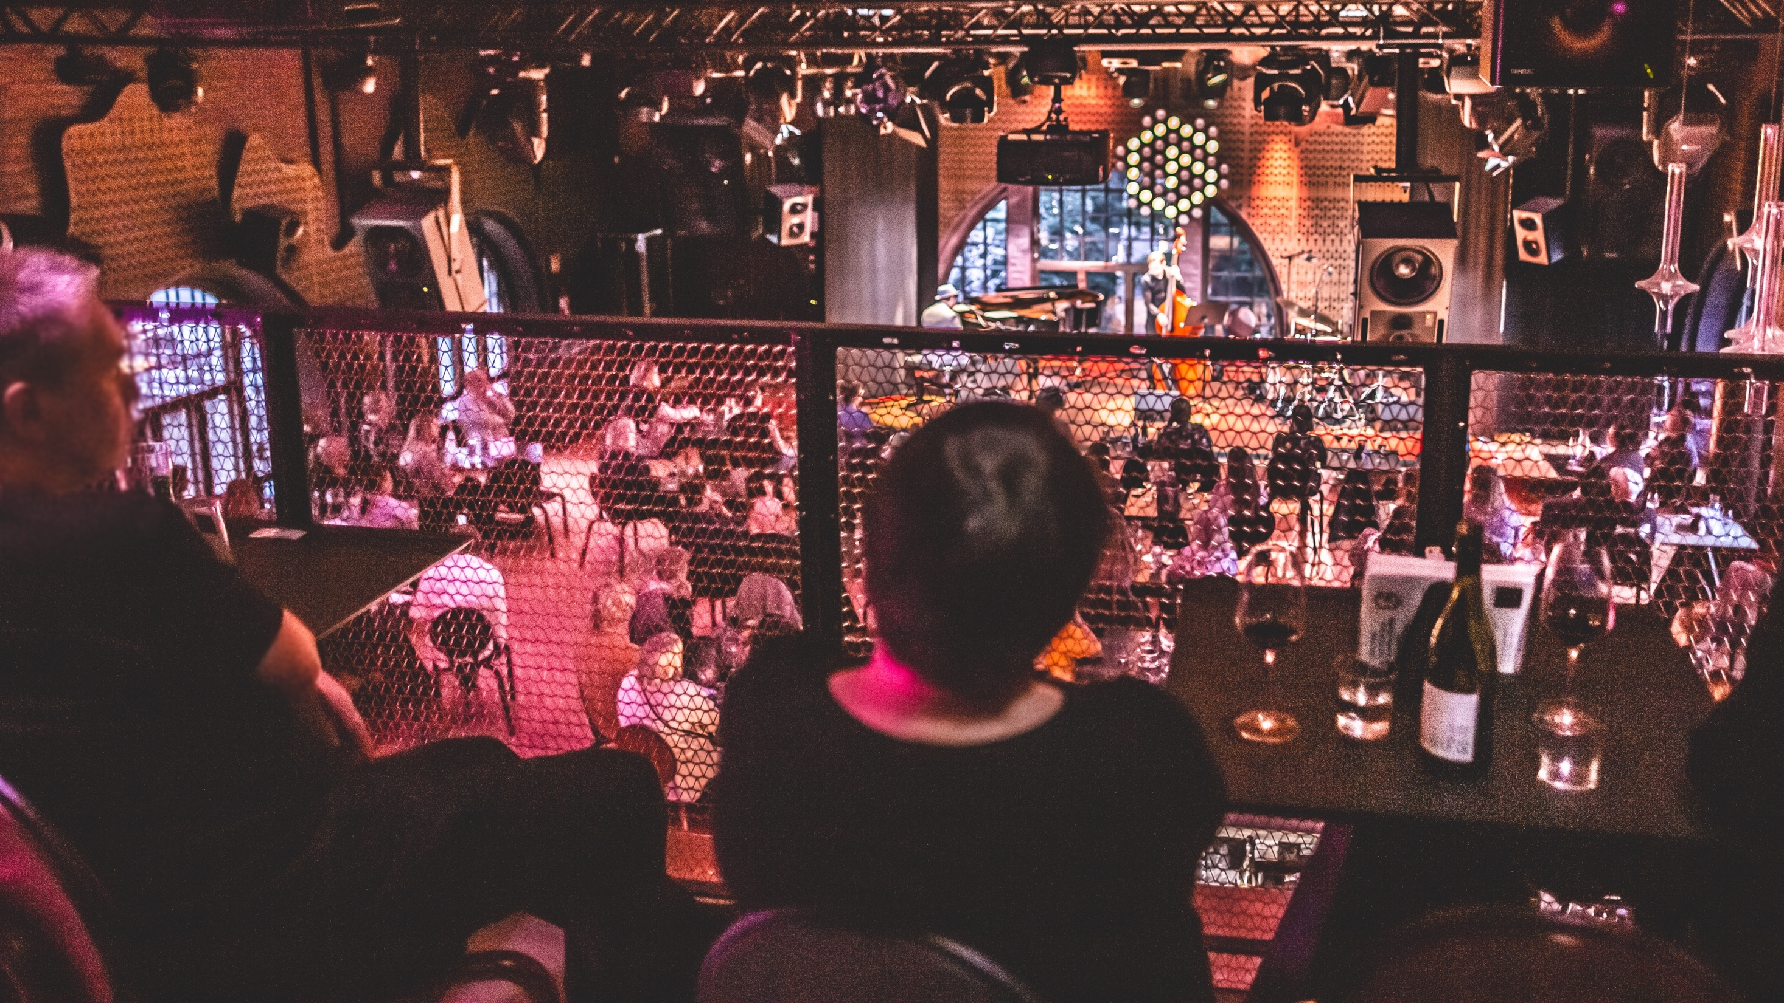
FEELING
The relaxed, forward-looking feeling you get in Tampere needs no explanation – you can sense it everywhere in the city.
Image: Visit Tampere / Laura Vanzo

Slide 23
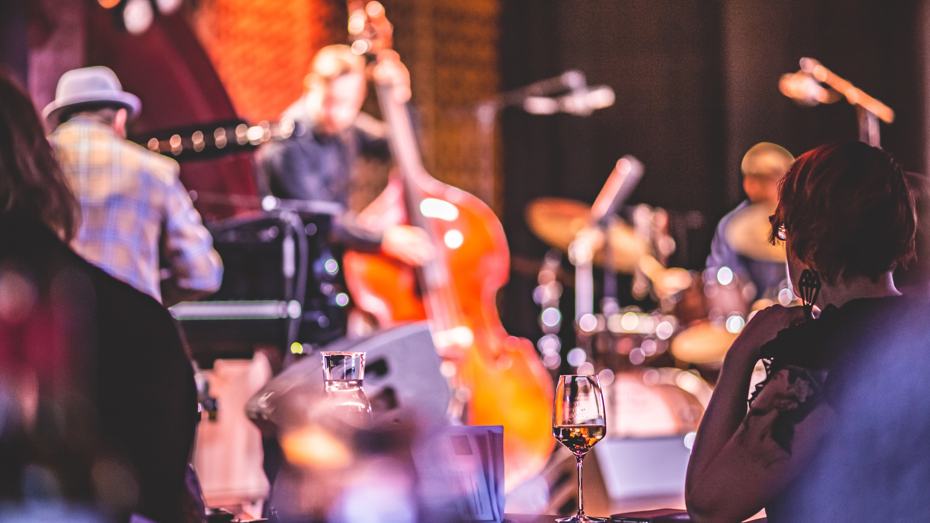
Sustainable growth with culture
2030
Culture affecting everyone
Home of creative people
City of significance, bigger than its size
Image: Visit Tampere / Laura Vanzo
Notes:
The goals of Tampere’s cultural strategy are: ​
Culture Affecting Everyone: Equal culture increasing welfare for all.​
Home of Creative People: Creative industries enhancing the city’s vitality.​
City of Significance: The vibrant urban environment improving the city’s congeniality​
Bigger than Its Size: Internationally attractive cultural offering becoming a central part of Tampere’s appeal​​

Slide 24
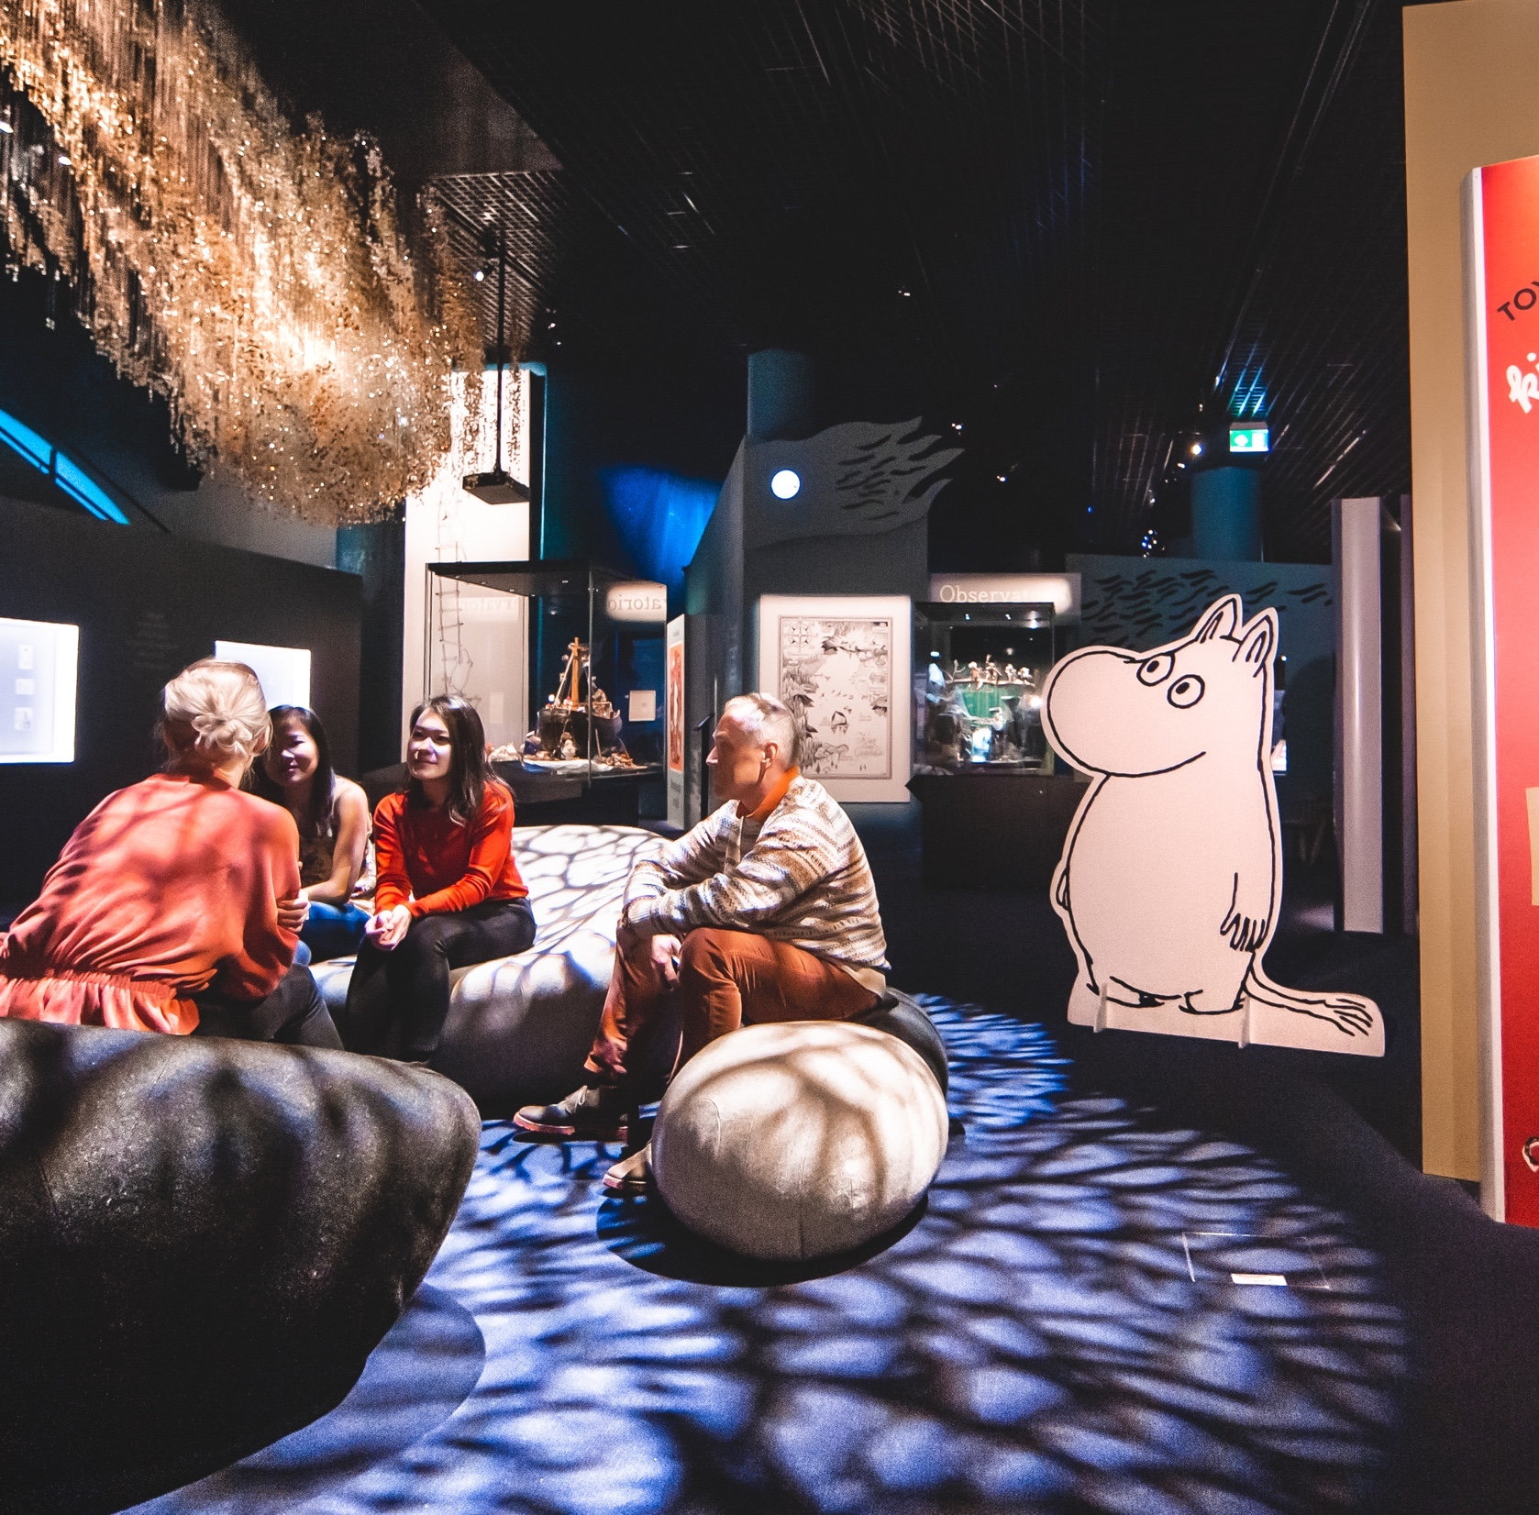
Implementing the cultural strategy
By 2030, we will improve the following, among others, to reach the goals set in our cultural strategy:
Accessibility of open cultural offering
Tailoring cultural services
Taking use of the positive effects of culture on wellbeing
Public art
Design of public spaces and providing them for cultural operators
Infrastructure for experiences and content
Image: Visit Tampere / Laura Vanzo
Notes:
Sustainable growth will be created with culture by 2030 with the following actions: ​
​
1. Culture Affecting Everyone: Actions​
1.1 Improving the accessibility of open cultural offerings​
1.2 Supporting participation in culture by tailoring services​
1.3 Power from diversity​
1.4 Utilising the positive effects of culture in social and health care services​
​
2. Home of Creative People: Actions​
2.1 Supporting networks, employment and expertise in the creative industries through inter-administrative cooperation​
2.2 More venues for cultural operators​
2.3 Developing services for the civil society​
2.4 Increasing the significance of education in creative fields and artistic education in growing new competence and talent​
​
3. City of Significance: Actions​
3.1 Increasing public art and its impact​
3.2 Design public spaces to enable interaction, leisure and hobbies.​
3.3 Design a high-quality environment in cooperation with residents​
3.4 Actively treasuring and promoting our unique history​
​
4. Bigger than Its Size: Actions​
4.1 Investing in infrastructure for providing experiences and content​
4.2 Investing in events​
4.3 Increasing awareness of Tampere as a cultural city ​

Slide 25
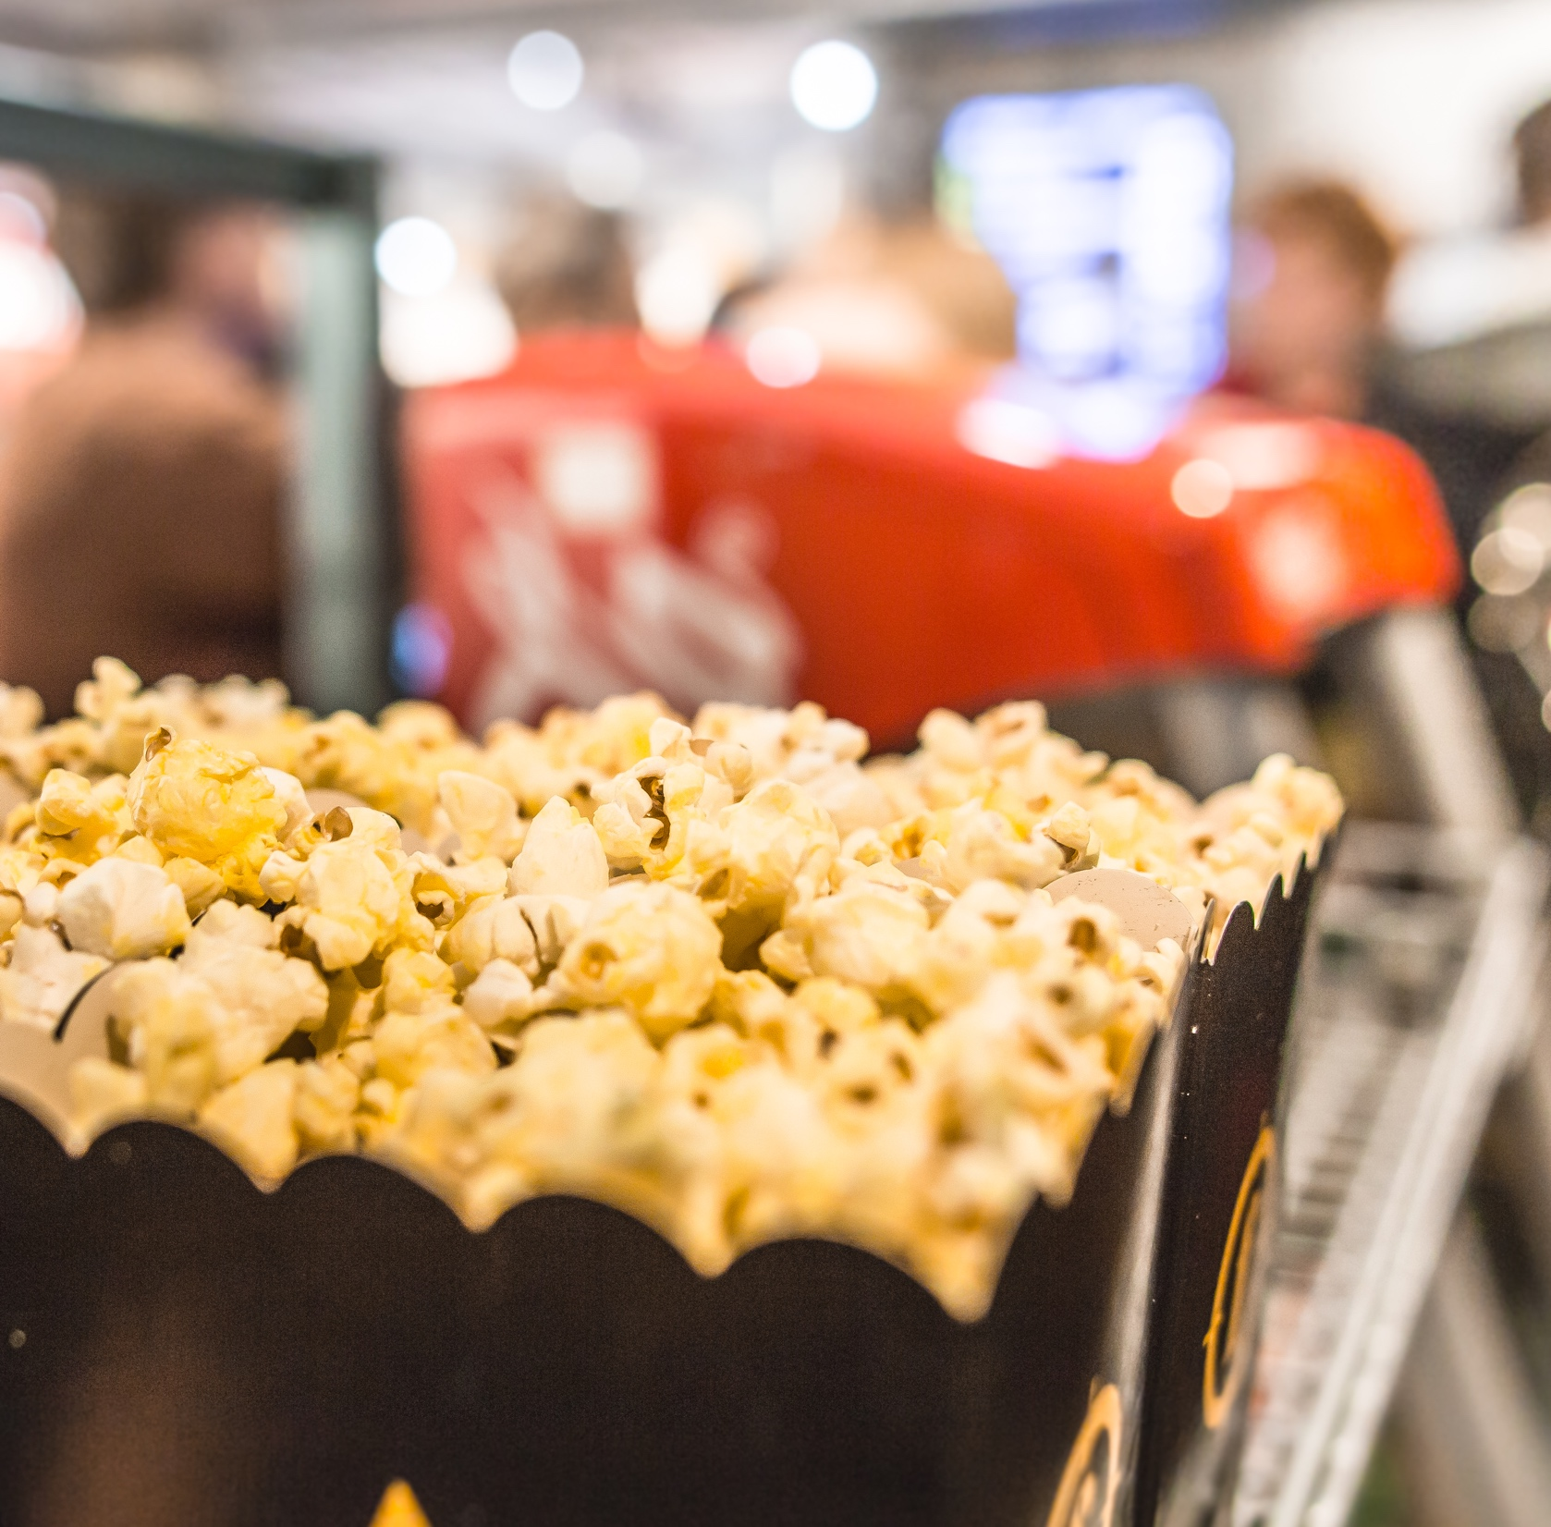
City of film
Movies filmed in Tampere include:
Dual, Hollywood
SuomiLOVE
Juice
Naissotilaat
Ivalo (post-production)
Pirjo
Gladiaattorit
Lakeside Murders – Koskinen
70 is just a number
TAMPERE’S PRODUCTION INCENTIVE SYSTEM 10–15 %
refund for production costs incurred in the Tampere region.
Image: Visit Tampere / Laura Vanzo
Notes:
Tampere’s production incentive system​
A 10–15% refund of production costs incurred in the Tampere region. A 10% standard refund with a chance for a 5% additional refund through marketing cooperation. ​
Applicable costs include purchases of services and goods made and wages paid within the Tampere region. All professional entertainment, drama, movie, documentary and VR productions can apply for the refund.​
​
Already produced at Tampere: ​
Invisible heroes (post-production)​
World Film Report (CCTV-6 China)​
Jahti​
Elossa 24h​
Yksittäistapaus​
Kontio&Parmas​
Onnenpyörä​
Melkein Totta​
Napakymppi​
Kellot Soi!​
Jaksa paremmin​
​

Slide 26
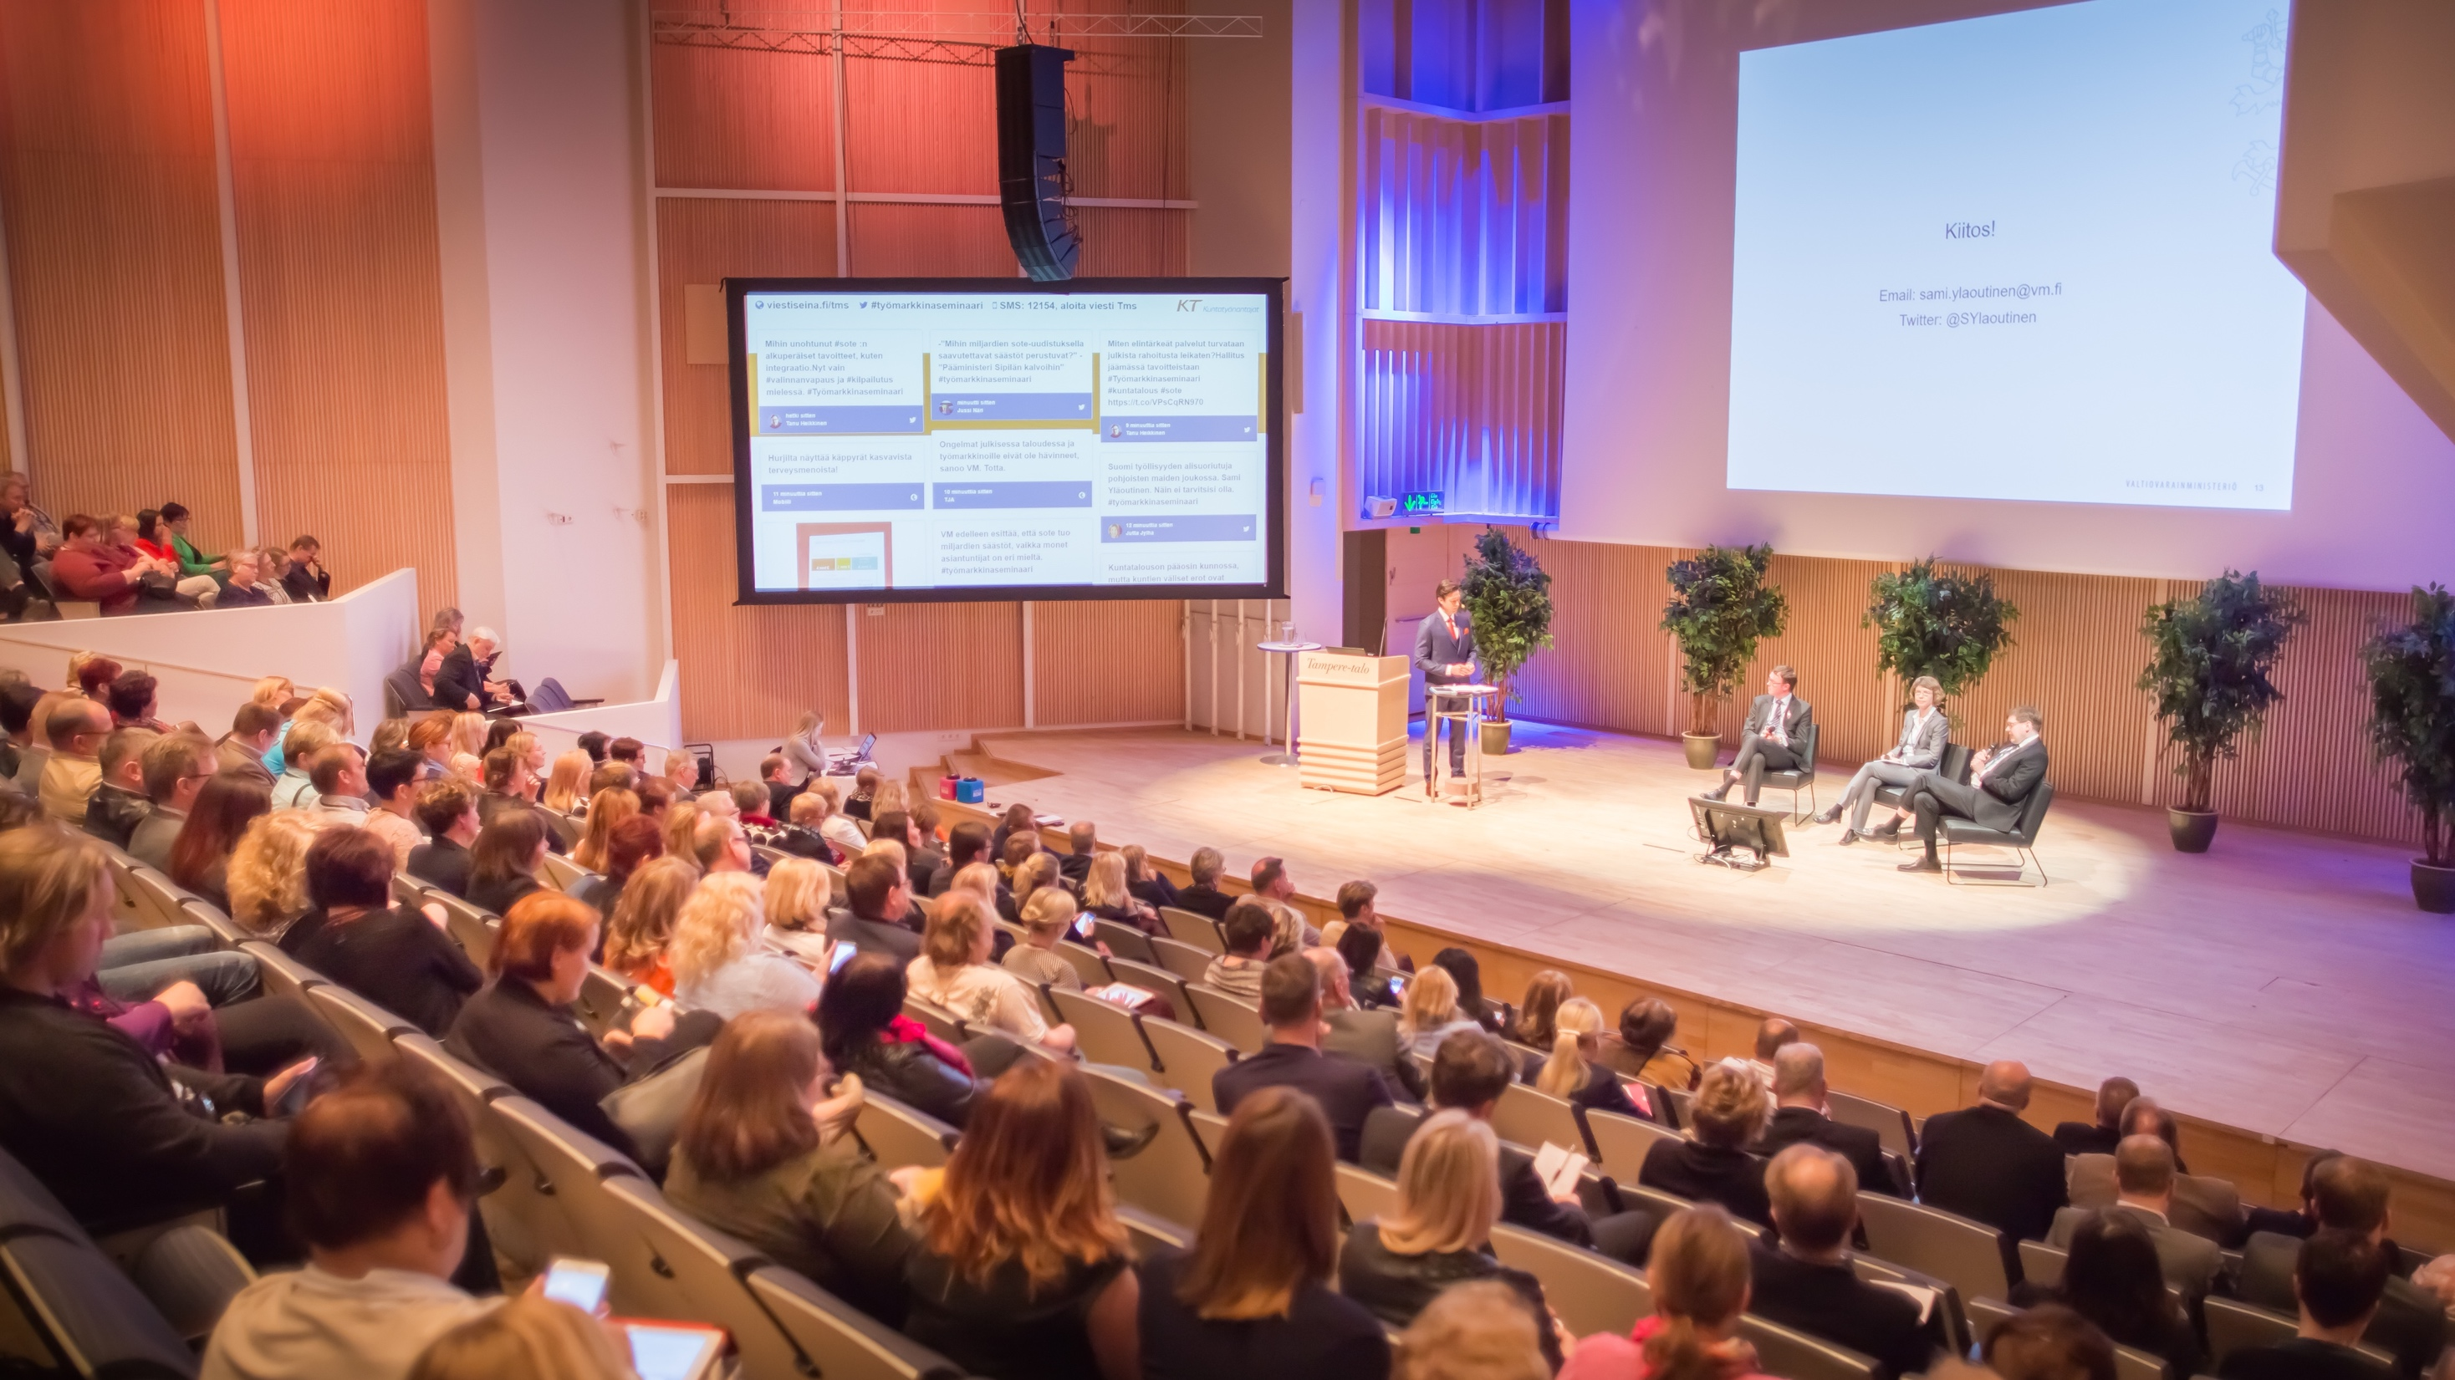
Business events, congresses and trade fairs in Tampere Hall & Tampere Exhibition and Sports Centre
454 000
visitors in events
911
business events, congresses and trade fairs
Image: Visit Tampere / Laura Vanzo
Notes:
Tampere Hall is the largest congress and culture centre in the Nordics. Tampere Hall is a venue for a variety of different events, such as business meetings, seminars, training events and family celebrations, national and international congresses, exhibitions, trade fairs, business celebrations and special events.
​
Tampere Exhibition and Sports Centre (TESC) was opened in 2005. It is owned by the City of Tampere and the corporation Tampereen Messut. ​
​
TESC provides a variety of facilities for event organisers, companies, associations and clubs to organise events and meetings.​
​​​

Slide 27
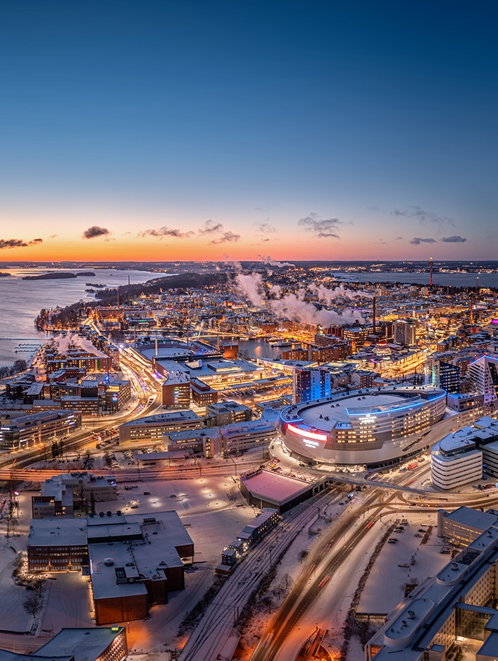
Event paradise
Two lakes dividing the city create a unique surroundings for events.
A bustling city with:
thousands of events from yard sales to international festivals
4.4 million event visitors (2022)
511 millioneuros revenue of events (2021)
Nokia Arena for 15,000 spectators opened in 2021
We invest in interesting events for large audiences
Image: Visit Tampere / Skyfox Marko Kallio
Notes:
2/3 of Finns live within a radius of 200 kilometres. Tampere has 30 hotels with 3,700 rooms and 8,000 beds. ​
​
Tampere’s location between two lakes ensures beautiful venues for events and excellent opportunities for leisure. ​
​
Most event venues and services are within walking distance. ​
​
We heavily invest in creating, enabling and attracting interesting events with large audiences. ​
​
We provide event organisers with optimal operational conditions, smooth administration and a modern infrastructure. ​
A multifunctional arena with a capacity of 15,000 was opened in the city centre in 2021. The arena is the first of its kind in Europe. ​

Slide 28
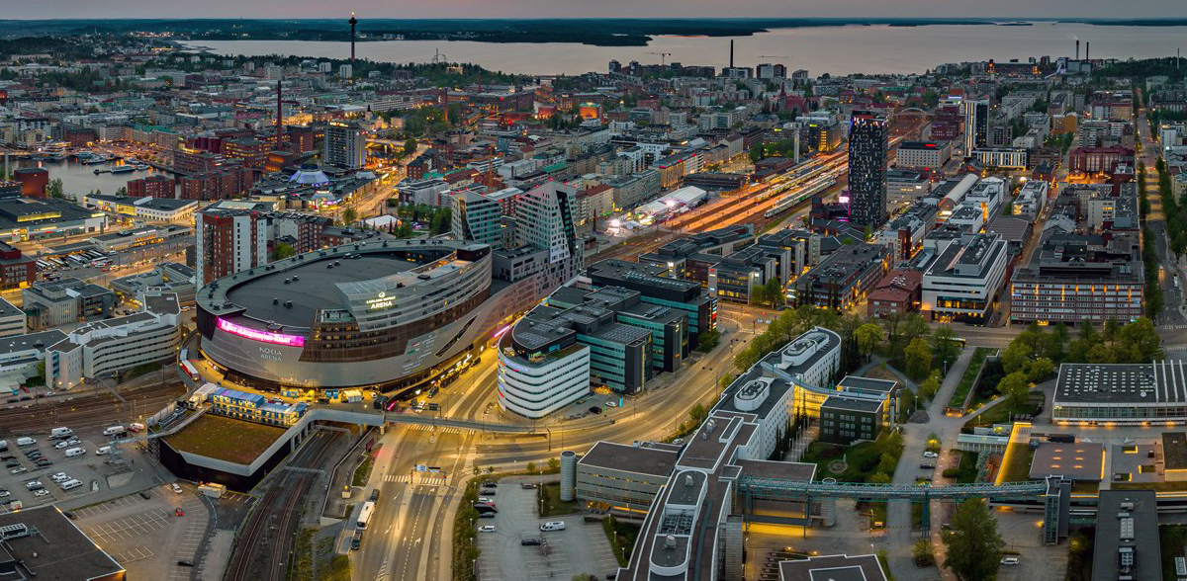

CHANGE
In a growing city, change is present everywhere you look – Tampere is constantly being built and developed further.
Image: Visit Tampere / Skyfox Marko Kallio

Slide 29
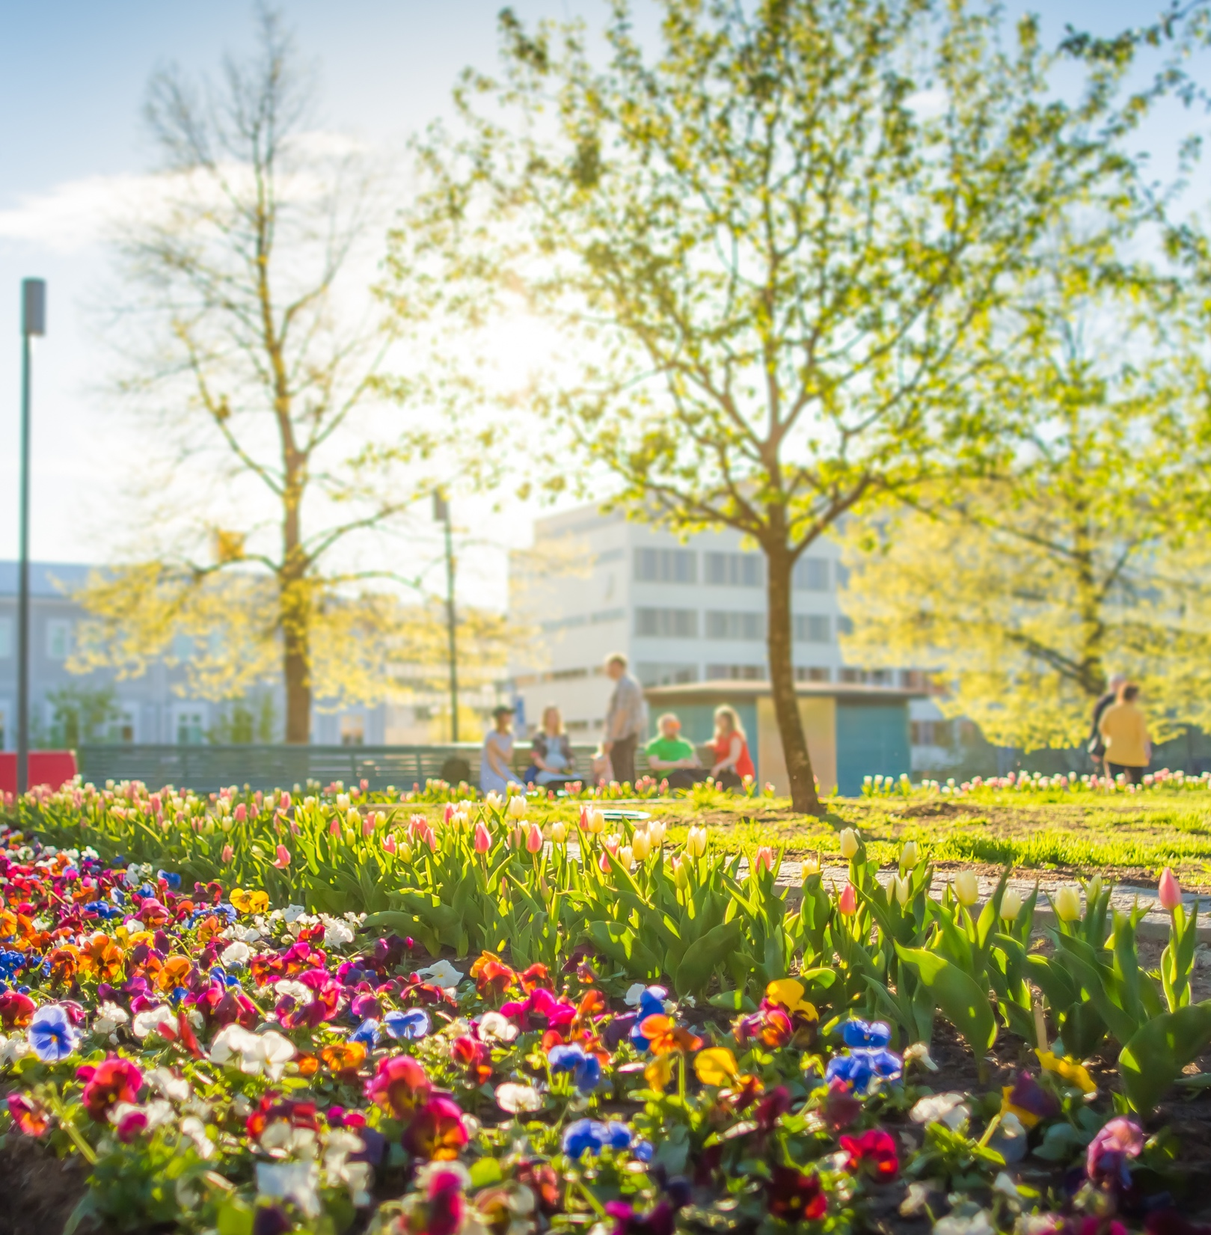
CARBON-NEUTRAL Sustainable Tampere 2030
Tampere will reduce its direct carbon emissions by 80 per cent compared to the 1990s levels
The remaining emissions will be compensated
Actions:
Biofuel boiler for the Naistenlahti power plant
Koukkujärvi biogas plant
Energy renovations of properties
Developing public transportation
Image: Visit Tampere / Laura Vanzo
Notes:
Sustainable Tampere 2030​
​
Target: carbon-neutral city by 2030​
The aim is to reduce direct carbon emissions by 80 per cent compared to 1990 levels and to compensate the remaining emissions.​
​
Most effective planned actions: ​
Replacing the second boiler in the Naistenlahti power plant with a biofuel boiler.​
Construction of the Koukkujärvi biogas plant​
Energy renovations of city properties​
Developing public transportation with the tramway​
​
Emissions in Tampere have already reduced: total emissions reduced 29% from the year 1990, and emissions per capita reduced 48% (confirmed data from 2017). ​

Slide 30
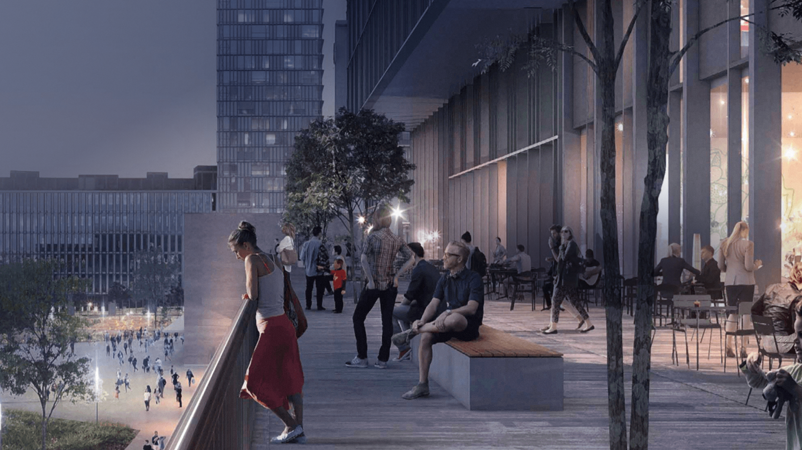
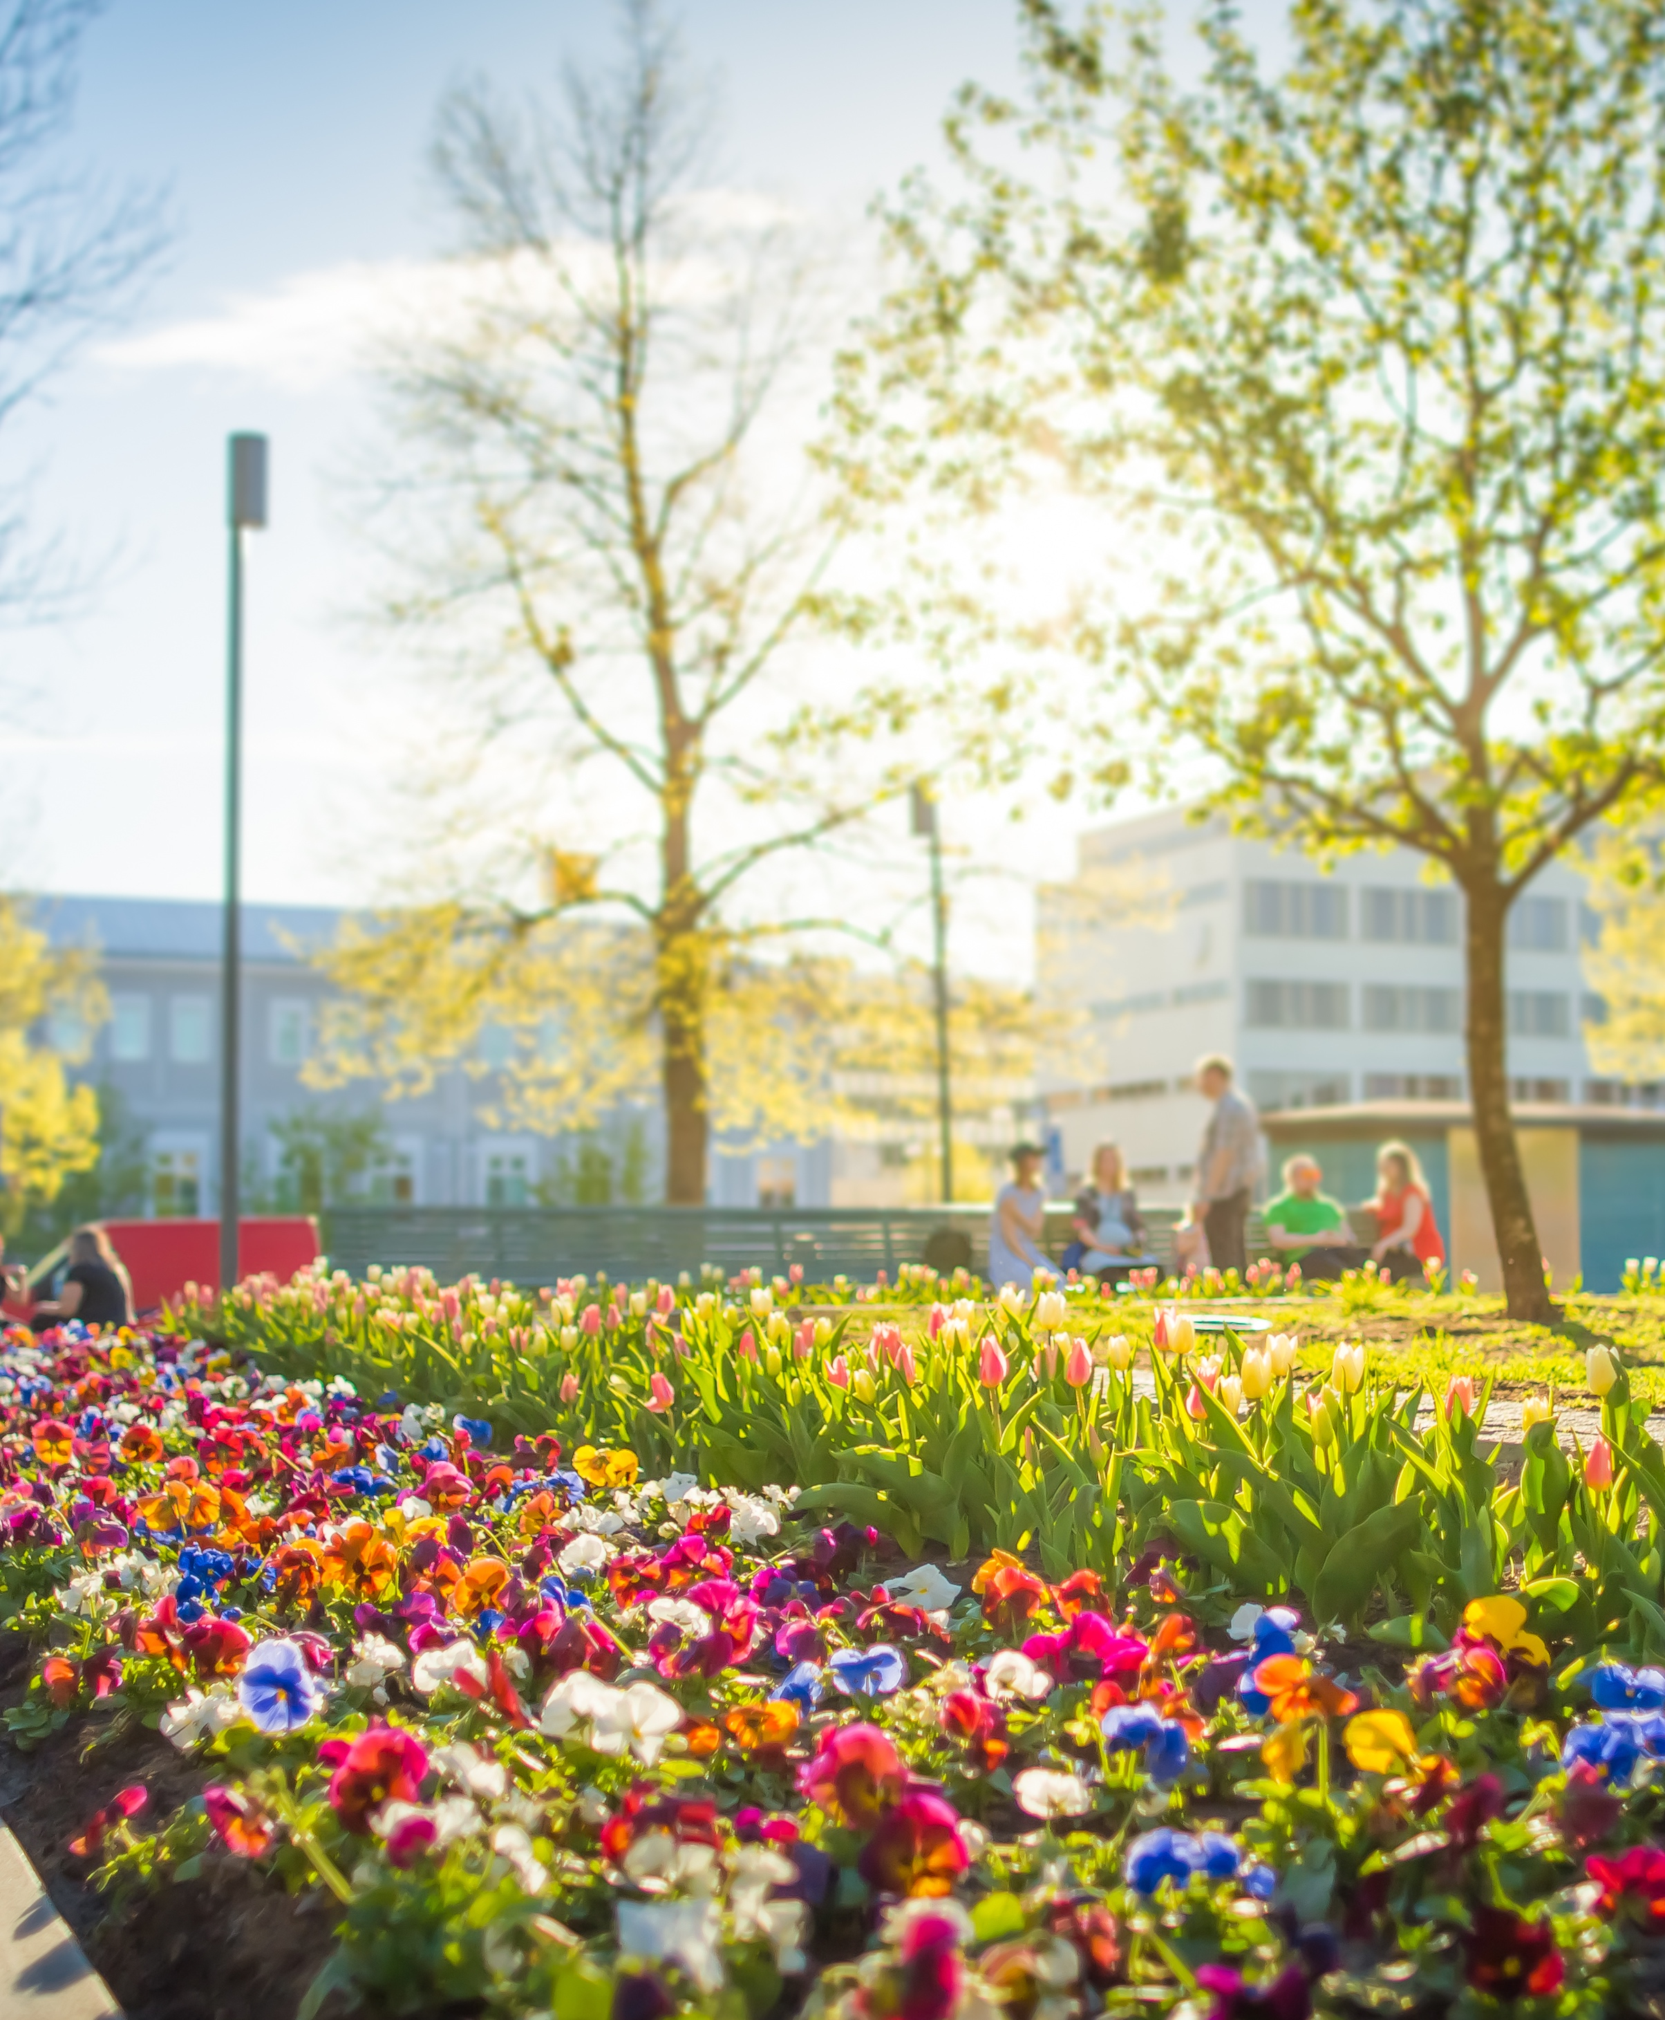
A five-star city centre
Renews the Tampere city center to serve even more residents and businesses.
Enables the development of new residential and recreational areas, business and retail premises and venues in the city center.
AIM: Tampere city center provides a pleasant experience and a place to have fun!
35-40 % more residents than in 2015
2030 welcoming and easily accessible city centre
Image: ©SRV/ Credit Tomorrow AB / Studio Libeskind
Notes:
Five-star City Centre is a development programme for 2011–2030 based on the city’s strategy. The programme is a comprehensive description of the targets set for the urban environment and operational environment of Tampere city centre and the practical measures to be taken to reach the targets in the coming decades.​
​
The city’s centre is being developed systematically in all respects, taking into account the urban structure, urban environment, urban transport, townscape and urban culture.​
​
By 2030, the city centre of Tampere will have 30% to 45% more residents than in 2015, and new important job centres, such as the Travel and Service Centre.​
​
The city centre has the capacity for building housing for around 15,000 residents. The programme holds potential for creating 15,000 new jobs. Accessing the city centre is easy and comfortable. Business is booming and services run smoothly. ​
​
An area in the city centre is built which is easy to come to or to have a presence or invest in. The structure of the city becomes coherent and denser. Modern architecture complements the older buildings, forming an interesting whole. Shores and the lakes become a part of the city centre. The streetscape is urban, interesting, lively and full of events and the spirit of Tampere. Lifestyle of residents is urban with a strong sense of community. People lead comfortable and healthy lives.​

Slide 31
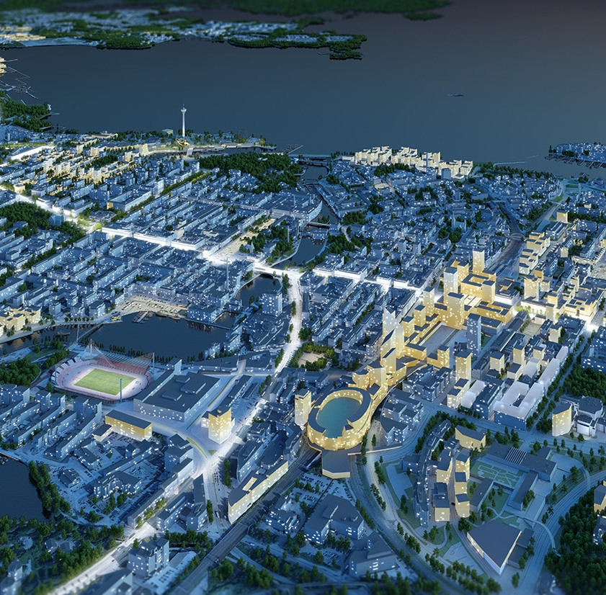
Innovative projects to create a bustling and attractive city centre:
Deck district: Travel and Service Centre and Nokia Arena
Ranta-Tampella district
Western city centre
Viinikanlahti district
Särkänniemi district
Tulli district
Tammerkoski rapids illuminated
Culture circle
Image: Tampereen kaupunki

Slide 32
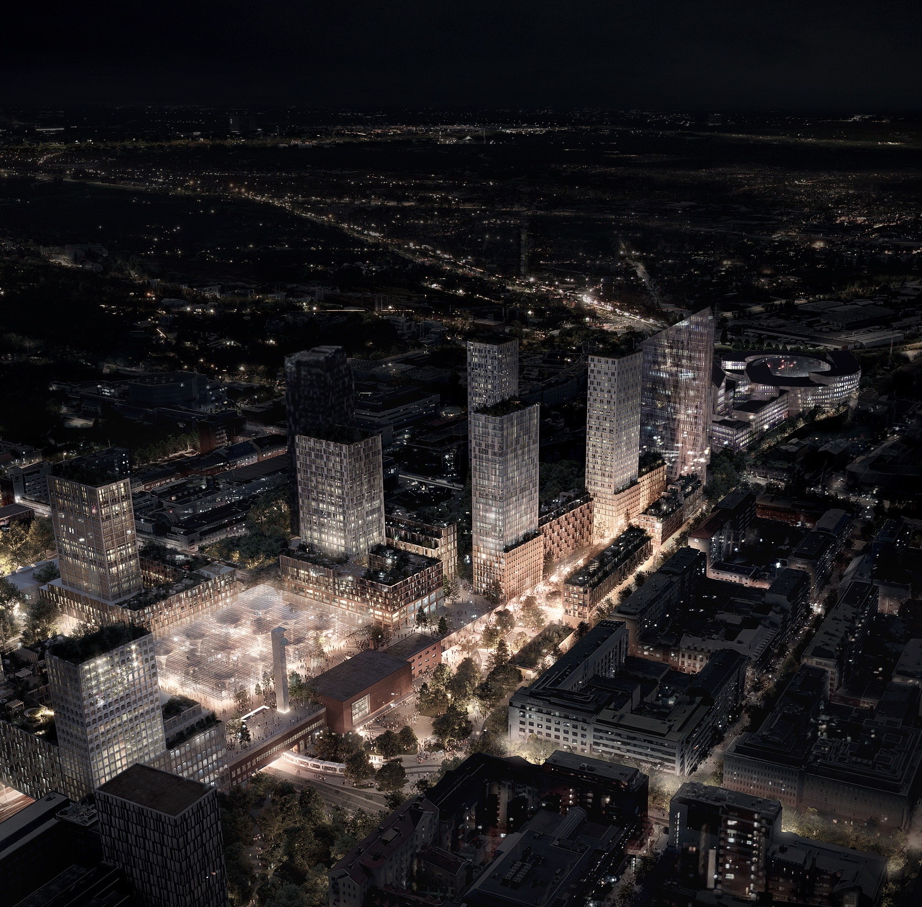
THE DECK – A new district for people and living in the city centre
The new and unique Deck district will be built by and above the railroad tracks. It is positioned in the new urban heart of Tampere, linking the east and the west sides of the centre.
The Deck combines different modes of mobility. It is an attractive hub for jobs, services and living. For companies the Deck district offers the best location in Finland’s most attractive growth centre.
The Deck district – full of life 24/7
Nokia Arena
Services
Homes
Park
Business premises
Tram stop and the Travel and Service Centre
20 million
potential visits annually
Image: ©SRV/ Credit Tomorrow AB / Studio Libeskind

Slide 33
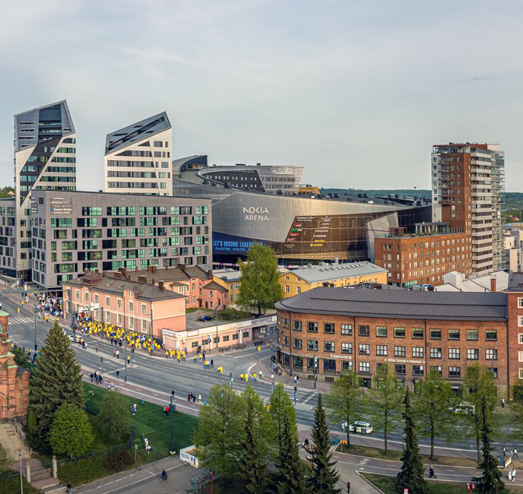
Nokia Arena
The first arena located in a city centre in Europe, Nokia Arena, serves as a venue for large entertainment and sports events. The arena provides exciting experiences, restaurants and a casino. Some hotel rooms offer a view of the events in the arena.
Nokia Arena:
Opened in 2021
The main venue for the ice hockey World Championship games in 2022
A million visitors and 120 events per year
15,000 seats
Arena is awake 24/7. Restaurants and other services are open for customers also when there are no events.
Image: Visit Tampere / Skyfox Marko Kallio
Notes:
The Arena on the Deck is a new generation multi-purpose arena: open 24/7 and located right next to a hotel, casino, restaurants as well as office premises and residential apartments. A competitive setting for mega productions required by international artists as well as large-scale sports and entertainment events. The arena, in the very heart of the city, will not house any parking spaces at all, given that it will be easy to reach on foot, by bicycle or by public transport.​
• Finland’s biggest multi-purpose arena​
• Sustainable development accounted for since the design phase​

Slide 34
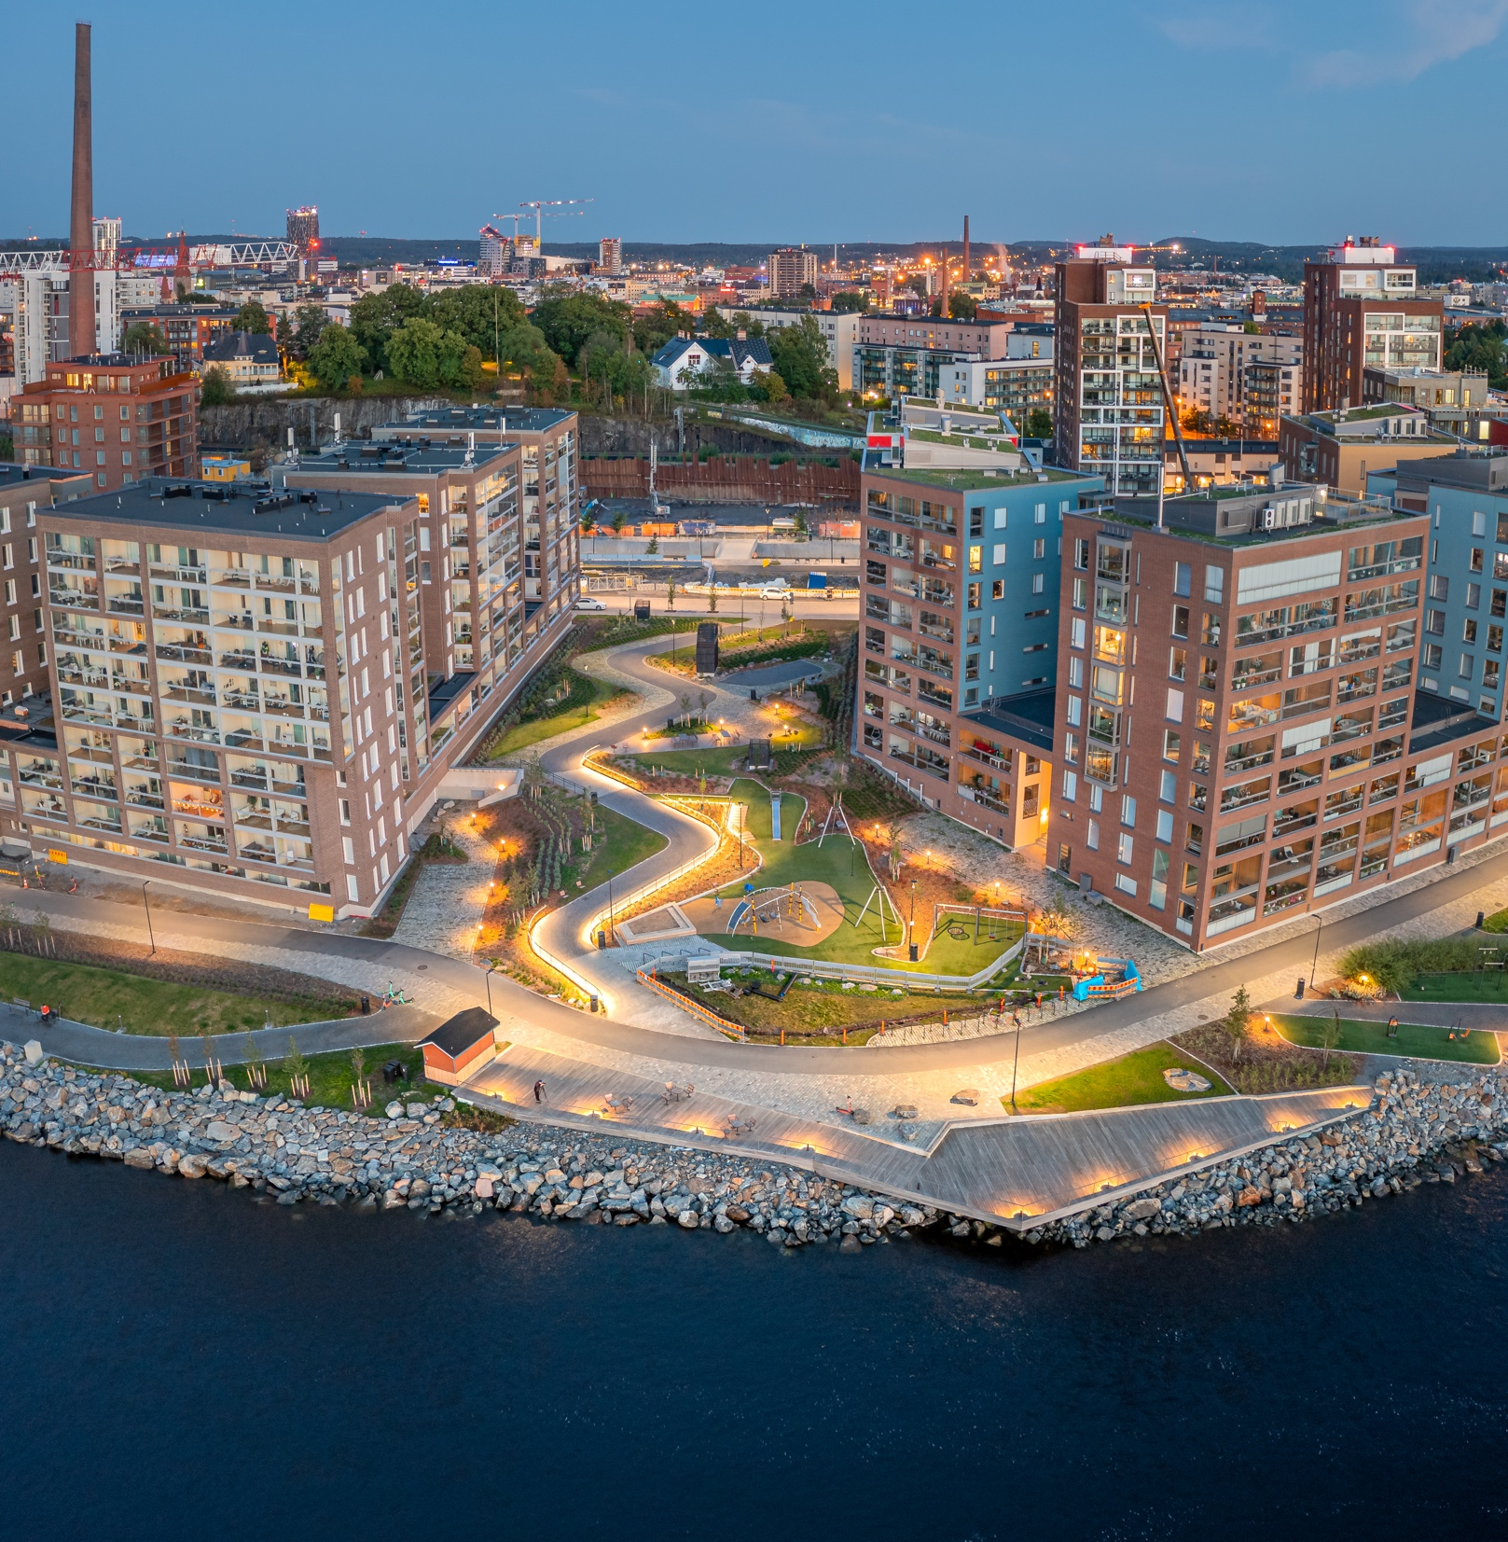
Ranta-Tampella – one step to reach the lake, two to the city centre
A new versatile residential area right next to the city centre and on the shore of lake Näsijärvi. Ranta-Tampella offers shore-side routes and versatile activities to all citizens.
Ranta-Tampella includes:
Leisure docks
Canals
Cycling and walking routes
Outdoor gyms
A climbing wall
3,500 homes for Tampere residents
Image: Tampereen kaupunki
Notes:
Ranta-Tampella is in a central location at the northern edge of Tampere’s city centre, on the shore of lake Näsijärvi and at the mouth of Tammerkoski. The area has a significant part in forming the cityscape of Tampere as seen from the Näsijärvi-direction, and it connects the city’s shore routes and different areas, thus creating new cycling and walking opportunities for residents. ​
​
The area is the last large completely new construction project near Tammerkoski and it includes a versatile selection of homes, both for renting and to be purchased. The shore streets and the channel with bridges that will be built at the centre of the area create a unique and distinctive urban atmosphere. The construction of streets, public areas and the systems for utilities come under the responsibility of the Five-star City Centre programme. Ranta-Tampella also has plenty to offer for those who do not live in the area, such as leisure docks, outdoor gyms and a climbing wall.​
​

Slide 35
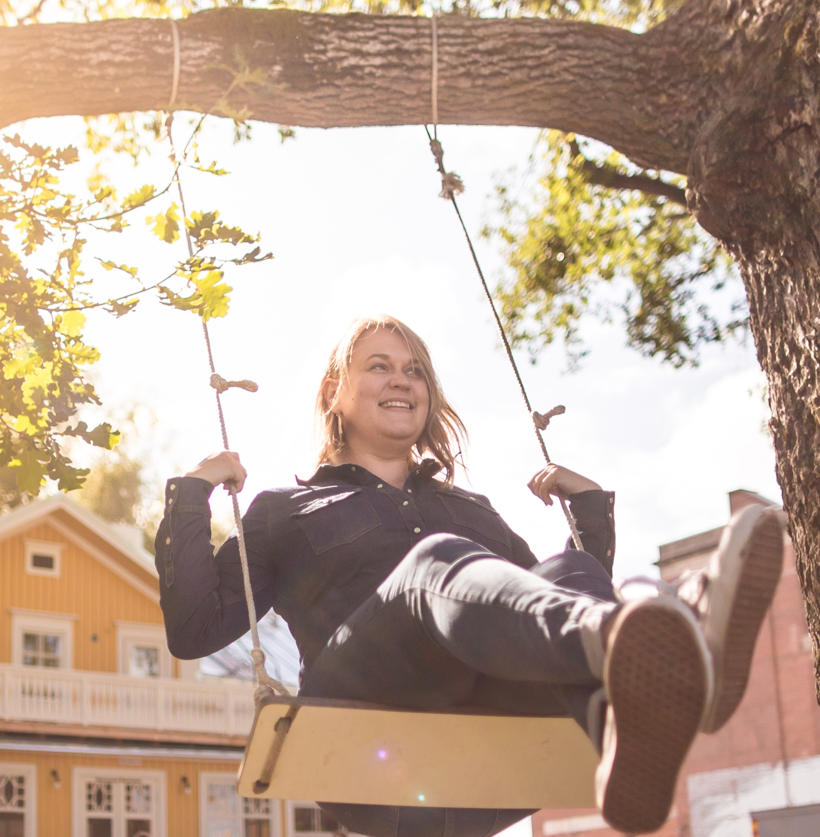
Hiedanranta a future city district on the shore of lake Näsijärvi
Hiedanranta in the future
25 000 residents
10 000 jobs
12-minute tram ride from the city centre (2024)
Hiedanranta now:
Test platform for smart and sustainable solutions in Tampere
Events and cultural activities
Construction begins 2023
Hiedanrannan Kehitys Oy owns the land and buildings and develops them.
hiedanranta.fi/en tampere.fi/hiedanranta @hiedanranta
Image: Visit Tampere / Laura Vanzo
Notes:
Hiedanranta is a future city district on the shore of lake Näsijärvi that is being developed in a new innovative way in cooperation with residents, companies, research institutions and communities.​
​
Hiedanranta enables ideas, experiments and urban culture to thrive. Hiedanranta has its own Kehitys Oy, which facilitates the inclusion of businesses and partners in the construction of a new city district.​
Hiedanranta is planned to include homes for 25,000 residents and jobs for 10,000 people. In 2024, the area can be accessed with the Tampere Tramway. The area is around four kilometres away from the city centre.​
​
Today, Hiedanranta is a test platform for new technologies and methods. The Hiedanranta development programme works with businesses that highlight digitalisation, sustainability, circular economy, energy and food production in their operations.​
​
The temporary Hiedanranta: The city enables operations in the area by renting facilities for temporary use and by supporting event organisation, for example. ​
During the first two years, the events organised in Hiedanranta had 20,000 visitors.​

Slide 36
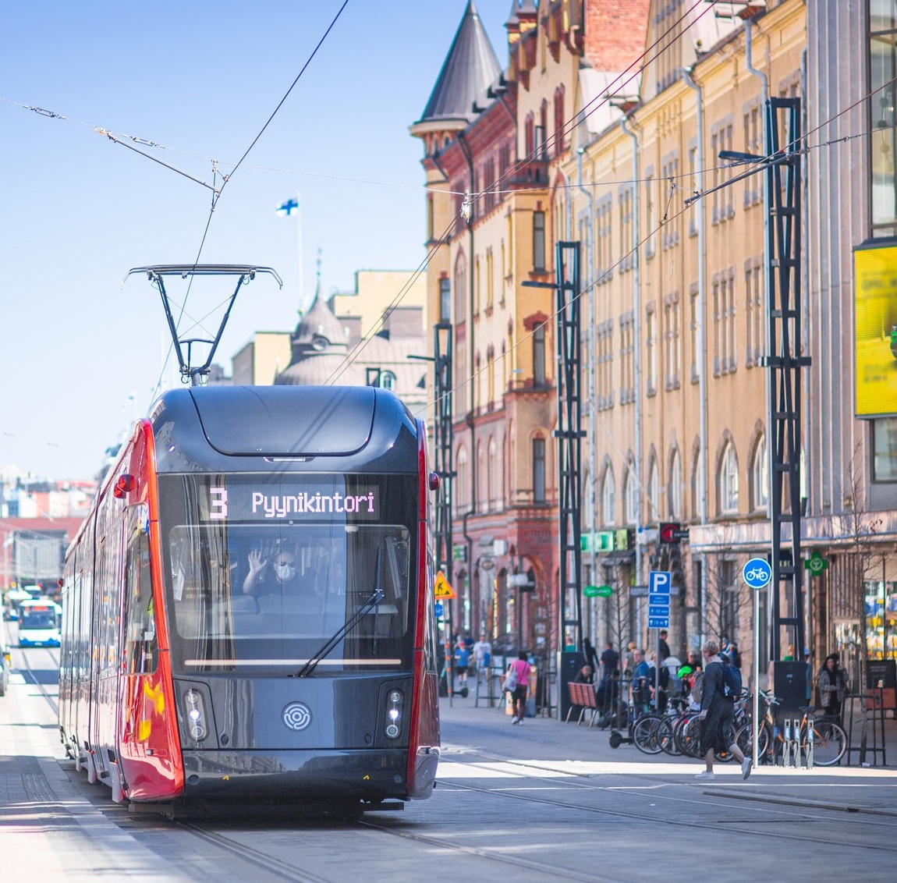
The tramway era of Tampere
9.8. 2021
Transport started on two routes:
Pyynikintori - Hervanta
Tampere University Hospital (Tays) - Sorin aukio
The second stage of construction:
Hiedanranta
Lentävänniemi
Regional tramway:
Linnainmaa – Pirkkala 2025-2028
Lielahti - Ylöjärvi 2029 –2032
Linnainmaa –Kangasala 2033-2036
2021 –
2024
Image: Visit Tampere / Laura Vanzo
Notes:
In 2017–2021, Tampere constructed a double-branched tramway that runs from Pyynikintori to Hervanta and from Sorinaukio (close to the new Arena) to Tampere University Hospital. The tramway is planned to be extended west from Pyynikintori to run through the new Hiedanranta district and to Lentävänniemi in 2021–2024. The second stage is under construction.​
​
The City Council of Tampere decided on the construction of the first stage on 7 November 2016. In addition to the tramway itself, the first stage included the construction of a depot in Hervanta.​
​
Tampere is already testing robot buses and autonomic vehicles that could transport people from more remote parking spaces to tram stops. ​

Slide 37
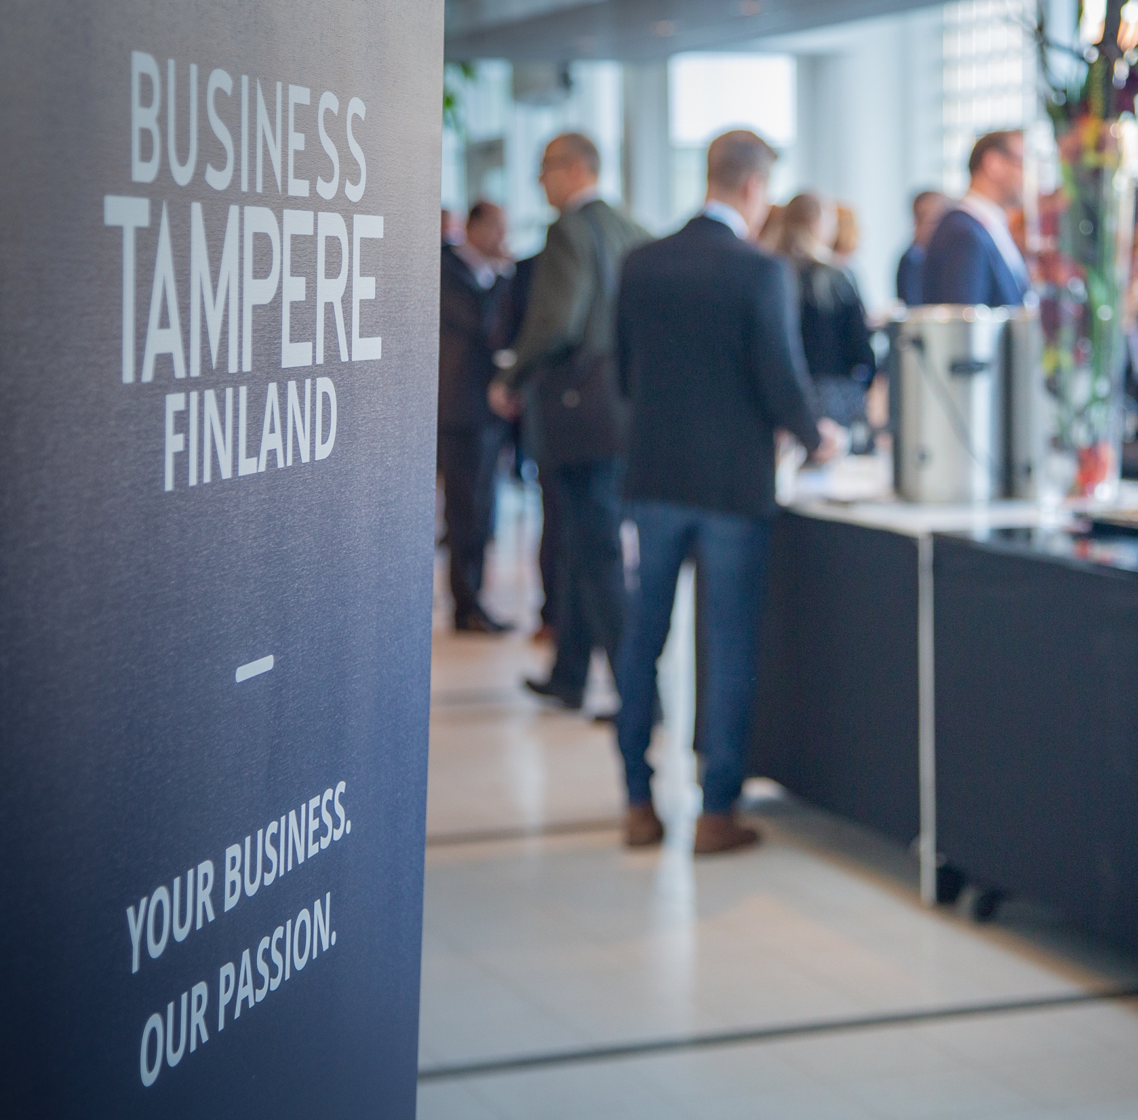
A great city to operate and invest in
The main reasons businesses choose the most attractive city in Finland:
Great availability of skilled workforce
Central location
Close connections to institutes of higher education
+7–15 %
return on invested capital
Image: Visit Tampere / Mirella Mellonmaa
Notes:
Tampere is a great city to operate and invest in. The main reasons for companies to operate in Finland’s most appealing city are good availability of workforce, central location and close connections to institutes of higher education. ​
​
The region of Tampere is Finland’s second biggest urban centre, right after the metropolitan area. Around two-thirds of Finland’s economic activity is located within a two-hour drive of Tampere. ​
​
Construction in Tampere yields a better return than construction in the other big cities of the Nordic countries.

Slide 38
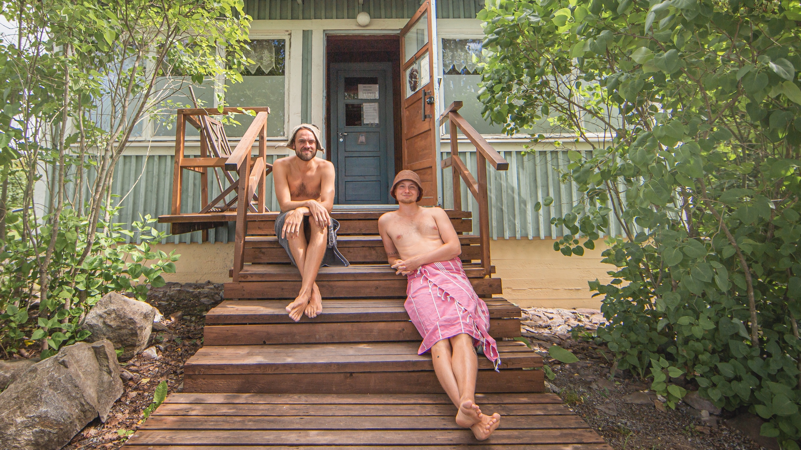
EXPERIENCE
With thousands of events, concerts and adventures, there’s always something to experience in Tampere. A quick dip in the lake or a morning coffee at the market are among the experiences offered by the city.
Image: Visit Tampere / Laura Vanzo

Slide 39
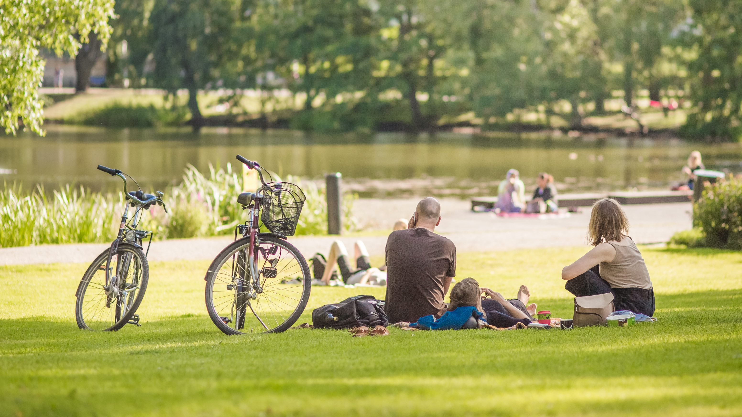
Nature in everyday life
2,751 lakes or ponds sized over one hectare
200 lakes or ponds in the City of Tampere area
3,800 hectares of forest in Tampere area
20 % of Tampere is greenspace
Image: Visit Tampere / Laura Vanzo
Notes:
In Pirkanmaa there area over 2 571 lakes or ponds sized over hectare. The lakes in the county are deep, on average 11 meters. Source: Pirkanmaan Kalatalouskeskus: https://www.kuhamaa.fi/jarvet/​
​
The City of Tampere owns approx. 7500 hectares of forests. Approx. 3800 hectares of forests are located in Tampere area. Source: https://www.tampere.fi/asuminen-ja-ymparisto/ymparisto-ja-luonto/metsat.html ​
There are 219 playgrounds. In addition there is a children's traffic park in Kaleva district. Source: https://www.tampere.fi/asuminen-ja-ymparisto/ymparisto-ja-luonto/puistot-ja-viheralueet/leikkipaikat.html​
One fifth of Tampere´s area is greenspace (including parks, forests and fields): https://www.tampere.fi/asuminen-ja-ymparisto/ymparisto-ja-luonto/puistot-ja-viheralueet.html​
Tampere city area has over 200 lakes or ponds.​
Water covers approx. 24% of Tampere area. Source: https://www.tampere.fi/liitteet/5o2F1q9zz/jarvivesiraportti07.pdf​
Biggest lakes are Näsijärvi and Pyhäjärvi. Näsijärvi is the 16th biggest lake in Finland​
​
Pyynikinharju is the highest esker in the world, reaching a height of 80 metres from the surface level of lake Pyhäjärvi.​
​
The Tammerkoski rapids dividing the city have a drop of 18 metres in elevation.​

Slide 40
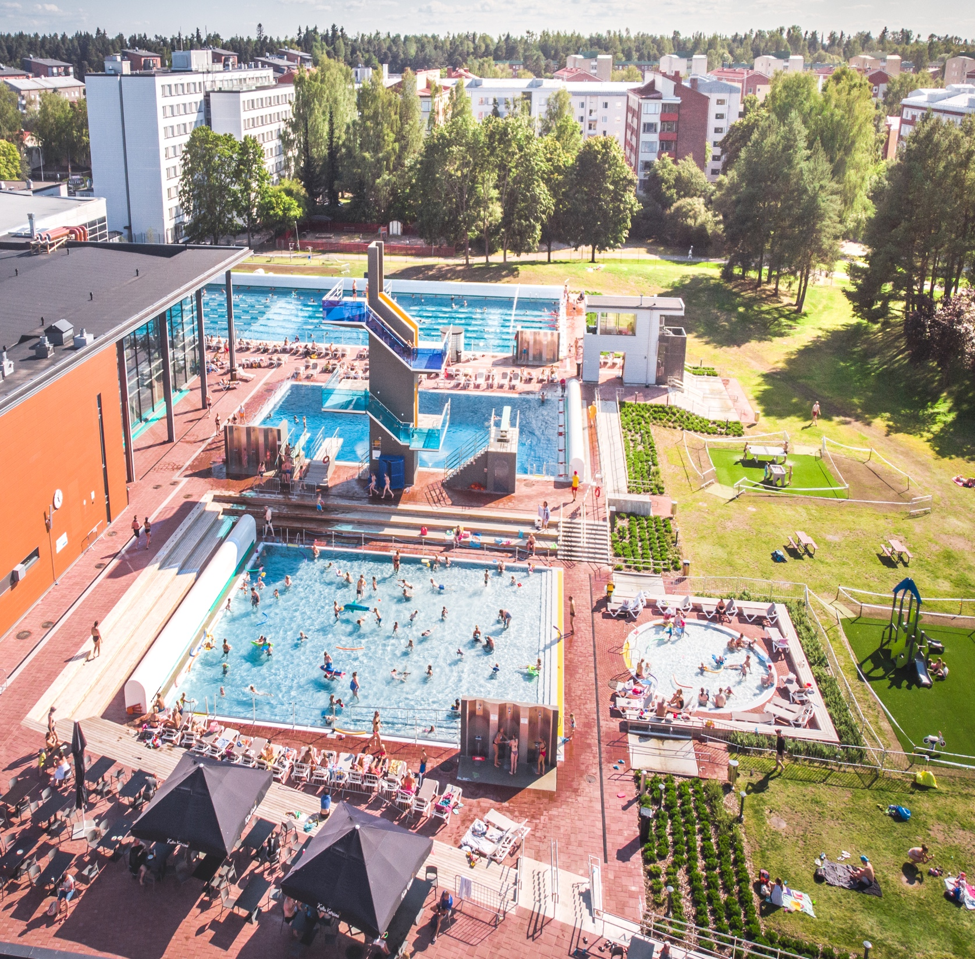
Joy of movement
27 outdoor gyms
85 km of leisure routes with lighting
648 km of cycling lanes
180 km of cross-country ski tracks
150 ice rinks
4 indoor ice rinks
31 beaches
9 winter swimming spots
4 swimming centres
1 outdoor swimming pool
Image: Visit Tampere / Laura Vanzo
Notes:
Tampere receives around 140,000 applications for reservations to exercise facilities every year. Tampere has 83 sports buildings and around 500 sport facilities.​
27 outdoor gyms (in public spaces and sports parks)​
85 km of leisure routes with lighting, around 120–130 km of ski tracks for cross-country skiing (if weather permits), however, not all tracks have lighting.​
4 indoor ice rinks (Tampere Ice Stadium (Hakametsä), training ice rink (Haka 3), Tesoma and Hervanta ice rinks) and the Sentteri Tampere Oy ice Rink (in Kaukajärvi) for which the City of Tampere takes care of the ice management and monitoring.​
31 beaches​
4 swimming centres (Tesoma, Pyynikki and Hervanta swimming pools and the Tampere swimming centre)​
1 outside pool in Kaleva (at the Tampere swimming centre)​
The Iso-Vilunen skate pool, BBMX track and trials track for bicycles, Mustavuori Ski Resort​

Slide 41
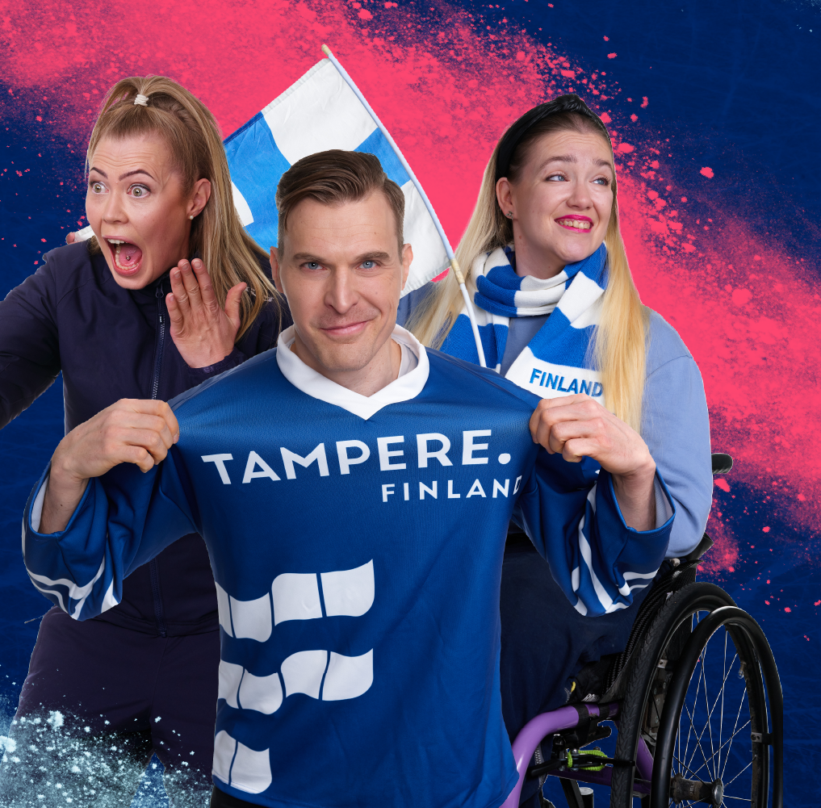
City of sports enthusiasts
635,000 people see SM-Liiga ice hockey games at Nokia Arena
26,000 people see Veikkausliiga football home games
21,000 people see women’s and men's teams floorball home games
10,000 people see Korisliiga basketball home games
35,000 see the Superpesis and Ykköspesisfinnish baseball home games
(Statistics from 2022-2023)
Image: Tampereen kaupunki
Notes:
Tampere has a broad selection of sports and culture events. The event selection is diverse and high in quality. ​
​​
More interesting data on Tampere’s events:​ https://public.tableau.com/profile/tampereen.kaupunki#!/vizhome/Tapahtumienvaikuttavuusarviointi2018/Etusivu ​
​

Slide 42
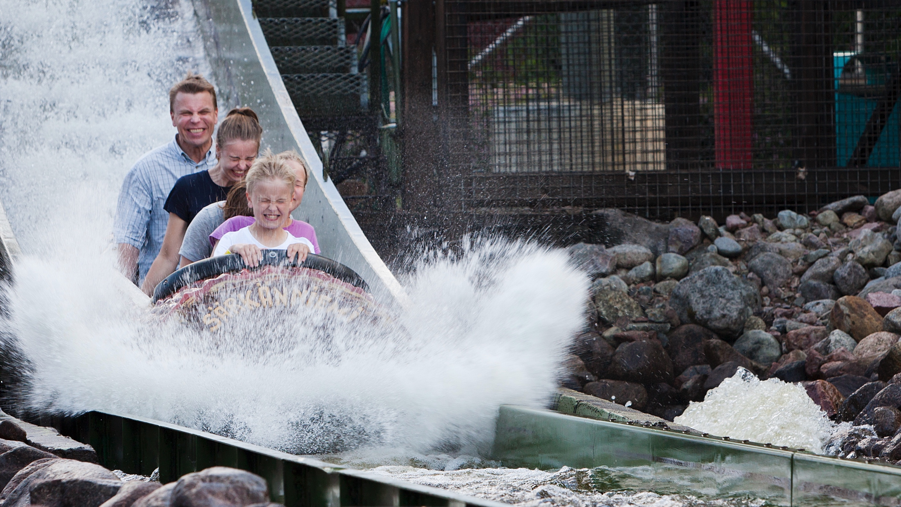
Tampere for families
30 rides in Särkänniemi
Summer oasis Viikinsaari
18 museums
13 parks
219 playgrounds
Image: Visit Tampere / Opa Latvala
Notes:
Tampere has plenty to offer for the whole family (Stable Yards, Tampere Market Hall, Pyynikki Observation Tower)​
​
Viikinsaari: The island includes the Lemmenpolku nature trail, a kiosk, a restaurant, swimming spots, a dance floor and even a chapel and a summer theatre. Boats leave for the island from Laukontori every hour on the dot, and from the island to Laukontori at half past.​
​
Särkänniemi: over 30 rides, aquarium, planetarium, Mauri Kunnas’s Doghill Fairytale Farm​
The Särkänniemi Theme Park has over 30 amusement rides. Satisfy your need for speed by riding the rollercoasters, take a swing in a carousel and travel around the galaxy in an armchair. Reach for the sky at Näsinneula observation tower and enjoy a fancy dinner there, observe underwater life in the aquarium or become part of the story at Doghill Fairytale Farm. Särkänniemi is more than just a theme park! Särkänniemi Theme Park is one of the most popular family destinations in the whole country.​
Doghill Fairytale Farm is a theme park centred around author Mauri Kunnas’s beloved dog stories. In the park, stories meet reality and form the most adorable whole. At Doghill, visitors become a part of a story happening in the 19th century, but with some modern twists. Doghill is all about action and fun, playing and experiencing. Visitors will meet the residents of Doghill, both human and canine, and the fairytale farm is home to many real-life animals as well.​
​
Parks: Sorsapuisto​
​
Näsinpuisto park and playground, combining art and functionality, is a themed playground based on poems by Kirsi Kunnas.​
The Pikku Kakkonen playground in Koskipuisto is suitable for older children as well: the renewed playground is an adventure course with climbing frames and themed play areas.​
The Eemil Aaltonen playground, a short walk from the city centre on the side of the Tammelantori marketplace, is right next to a large park area and a great place to spend time as a family.​
​
Museums (Museum Centre Vapriikki including several museums and exhibitions, Moomin museum, Spy Museum, Natural History Museum and Police museum)​
​
219 play areas in parks in addition to the playgrounds of schools and day-cares.​
​

Slide 43
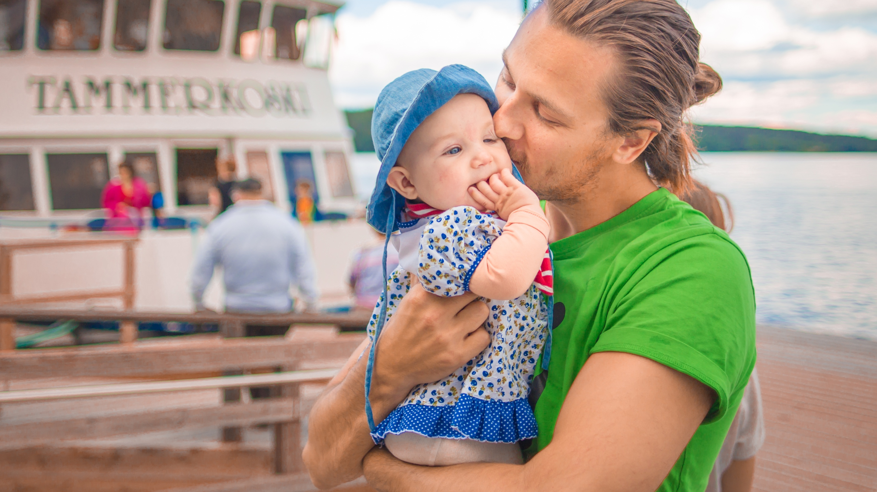
HOME
Home is always close to one’s heart but different for each of us. Tampere is a home that offers a good place to live, study, work and run a business in, or just to visit.
Image: Visit Tampere / Laura Vanzo

Slide 44
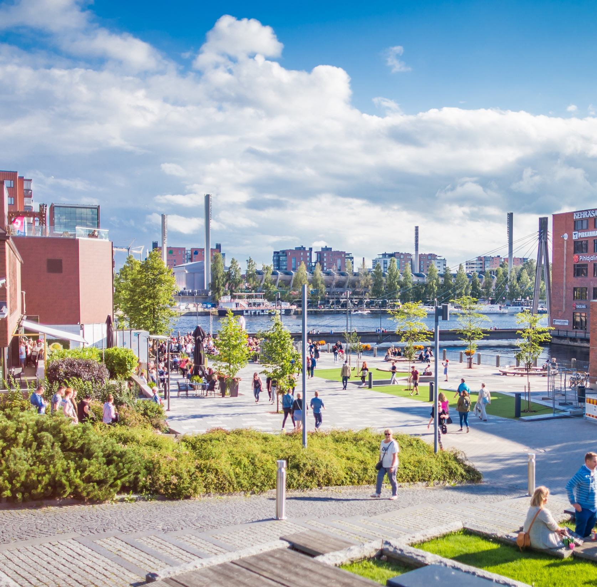
The most appealing city to settle in
5,000
new residents each year
Why Tampere?
A relaxed and easy-going atmosphere
Cost-effective housing opportunities
Ongoing development and renewal of residential areas
Easy to move from place to place on foot, by bike or public transport
A lot of activities and events to participate
A beach always just a bike ride away
15–20 %
of newcomers stay in Tampere at least 10 years
Image: Visit Tampere / Laura Vanzo
Notes:
Living in Tampere adds quality to life​
​
Housing costs are lower than in the capital region. Cost-efficient living expenses, congestion-free traffic and​ a broad range of opportunities for different experiences make everyday life easy.​
​
New, versatile residential areas are being constructed. Most of them are located next to the tramway. At Tampere, the beach is always just a bike ride away, no matter which district you are in.​
​
Tampere grows with around 3,000 residents each year and in 10 years, 15–20% of residents are newcomers. Tampere has been ranked the most attractive city in Finland in several studies.​

Slide 45
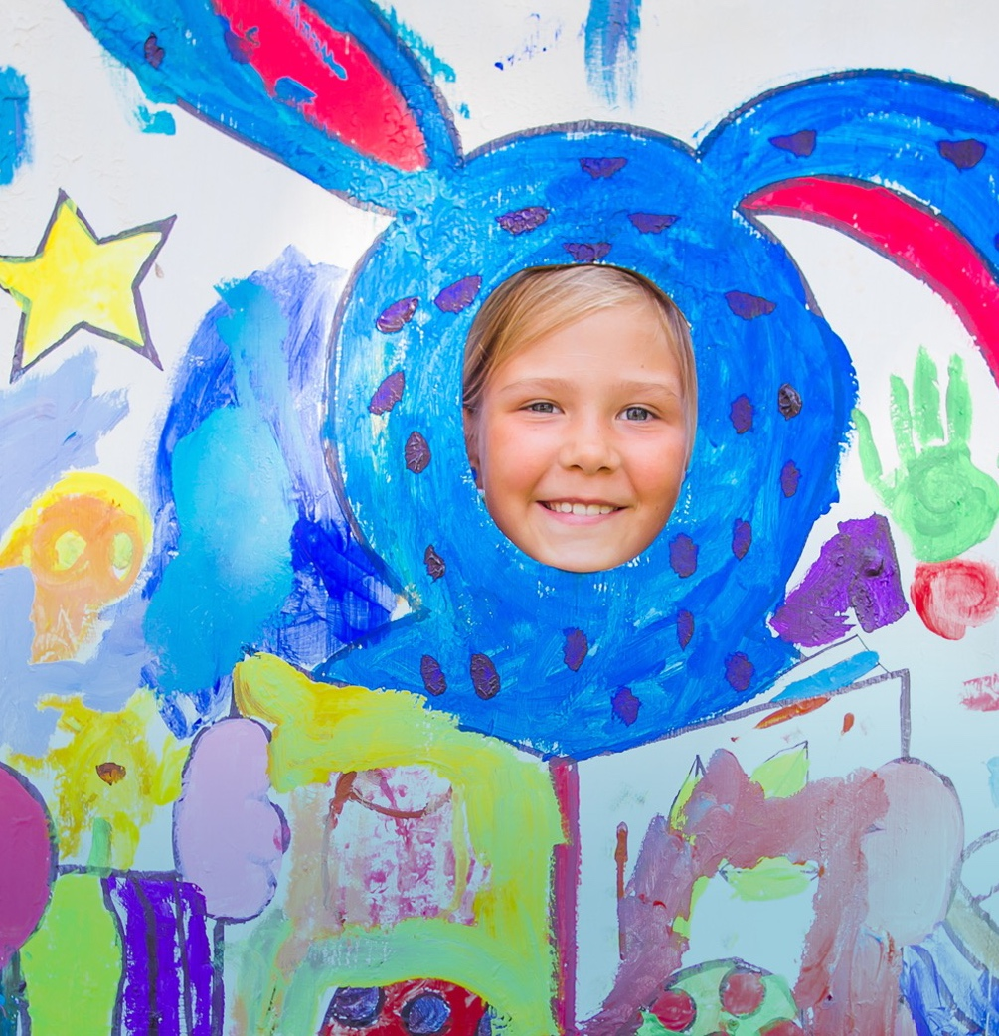
On the path of learning – EARLY CHILDHOOD EDUCATION AND BASIC EDUCATION IN TAMPERE
6,900 children in early childhood education provided by the municipality
2,190 children in private early childhood education institutions
140 children in open early childhood education
20,439 children in preschool education and basic education
30 comprehensive schools
16.6 pupils: average class size for years 1–6
17.2 students: average class size for years 7–9
109 children in preparatory education for immigrants
Image: Visit Tampere / Laura Vanzo
Notes:
109 children aged 7-16 in preparatory education for immigrants​
​

Slide 46
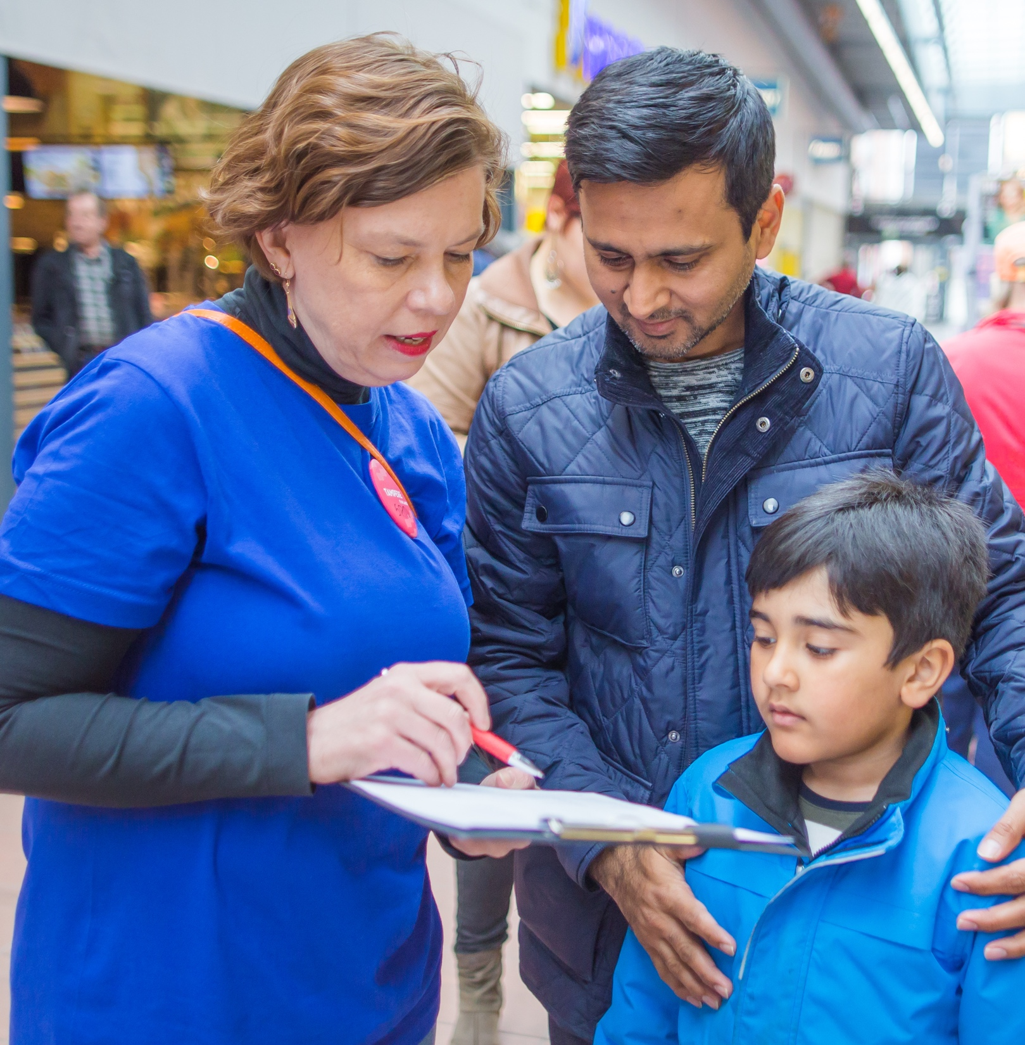
We participate and make a difference!
The residents in Tampere have numerous ways to participate in and influence the actions of their city:
Influencing bodies: Tampere Children’s Parliament, Tampere Youth Council, Tampere Immigrant Council, Tampere Disability Council, Tampere Older People's Council, Council of representatives for associations
Direct ways of influencing: survey, feedback, co-developing, public discussion
Volunteering and companion operations, city-supported crowdfunding projects
“Mun Tampere” participatory budgeting
Testing digital citizens' panel in the Tampere Region
Image: Visit Tampere / Laura Vanzo
Notes:
In Tampere, you too can participate and make a difference​
​
Tampere is a city for active people, who are provided numerous ways to participate and influence the city and its services.​
Representative influencing bodies include the Tampere Children’s Parliament, Youth Council, Tampere Immigrant Council, the Older People’s Council, Council of representatives for associations and the parliament for clubs.​
Direct ways to influence are provided with different public events and meetings of regional networks and the many methods of co-development (surveys, pilot projects and participation in them, participatory planning).​
Different city-supported forms of civil activism include volunteer- and companion-based activities, associations and neighbourhood activities. ​
​
Tampere is testing and developing new methods for participation and influencing, such and the mayor’s crowdfunding pilot and the “Mun Tampere” participatory budgeting.​
​

Slide 47
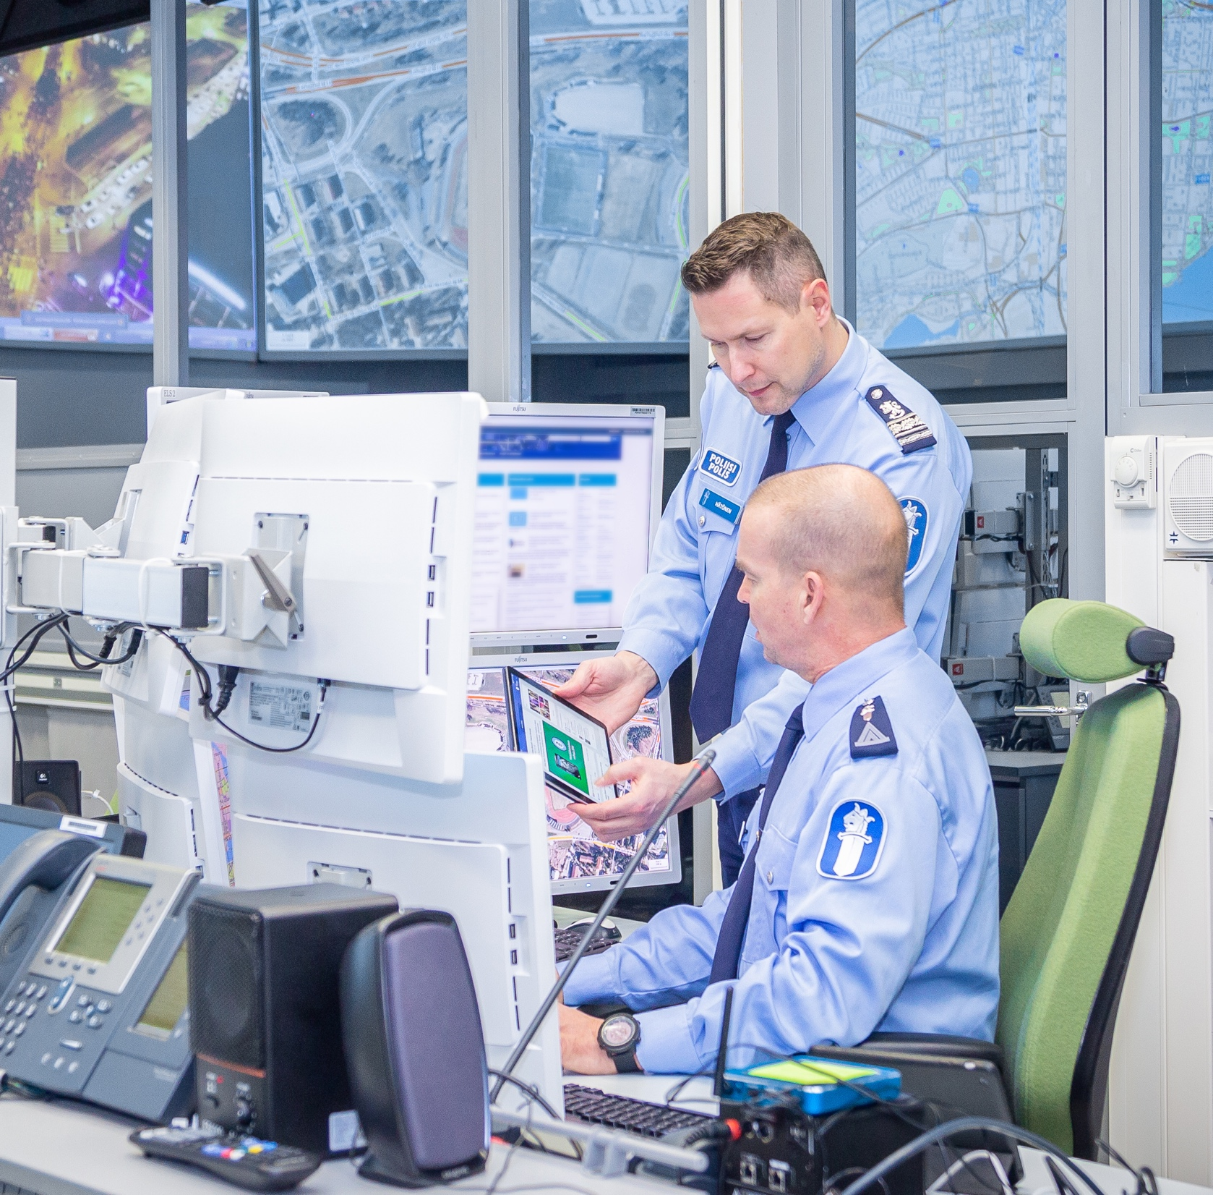
Building the future together
Safety and security are essential parts of building a smart city that takes full use of modern technology and its solutions.
Tampere Region Safety and Security Cluster since 2011
Improving safety and security in cooperation with the largest players in the industry
Tampere region safety and security ecosystem
Brings together safety and security businesses operating in the region
Helps developing new opportunities for business
Increases awareness of safety and security competence in the region
The SURE – Smart Urban Security and Event Resilience Project
Tampere gets over MEUR 3 of EU funding for improving urban and event security
Image: Visit Tampere / Mirella Mellonmaa
Notes:
Safety and security​
The City of Tampere is developing urban safety and security in cooperation with the related operators in the region (from authorities to third-sector operators).​
​
The Tampere Region Safety and Security Cluster that began its operations in 2011 has created excellent conditions for cooperation and competence development in the safety and security industry in the region. The operating environment is optimal, since the operators want to cooperate closely and at the same time feel that their expertise is already competitive at an international level. This creates an excellent environment for the development of new innovative solutions and for marketing of the region’s high-class expertise.​
​
Planned and coordinated cooperation. The city coordinates multiple security and safety operator networks.​

Slide 48

Research in health sciences and quality care
In addition to Tampere University Hospital, the following care for our health:
The Coxa hospital for joint replacement
Tays Heart Hospital
Fimlab Laboratories
Imaging Centre and Pharmacy
Vascular Surgery and Procedural Radiology Unit
Image: Visit Tampere / Opa Latvala
Notes:
Tampere is home to high-quality health care and top-class research in health sciences. In the Pirkanmaa Hospital District, health care is provided by the Tampere University Hospital, i.e. Tays. ​
​
Some services are provided by corporations owned by the hospital district: the Coxa hospital for joint replacement, Tays Heart Hospital and Fimlab Laboratories. Imaging and pharmaceutical services are provided by the Imaging Centre and Pharmacy, which also includes the globally unique Tays Vascular Surgery and Procedural Radiology Unit. ​
​
The Coxa hospital for joint replacement is the only one of its kind in Finland, and one of Europe’s leading hospitals specialising in joint replacement. Its reputation as a centre of excellence has also brought with it more responsibility, since Coxa now handles all the most challenging joint replacement surgical procedures in Finland. In addition to the joint replacement hospital in Tampere, Coxa also has clinics in Helsinki, Lahti, Pori and Turku.​

Slide 49

THANK YOU
Firstname Surname, title, date
Image: Visit Tampere / Laura Vanzo

